Slide 1
The Texas Instream Flow Program: Developing Instream Flow Recommendations with Consideration for Mussels
Clinton Robertson
River Studies Program - TPWD

Slide 2
Senate Bill 2
In 2001, the Texas Legislature directed TCEQ, TPWD & TWDB to:
Establish data collection and evaluation program
Determine flow conditions necessary to support a sound ecological environment in Texas rivers and streams

Slide 5
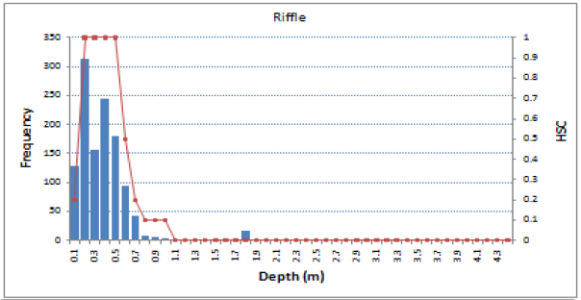
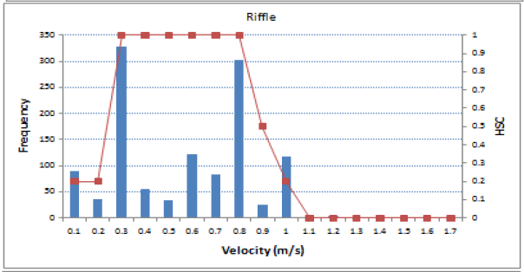
Fish Habitat Suitability Criteria

Slide 6
Calaveras – Riffle Habitat Guild
2D Hydraulic Models
66 cfs
263 cfs
458 cfs

Slide 7
Weighted Usable Area

Slide 8
Indicator Species Identified Through the TIFP Study Design Process
Lower San Antonio River
mussels
golden orb (Quadrula aurea)
Middle/Lower Brazos River
mussels
Lower Sabine River
mussels
mussel species of concern
Middle Trinity River
mussel species of concern
mussels
Lower Guadalupe River
mussel species of concern
mussels

Slide 9
TIFP Mussel Studies
Habitat Requirements of the Golden Orb
Lower San Antonio and Guadalupe Rivers (Hammontree et al. 2012, UNT)
Persistent Mussel Habitat
Lower San Antonio River (TIFP - Ongoing)
Habitat Requirements of Mussels in the Lower Brazos River (TAMU IRNR - Ongoing)

Slide 10
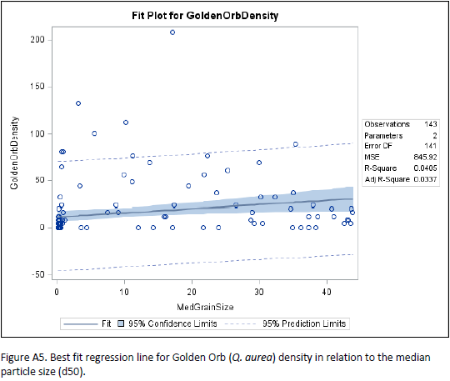
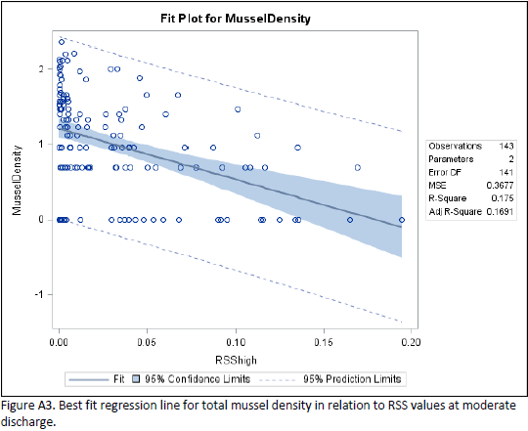
Golden Orb Habitat
S.E. Hammontree et al. 2012. Habitat Requirements of the Golden Orb (Quadrula aurea). Texas Water Development Board Contract No. 0904830970

Slide 11
Persistent Mussel Habitat
Calibrated 2D model for TIFP study sites on the Lower San Antonio River and Lower Cibolo Creek
Designate “persistent” mussel habitat on maps using habitat criteria developed from Golden Orb study (RSS)
Sample three TIFP study sites: 100 quadrats per site in “persistent” habitat and 100 quadrats not “persistent” habitat

Slide 12
Persistent Mussel Habitat
San Antonio River – Calaveras Site
Low Flow

Slide 13
Persistent Mussel Habitat
San Antonio River – Calaveras Site
High Flow

Slide 14
Persistent Mussel Habitat
San Antonio River – Calaveras Site
Across All Flows

Slide 15
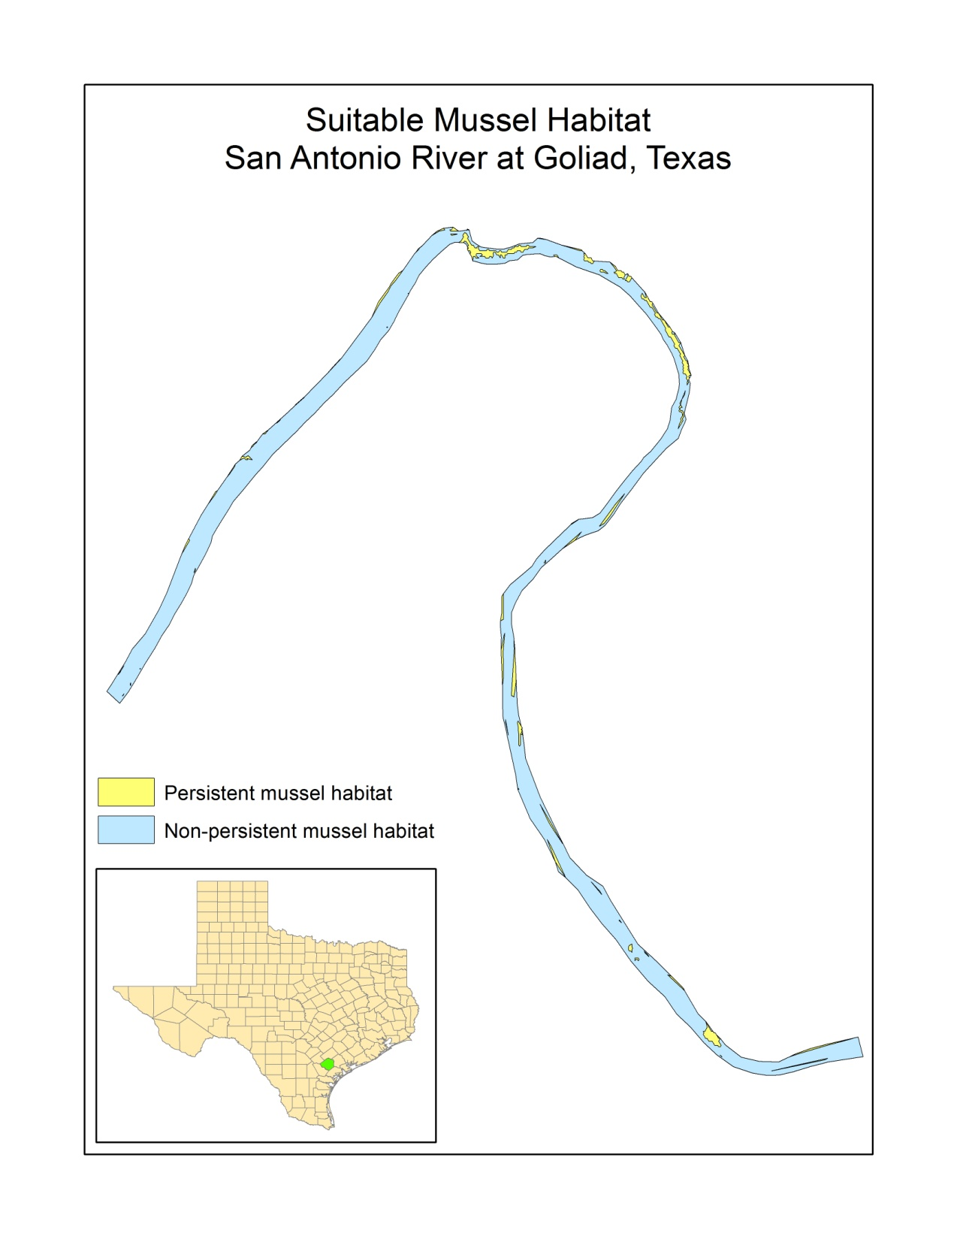

Slide 16
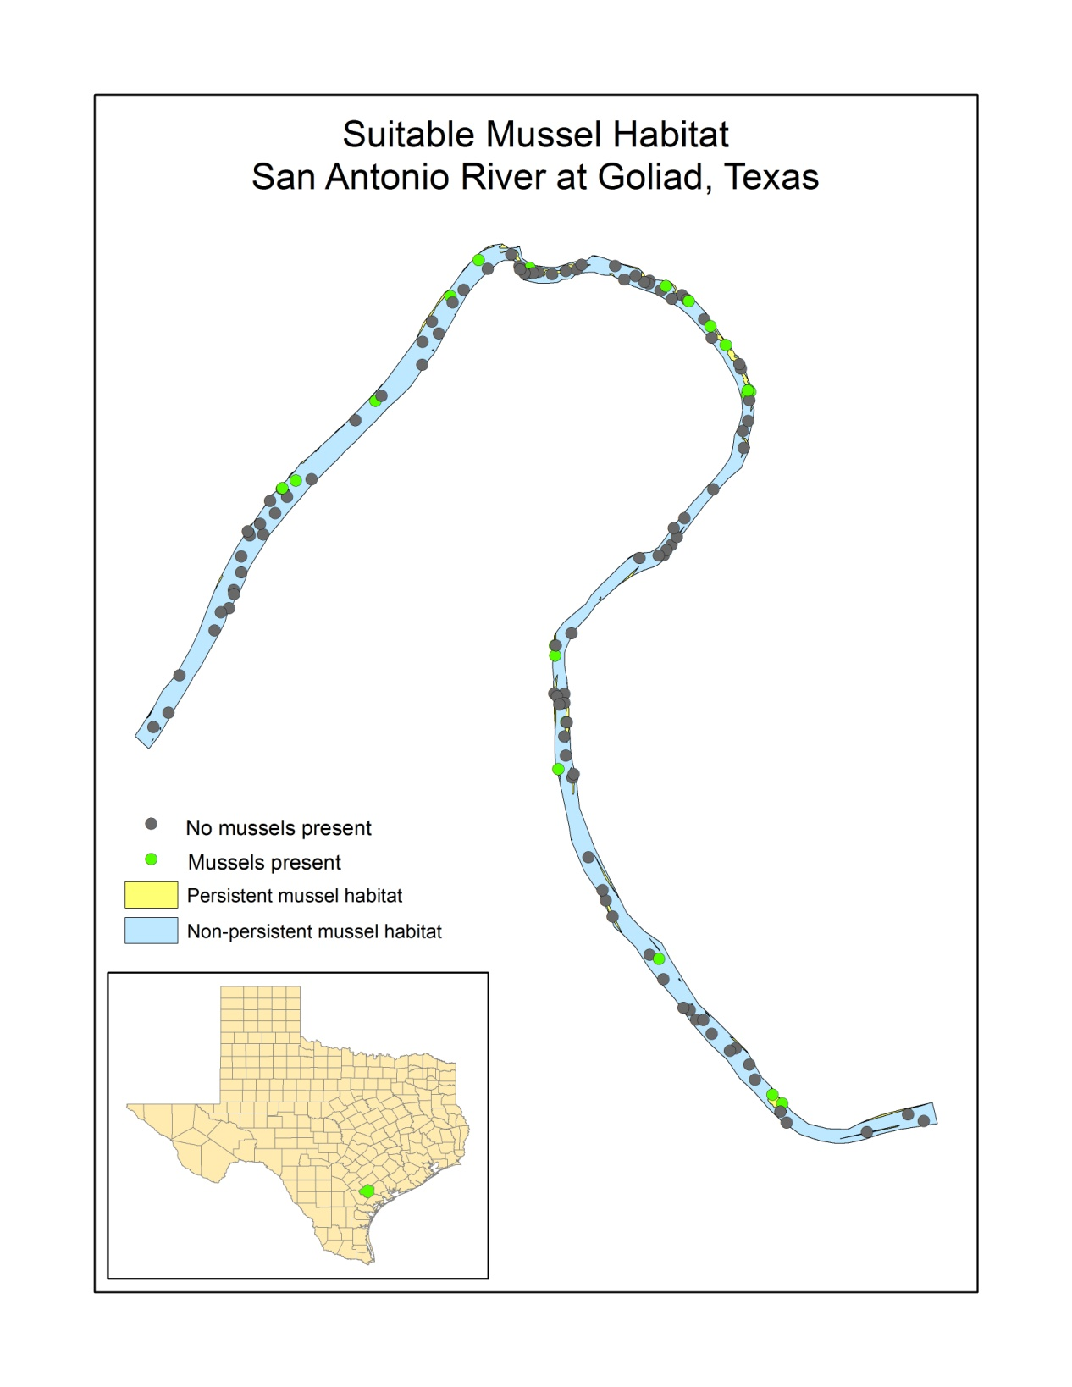

Slide 17
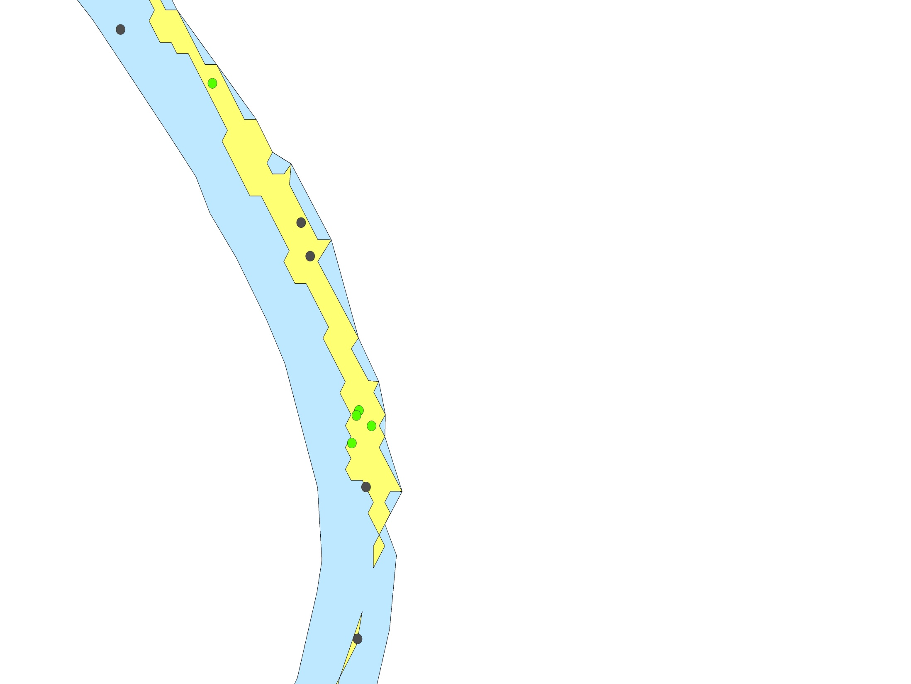

Slide 18
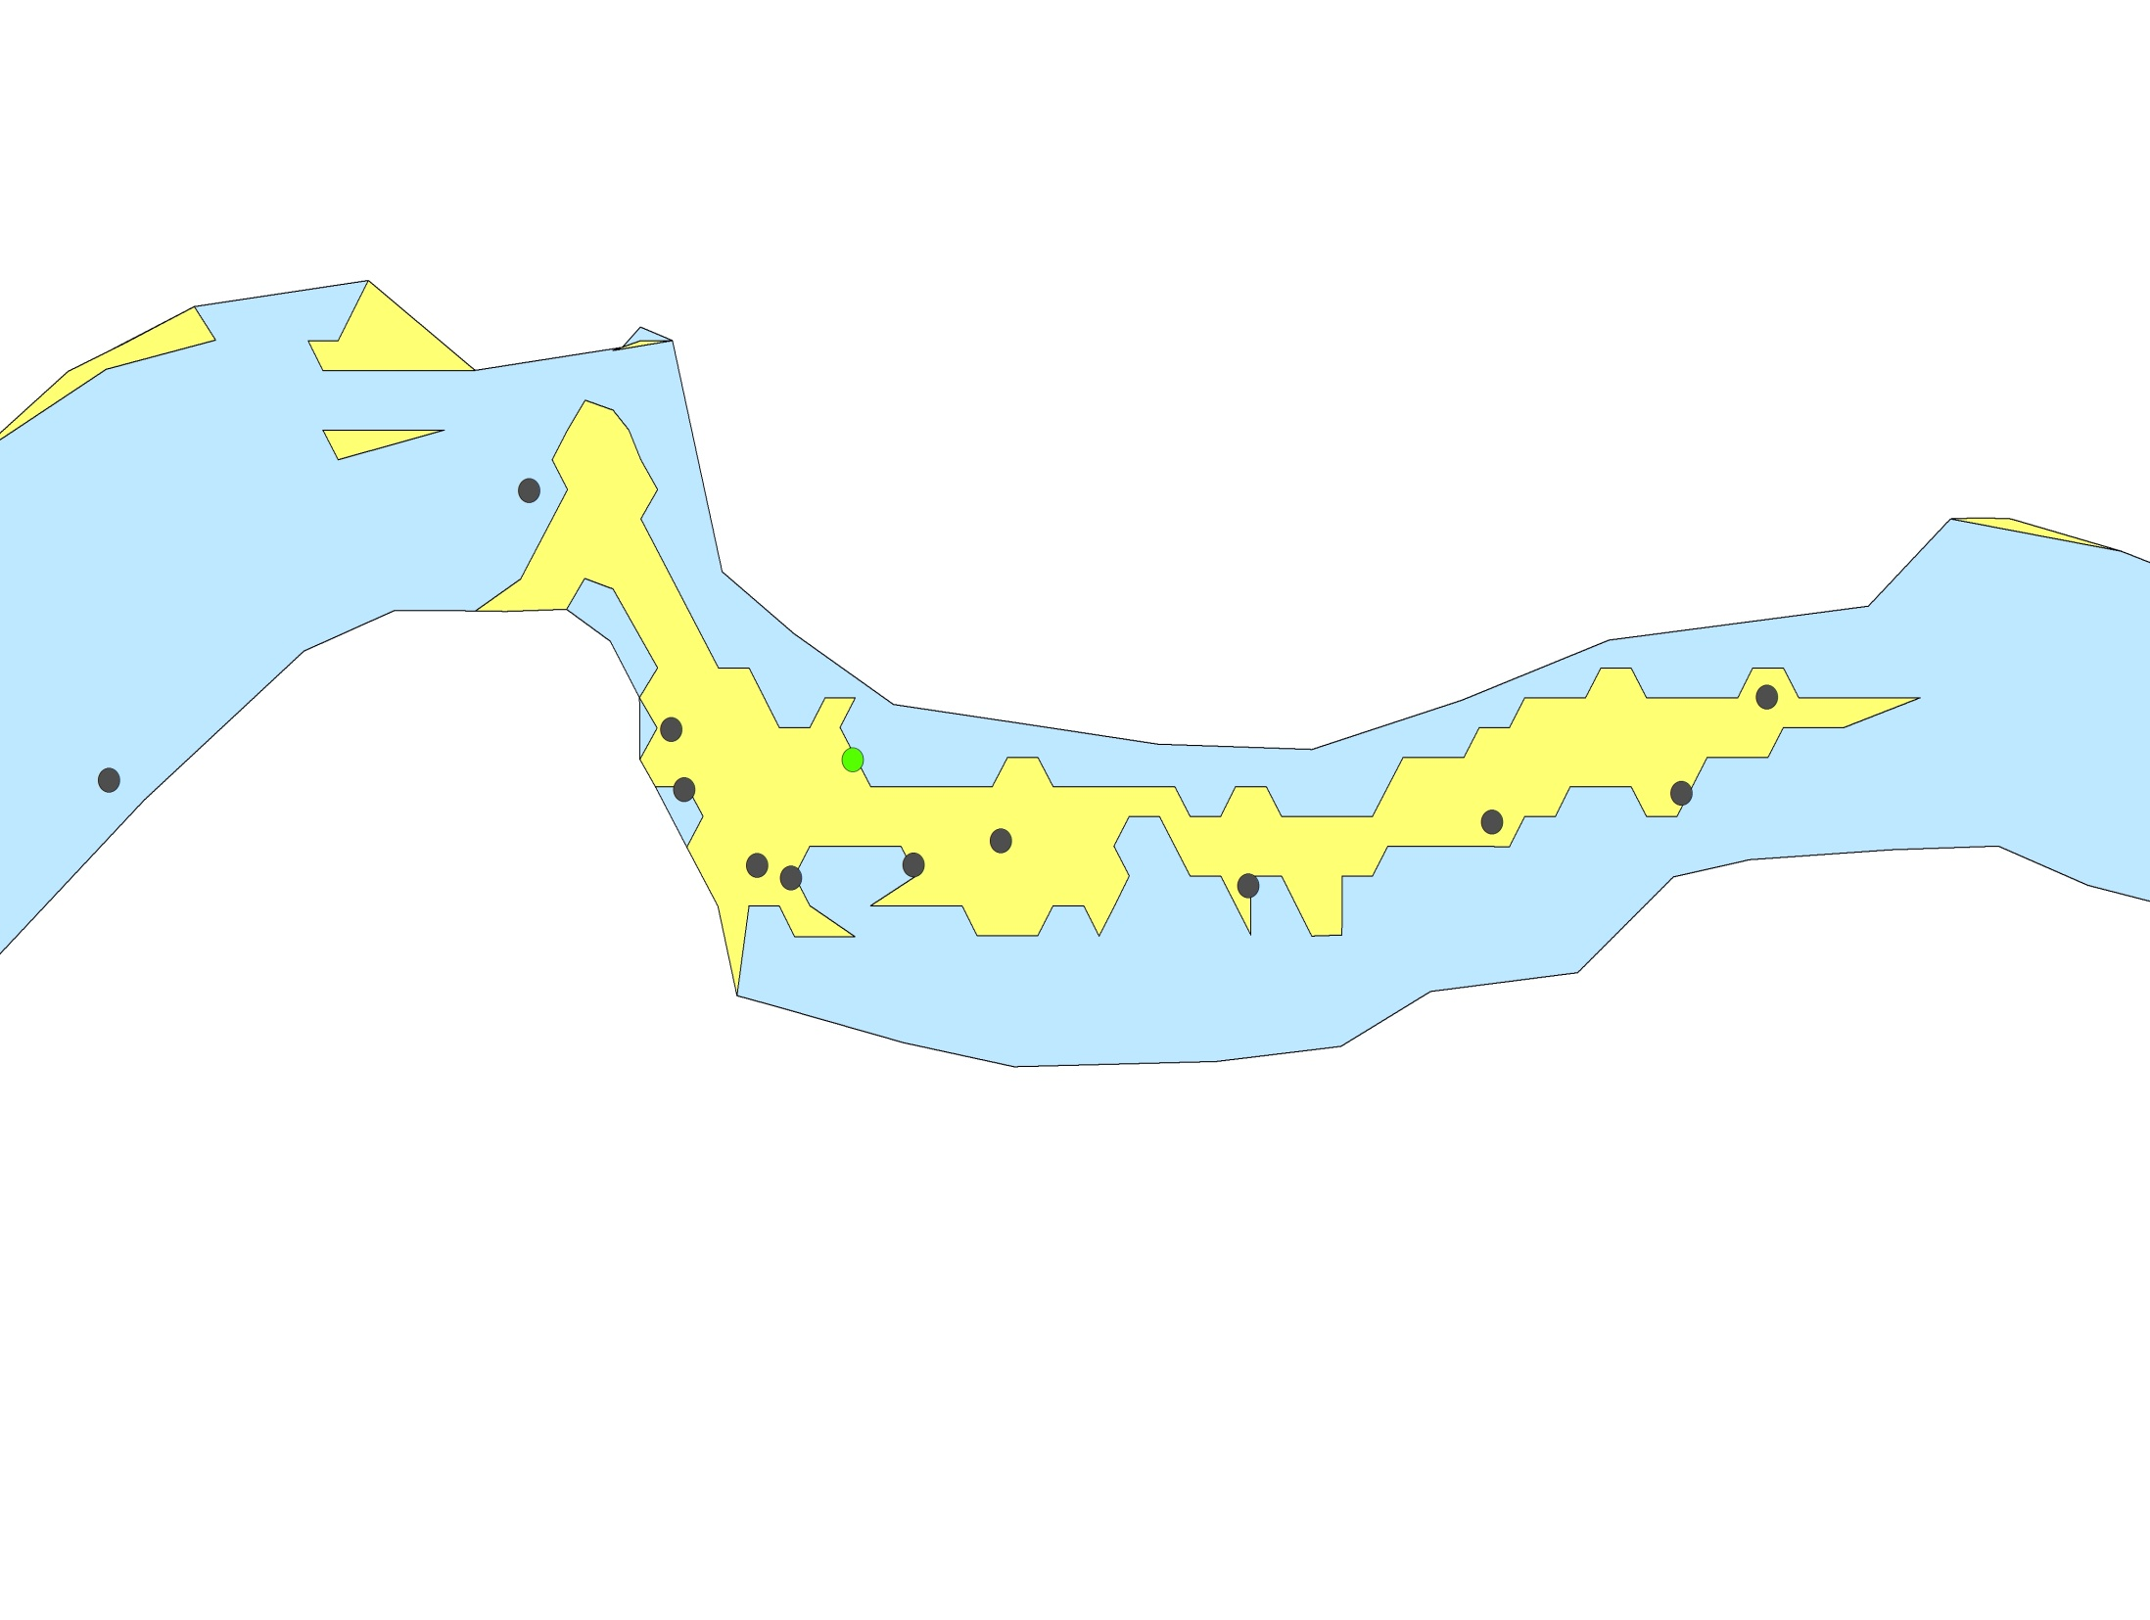

Slide 21
Lower Brazos Mussel Habitat
Quantitative sampling design to determine habitat requirements of mussels
Stratified random sampling design within TIFP study sites
Collect habitat parameters (depth, velocity, near bed velocity, FST, bed roughness, substrate size, etc…) at multiple flow levels to develop mussel habitat suitability criteria
Use HSC to model hydraulic habitat suitability across base flow and pulse flow ranges

Slide 22
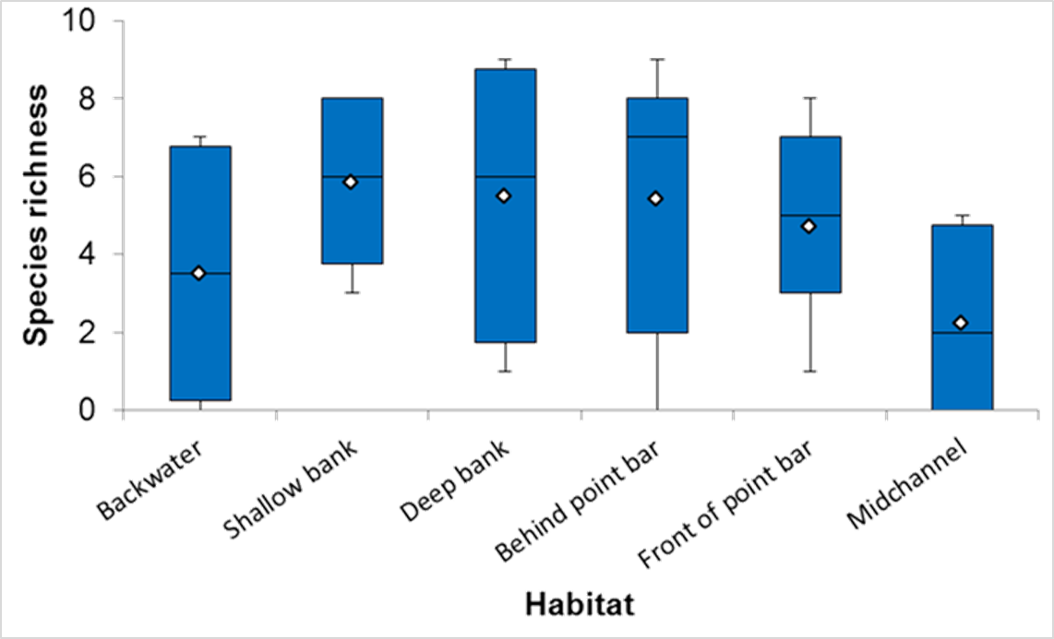
Lower Brazos Mussel Habitat

Slide 26
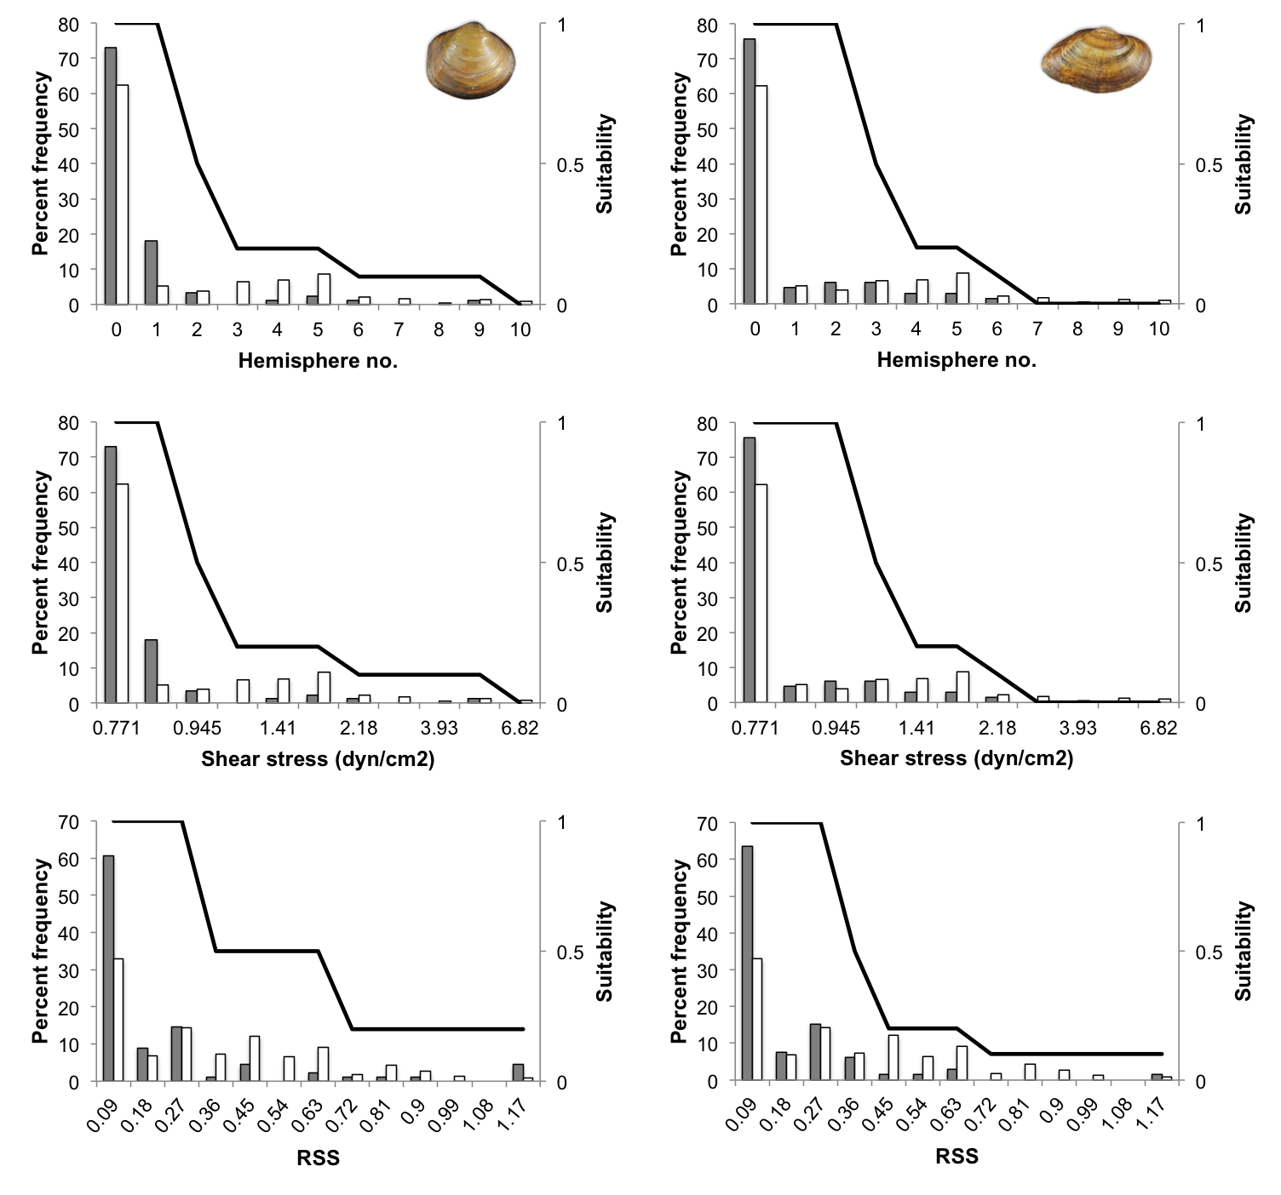

Slide 27
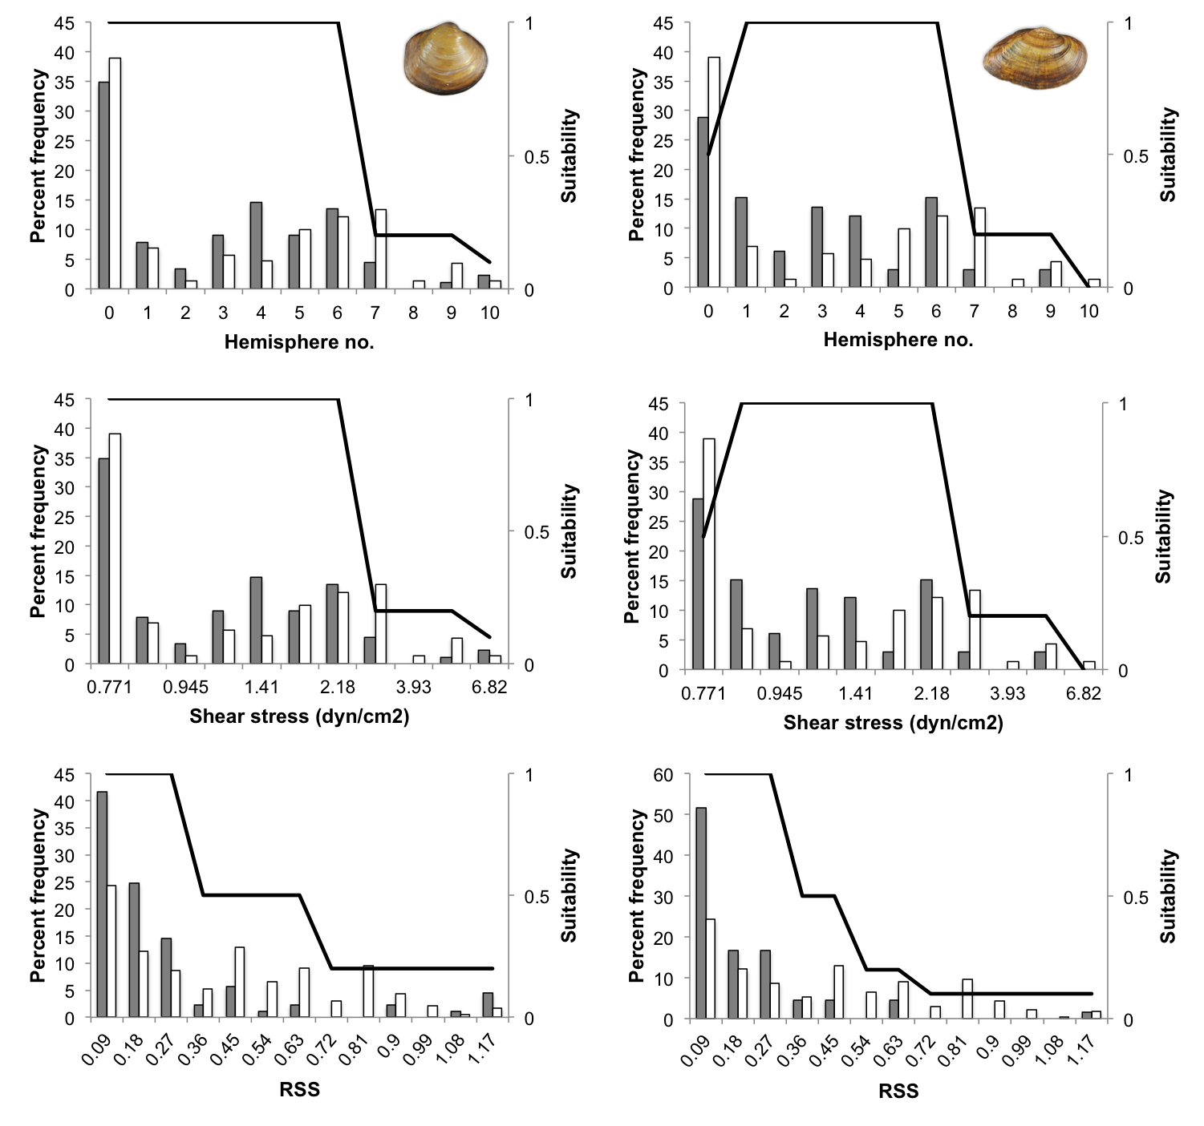

Slide 28
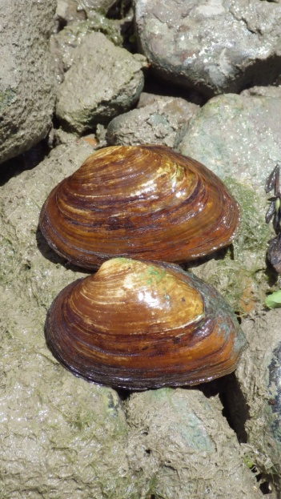
Mussel Data Needs for Instream Flow Studies
Recent distribution and abundance data
Life history information
reproductive cues (i.e. temp)
spawning period
fish hosts
water quality
Habitat utilization information
substrate
current velocity
depth
complex hydraulic parameters

Slide 29
Integrating Flow-ecology Relationships
Fish life history and habitat utilization
Water quality modeling
temperature
dissolved oxygen
Refinement of Mussel hydraulic habitat modeling (2D/3D)

Slide 30
www.twdb.texas.gov/instreamflows/

Slide 31
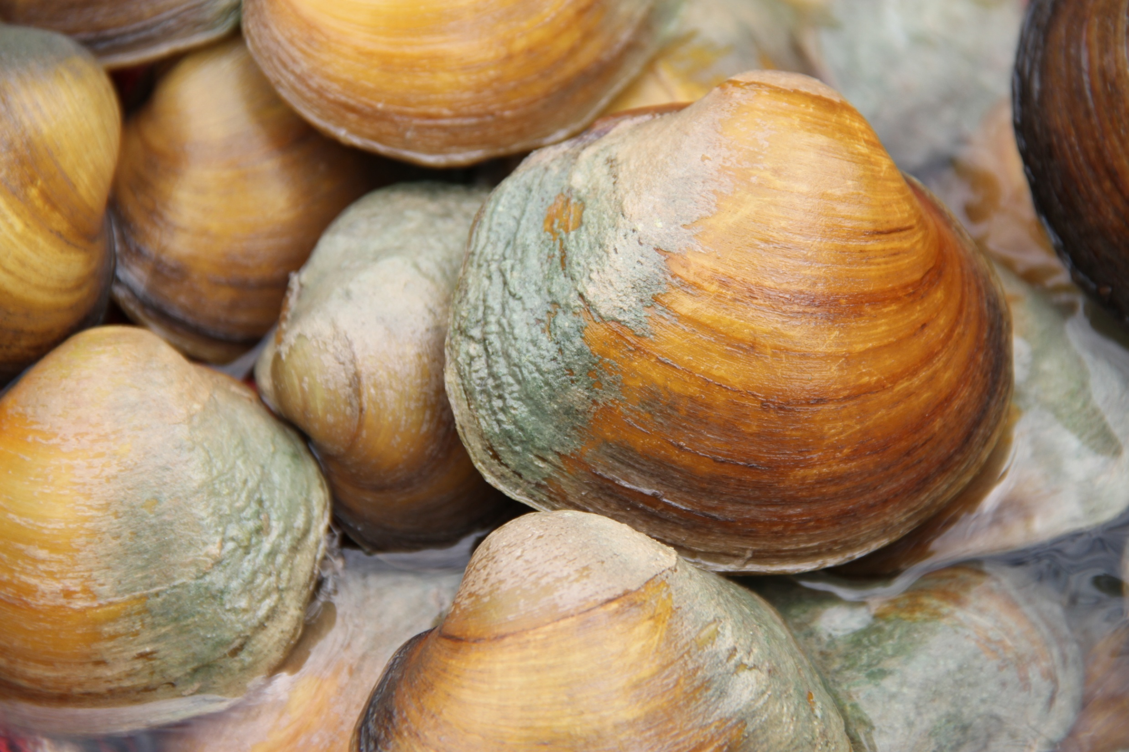
Questions?
clint.robertson@tpwd.texas.gov

