Slide 1
History of IFC
(Modified Version of the 2018 IFC Biennial Meeting 20th Anniversary
Governing Council Presentation from FLOW 2018)
Robert Holmes, IFC President (2020-2022)
IFC Biennial Meeting
The Hilton Broadway Hotel
Columbia, MO
April 8, 2022

Slide 2
Why IFC Founded & Accomplishment
Highlights
What next?

Slide 3
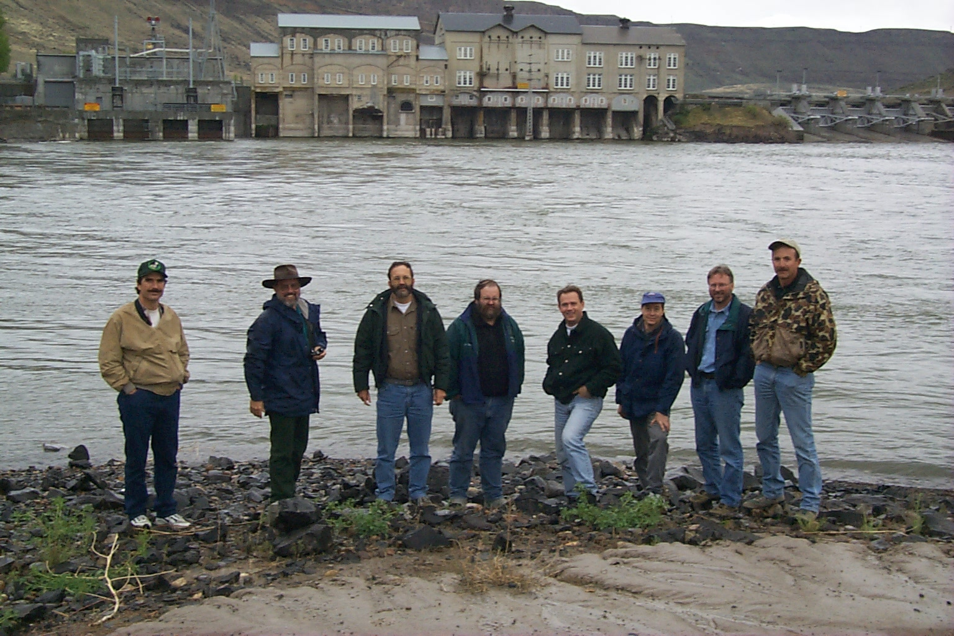
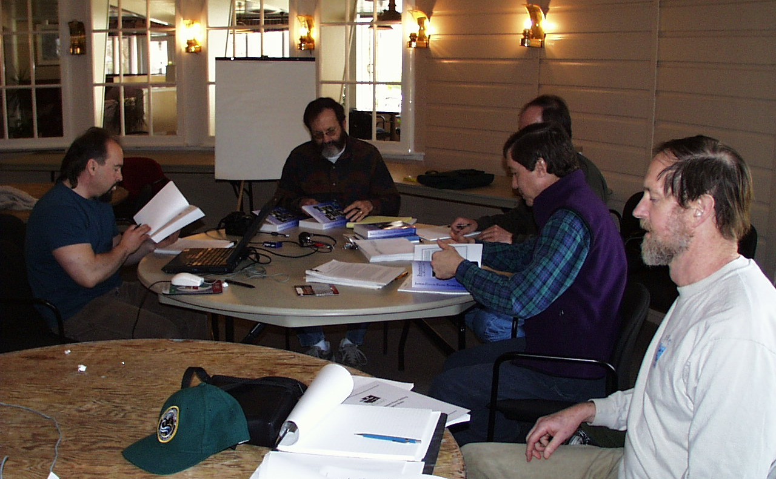
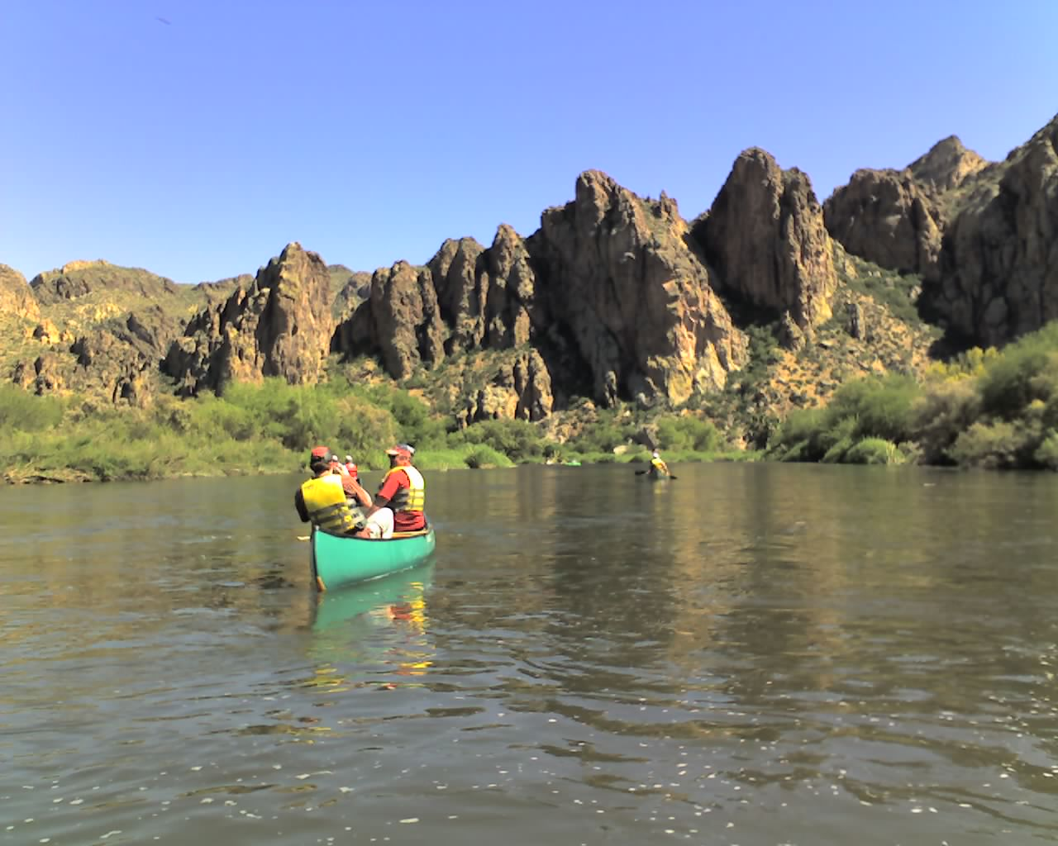
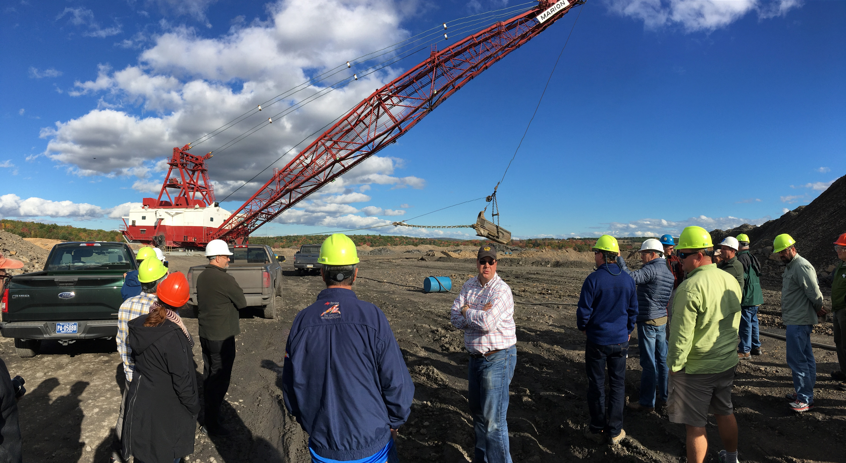
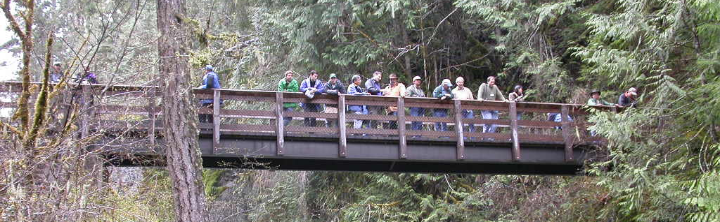
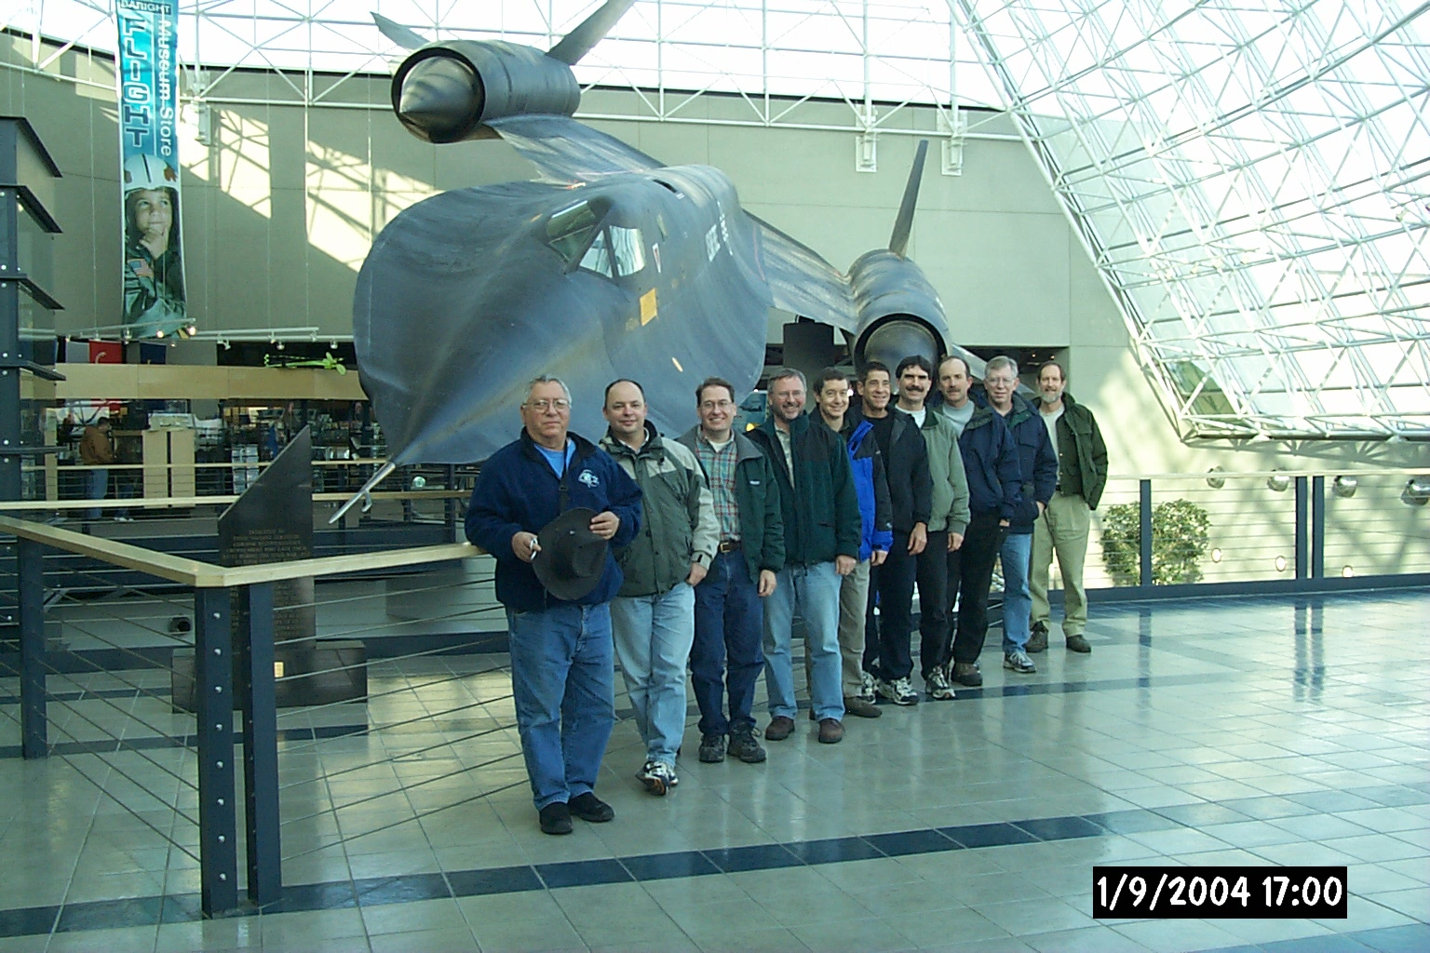
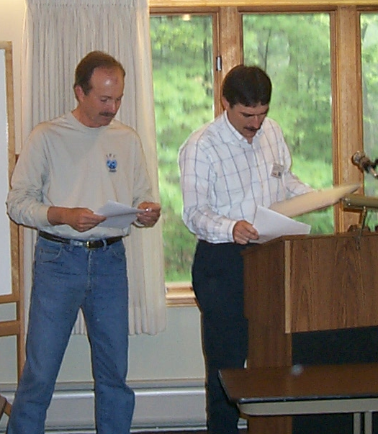
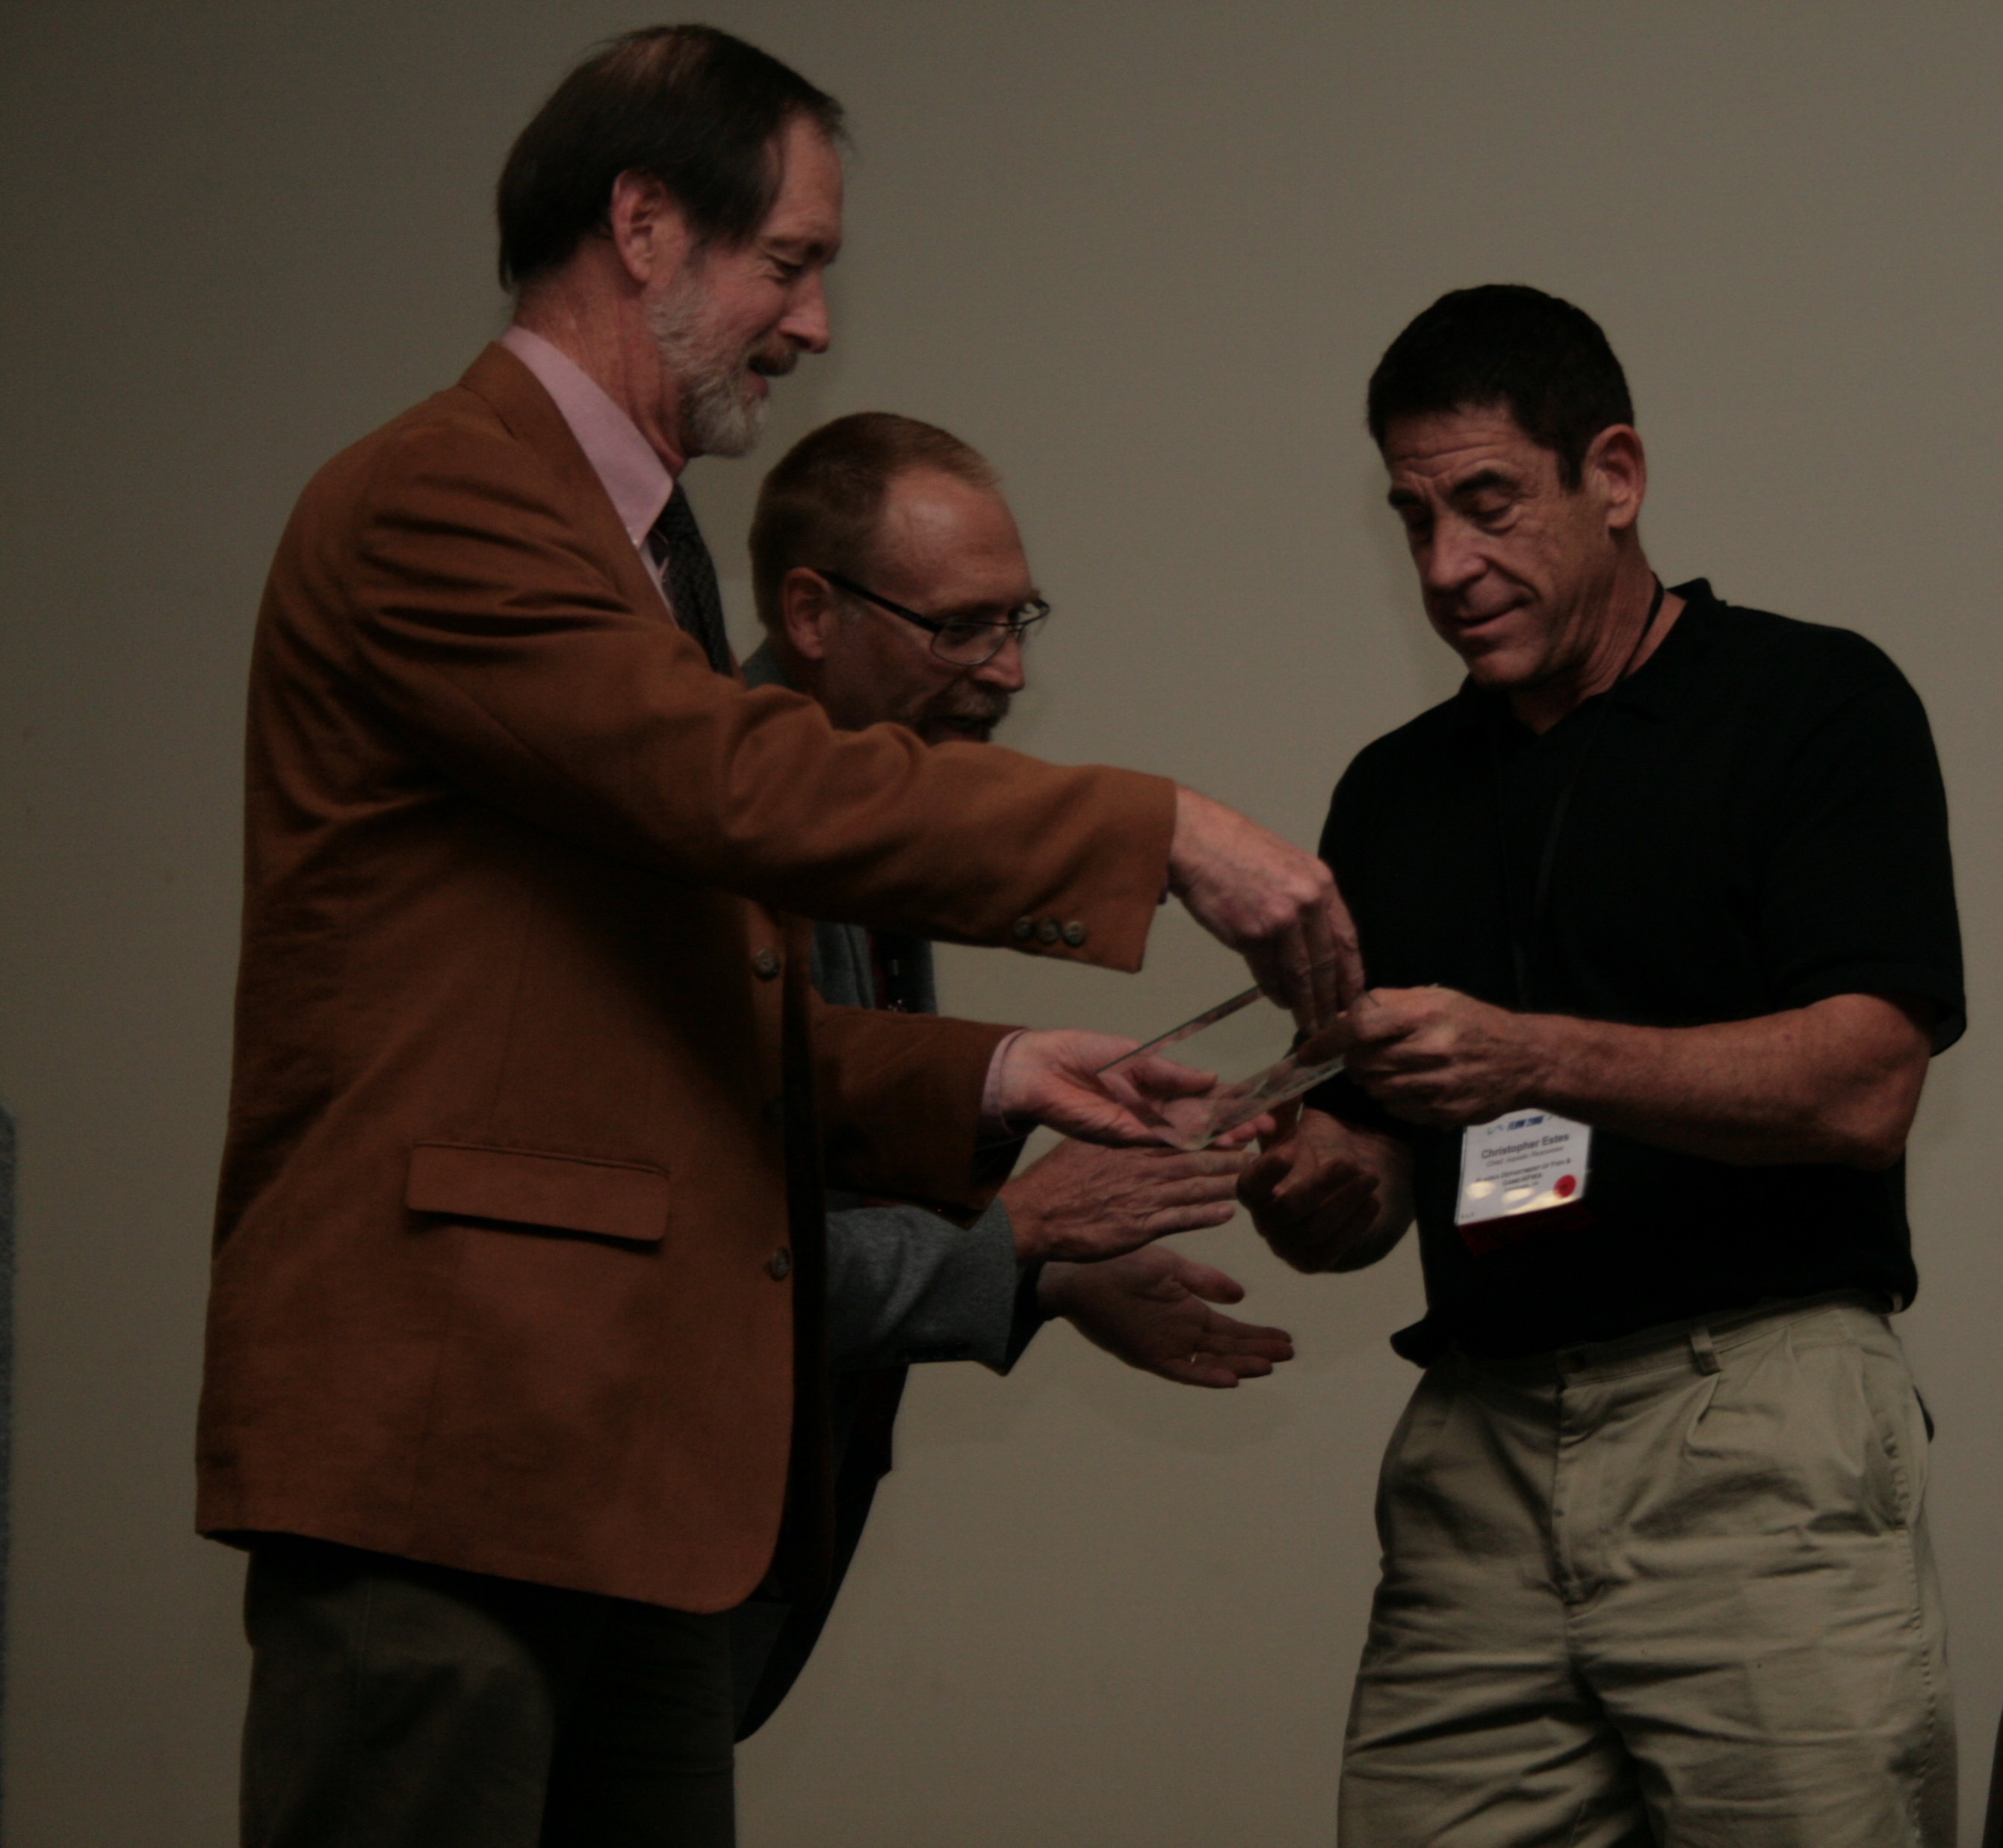

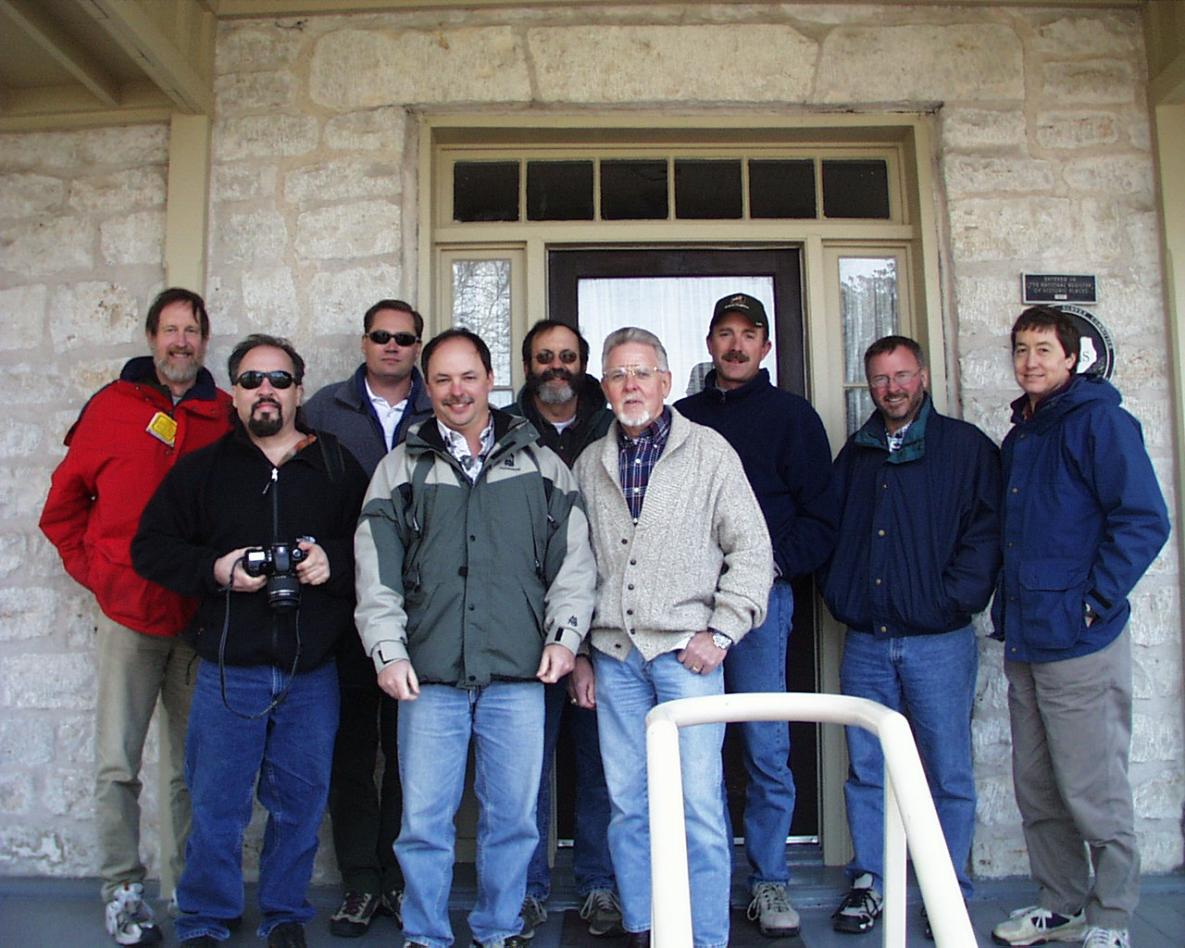
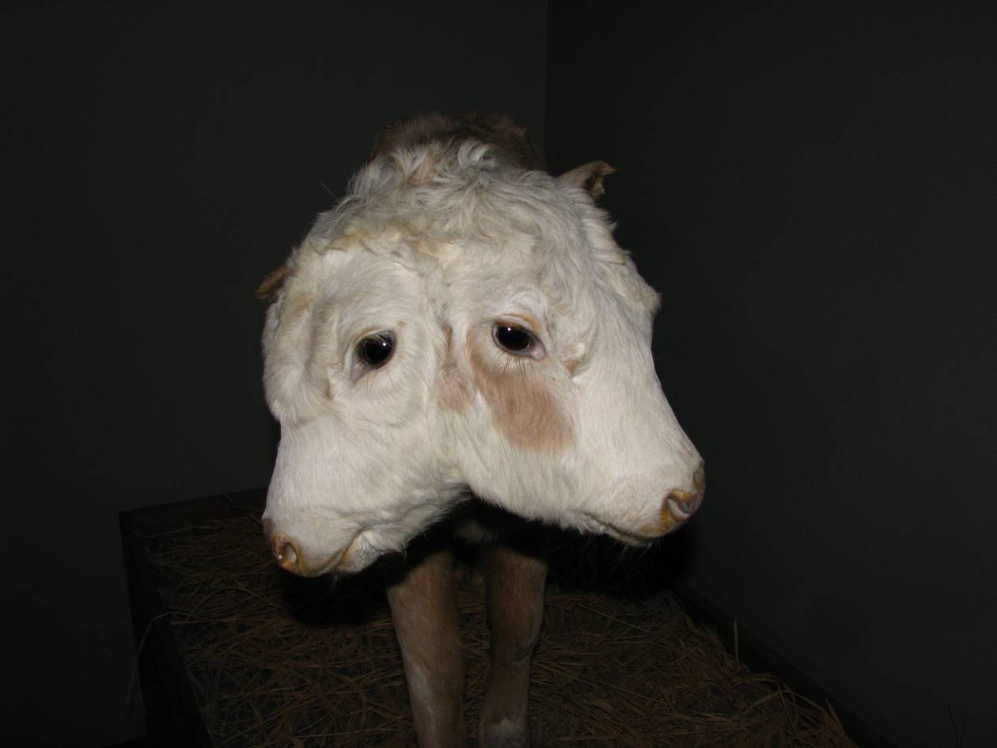
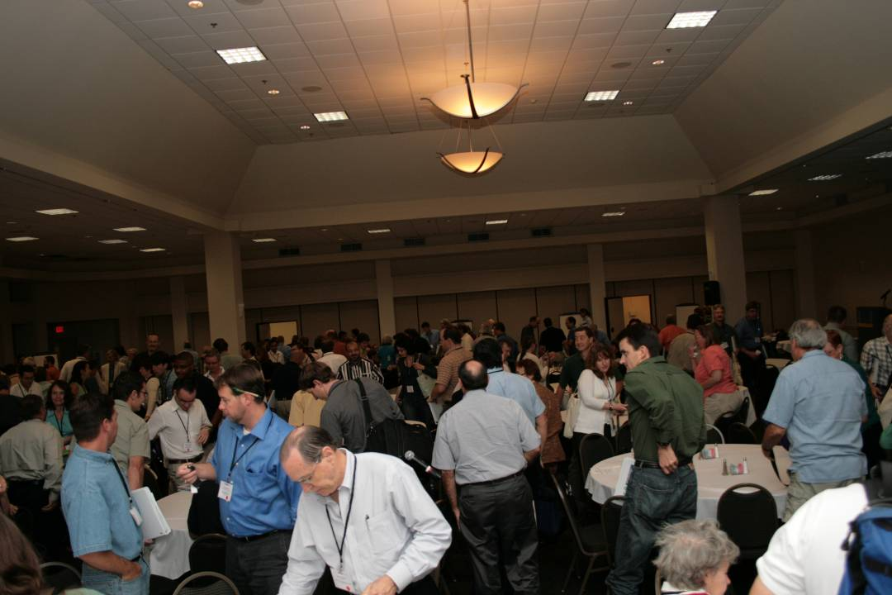
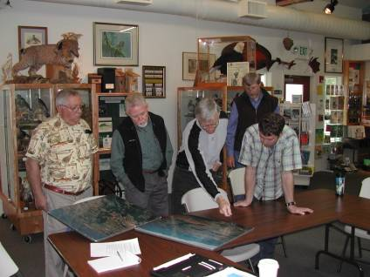
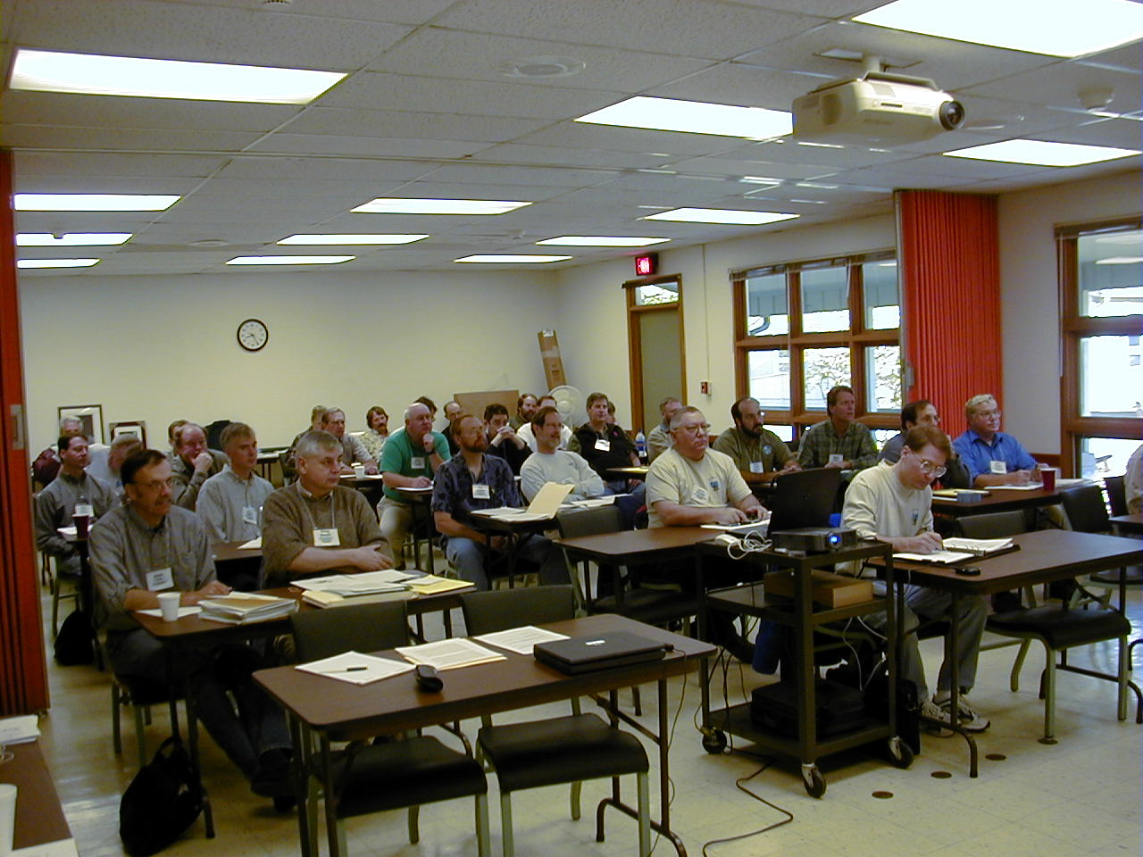

Slide 4
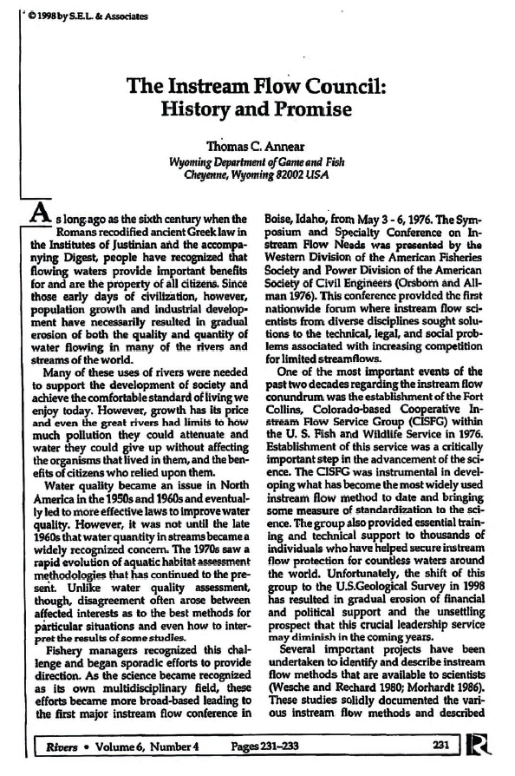

Problem/Need:
Erosion of Cooperative Instream Flow Service Group, USFWS/USGS
Fish and Wildlife agencies:
  Lacked staff trained in Instream Flow (IF) & Water Levels (WL)
  Lacked standard protocols for IFWL conservation (protection, restoration, & enhancement) studies & implementation
  Lacked adequate policies and procedures for IFWLC
  Lacked laws written to protect IFWLC
  General unawareness of what neighbor states/provinces did/do & why
AFS too broad to fill void
Annear, T. 1998. Rivers: Vol 6, No 4, 231-233. www.instreamflowcouncil.org/about/

Slide 5
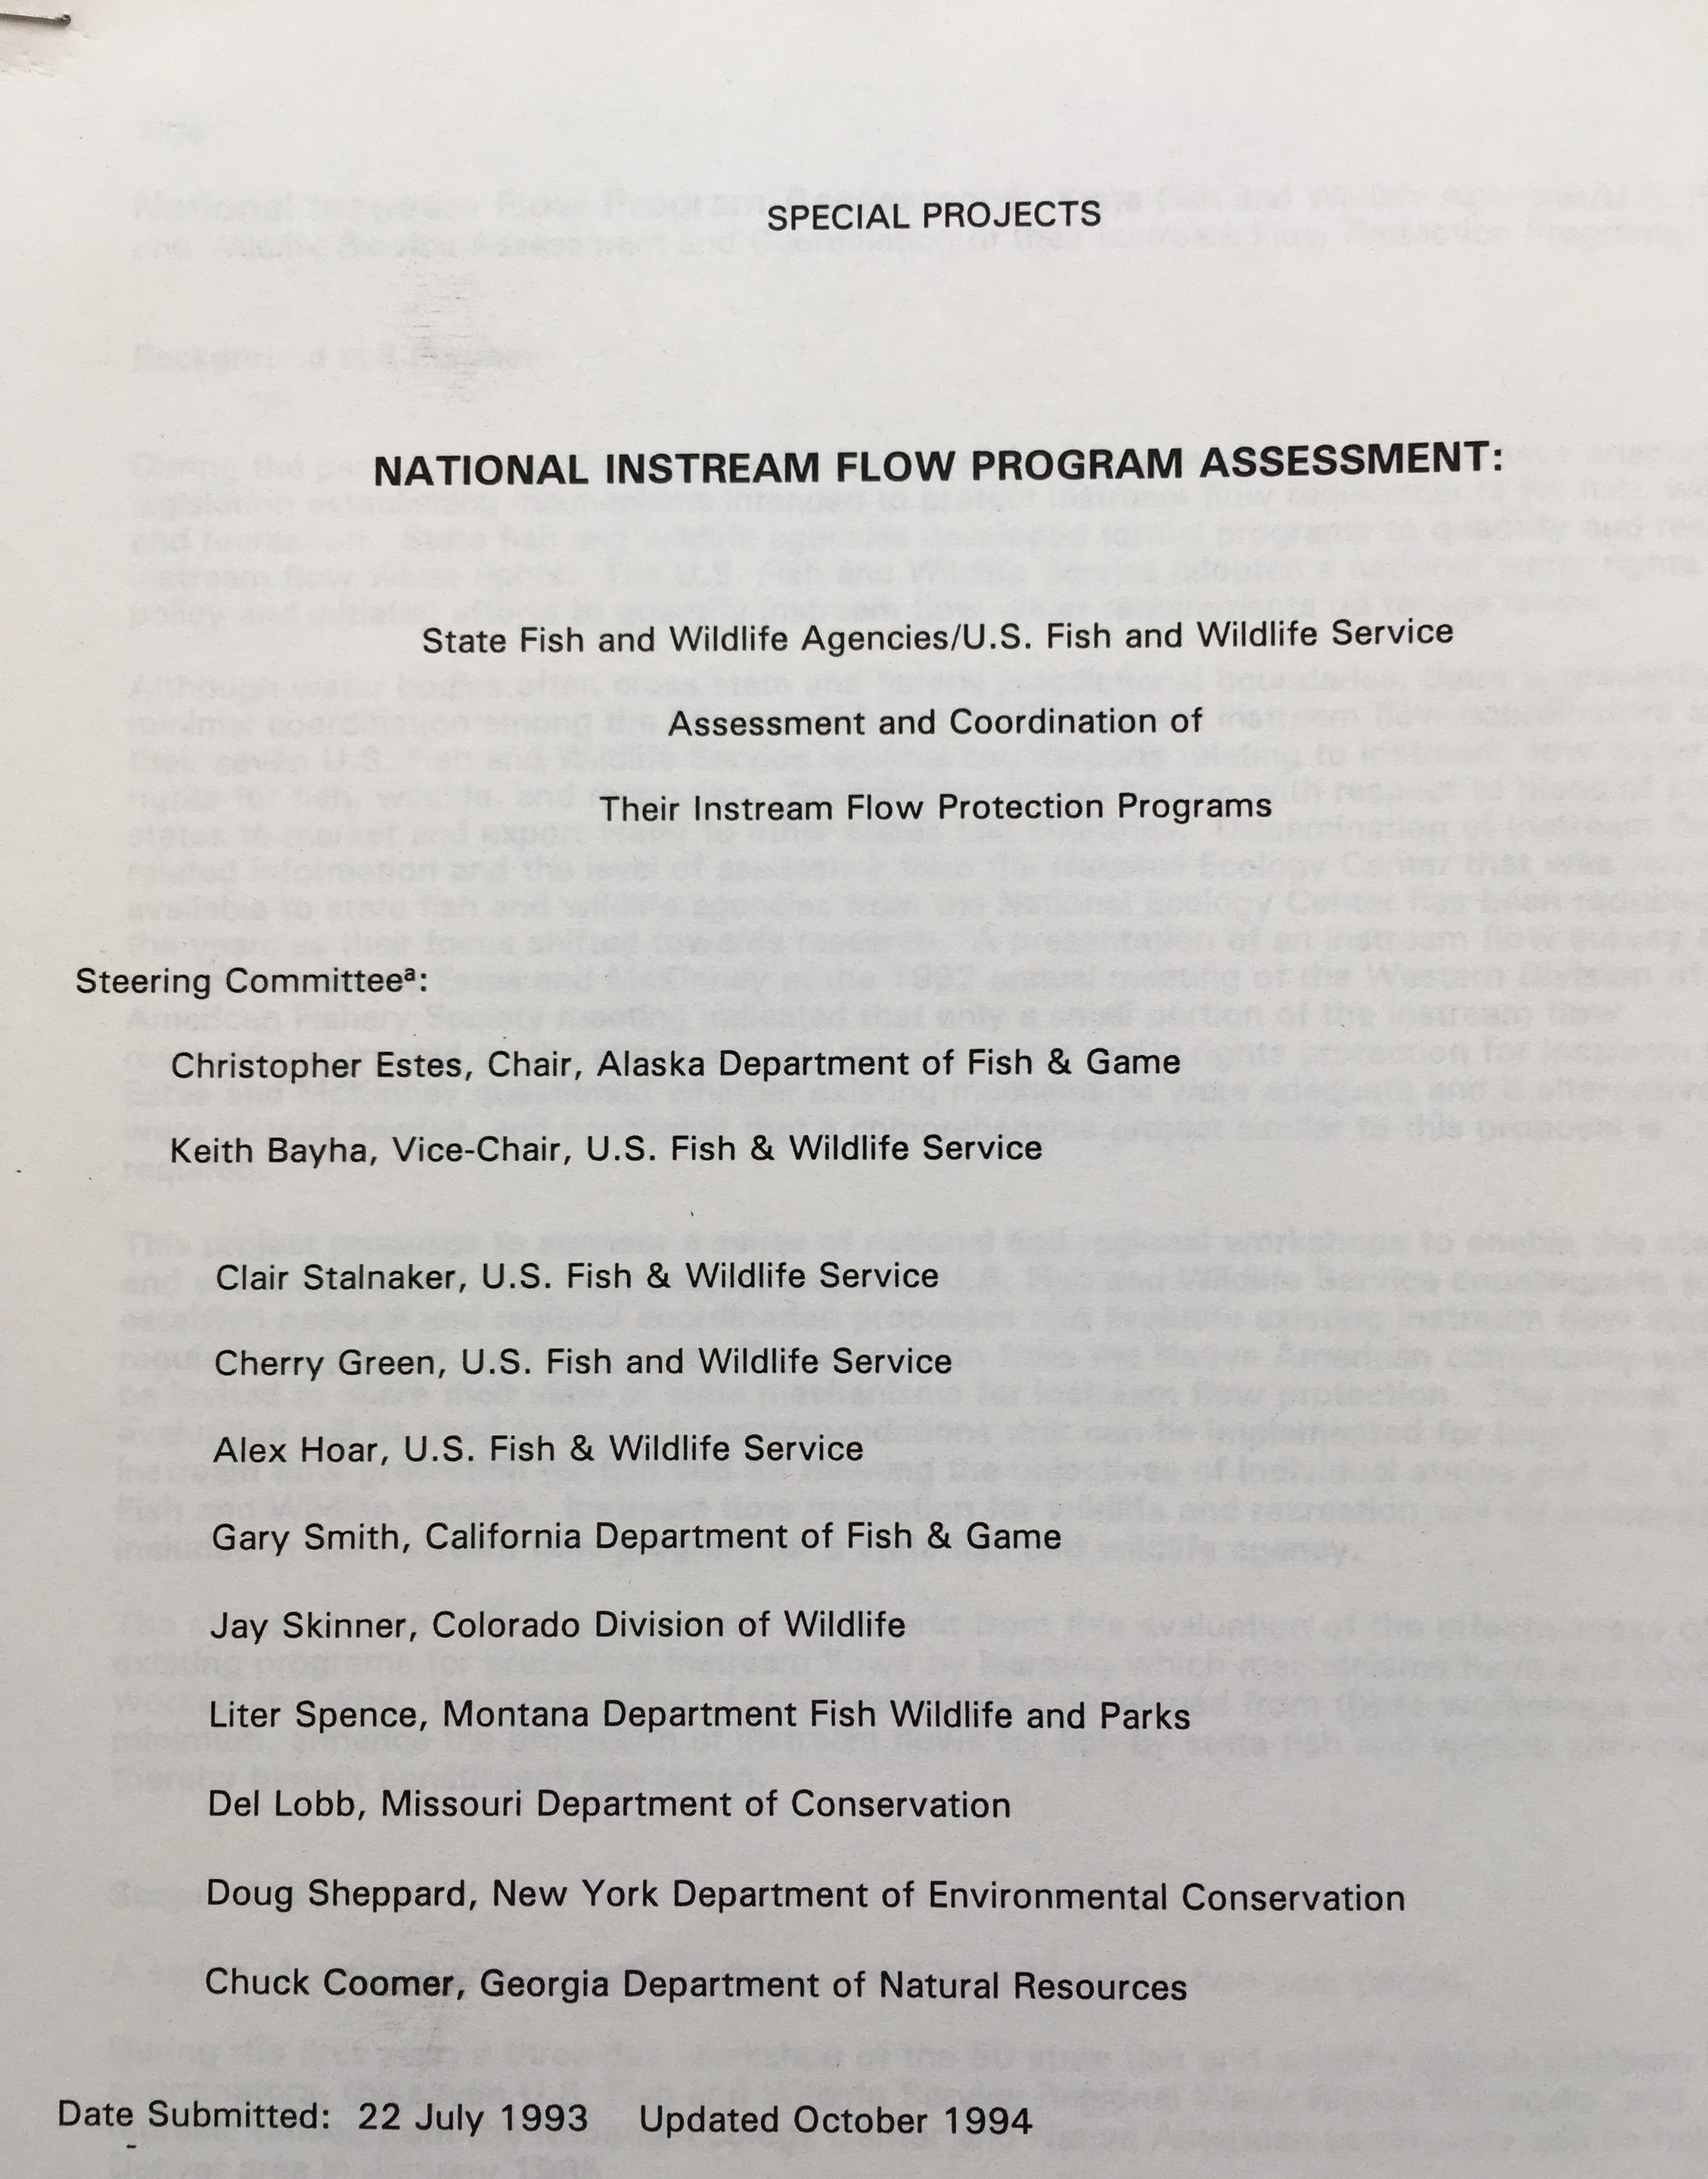
National Instream Flow Program Assessment (NIFPA)
Project Initiated in 1993
Representatives from every US fish and wildlife agency met in 1995 and 1996.
Assessed each state’s* instream flow program.
Produced videos defining the roles of the Public Trust Doctrine
Led to the formation of IFC. First official meeting in Denver, CO, 1998
------------------- *USFWS Regions & Tribal, too

Slide 6
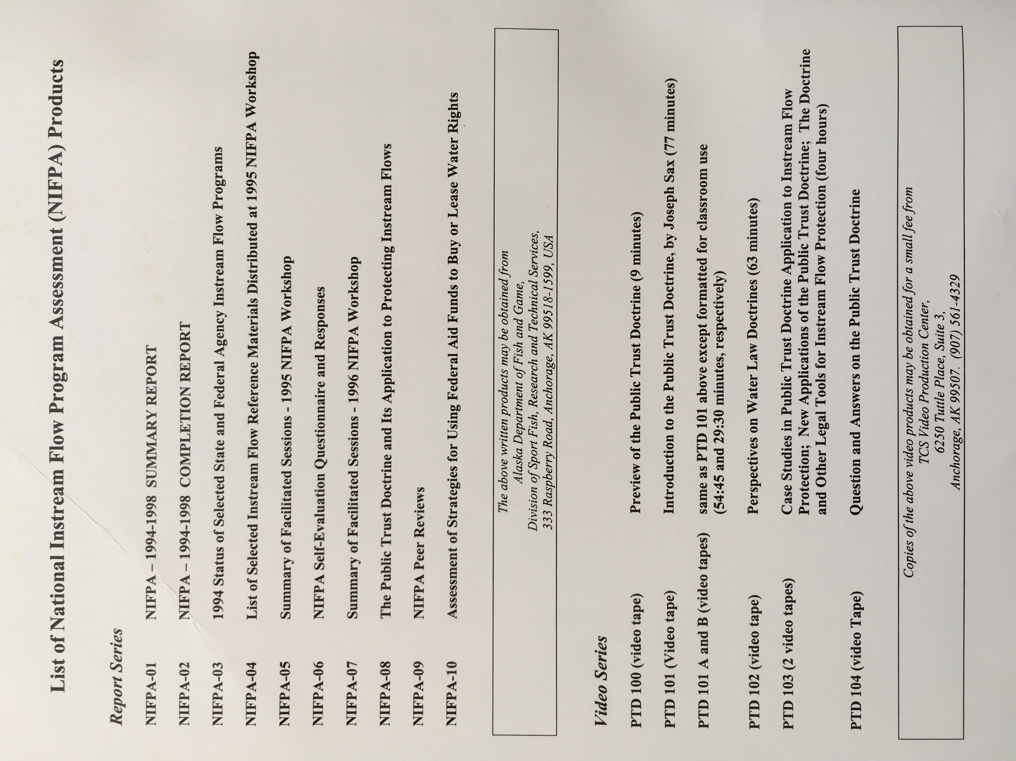
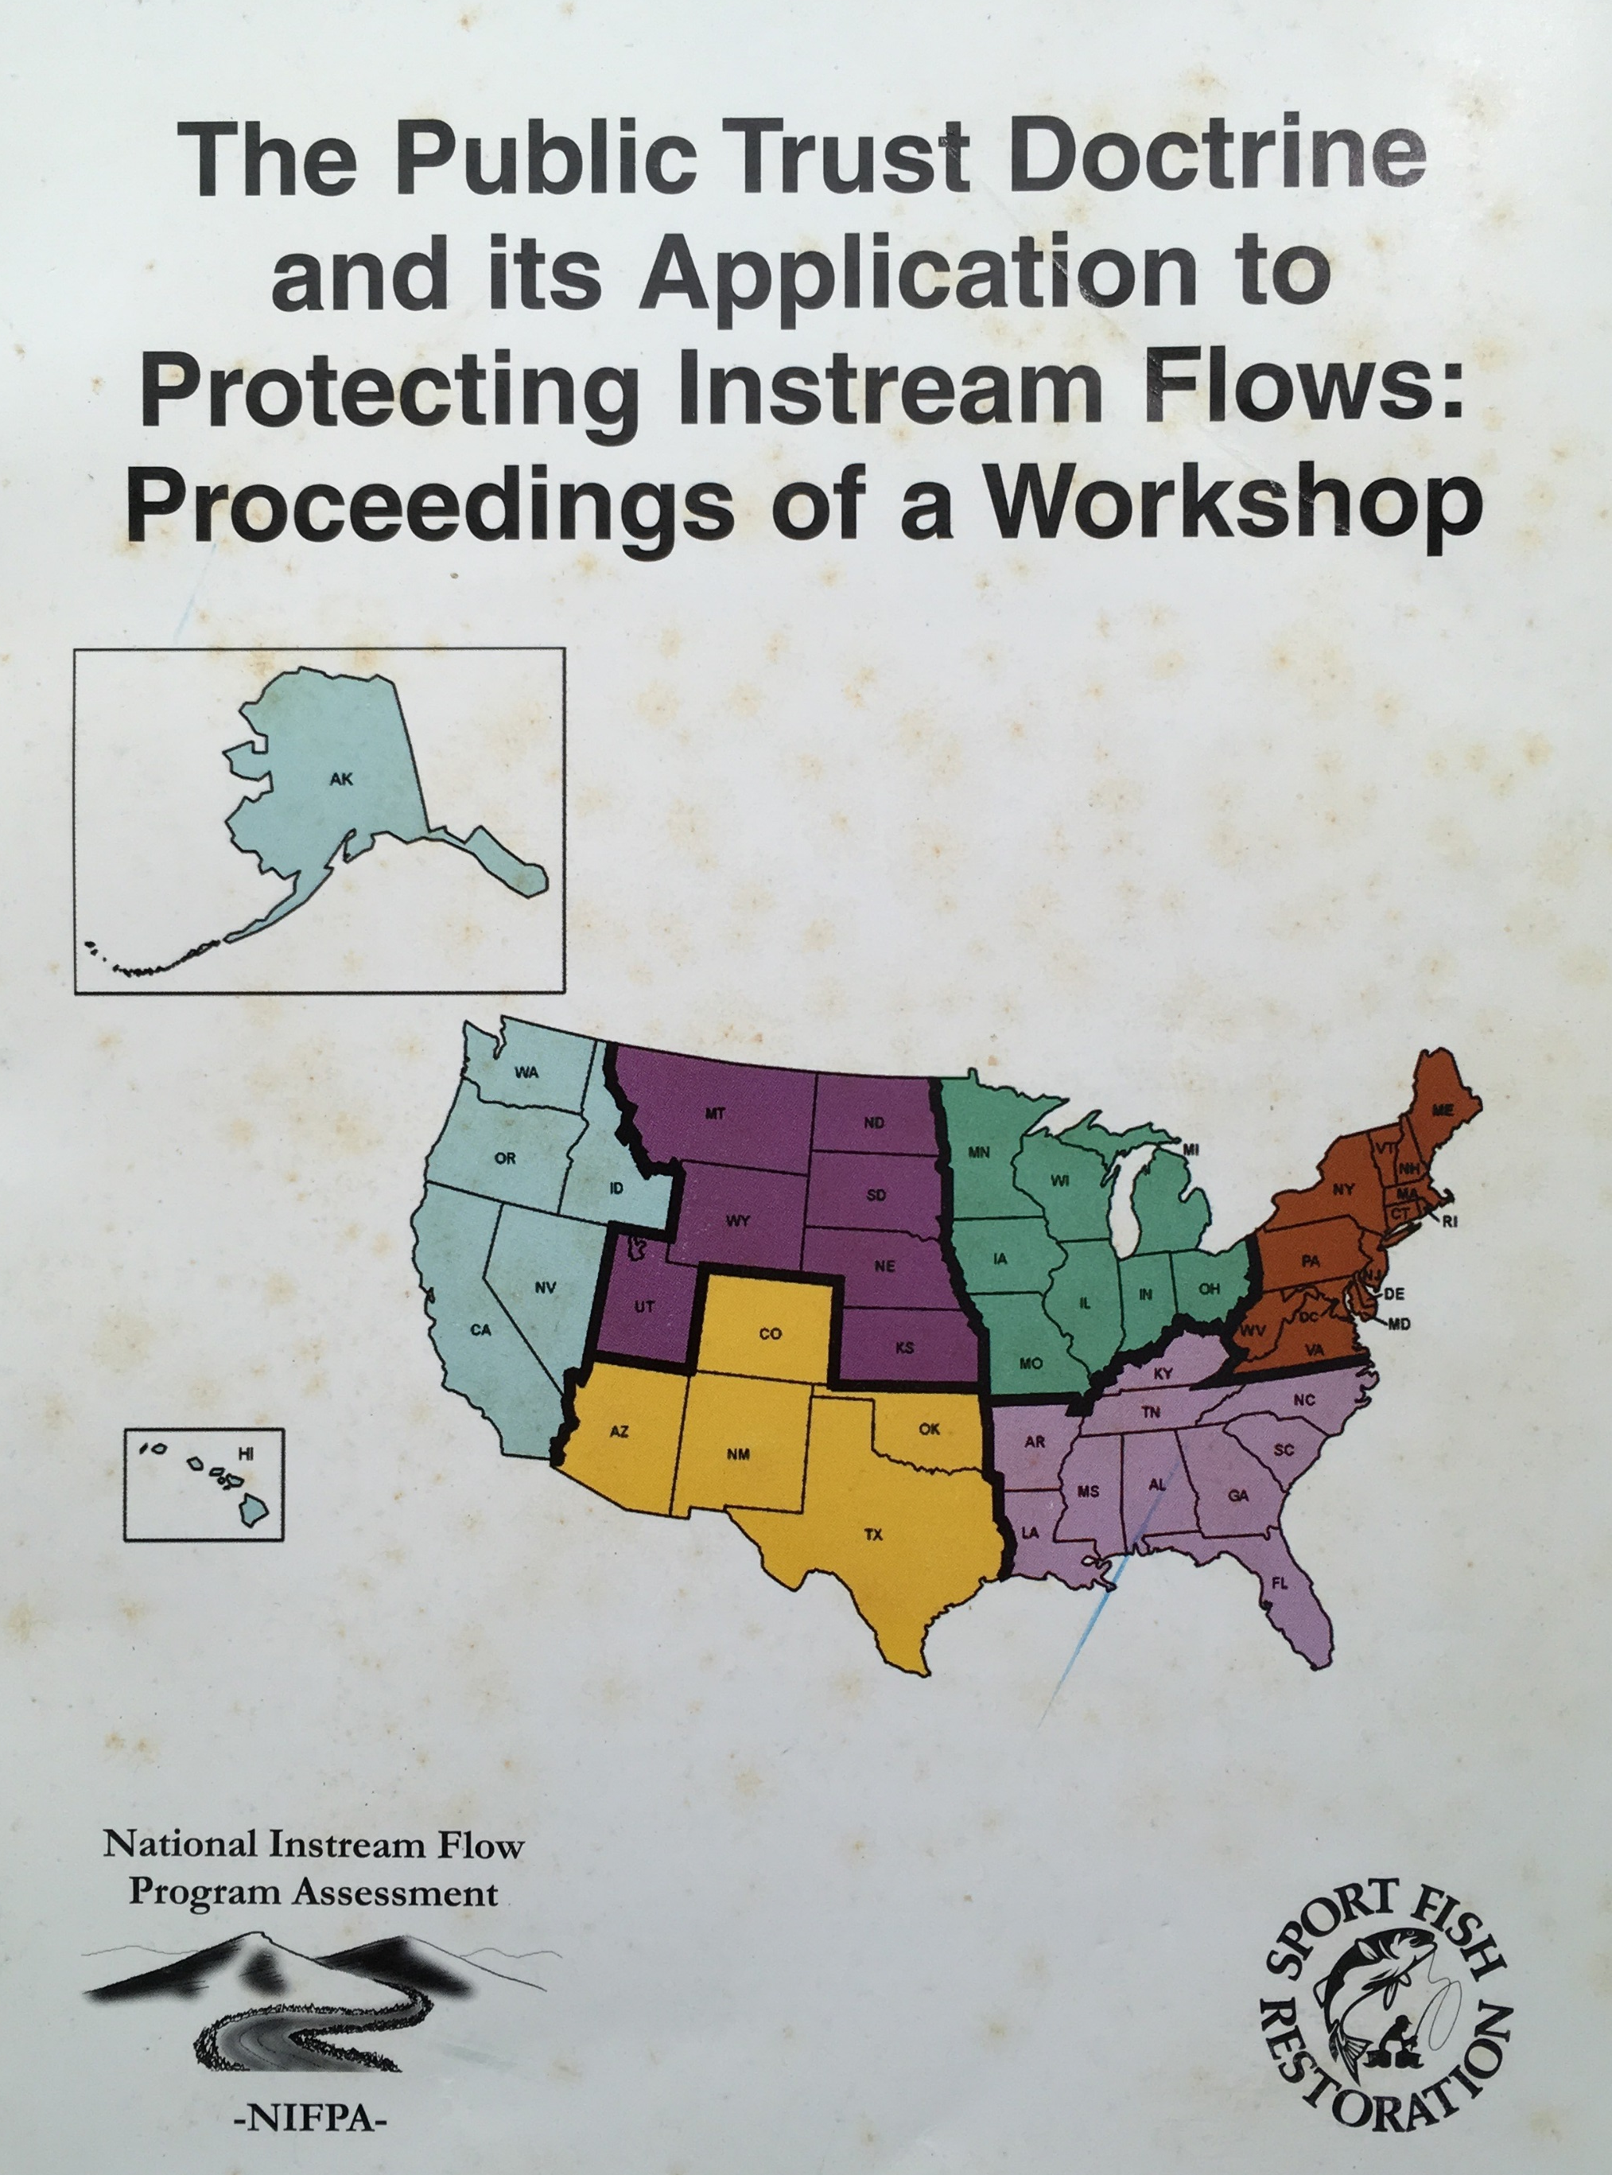

Slide 7
https://www.instreamflowcouncil.org/the-public-trust-doctrine/

Slide 8
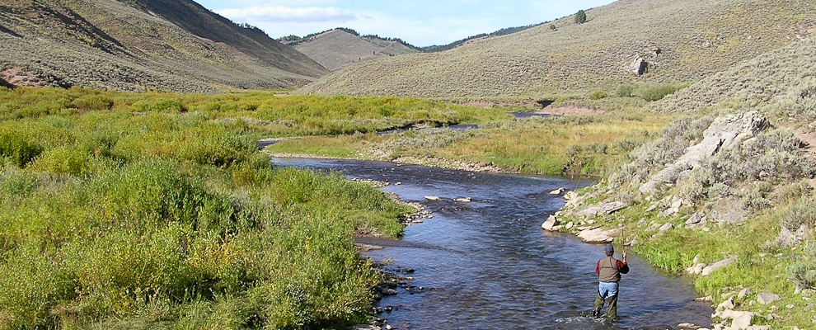
Steering Committee launched at NIFPA in 1996 to create an IFC.
Bylaws and Charter drafted & IFC established in 1998.
Vision: that each water body in Canada and the United States has flow and water regimes that sustain ecological integrity.
Mission: to improve the effectiveness of state, provincial, and territorial instream flow programs and activities in conserving (protecting, maintaining, and restoring) aquatic ecosystems.
Notes:
Is footnote needed re this summarn version reflects the evolution of original language?

Slide 9
Instream Flow Council Development Steering Committee Members
Tom Annear, Chair
Ian Chisholm
John Kauffman
Steve Filipek
Larry Hutchinson
Rick Jacobson
Randy Moss
Gary Smith
Gary Whelan
Christopher Estes

Slide 10

INSTREAM FLOW COUNCIL HIGHLIGHTS

Slide 11
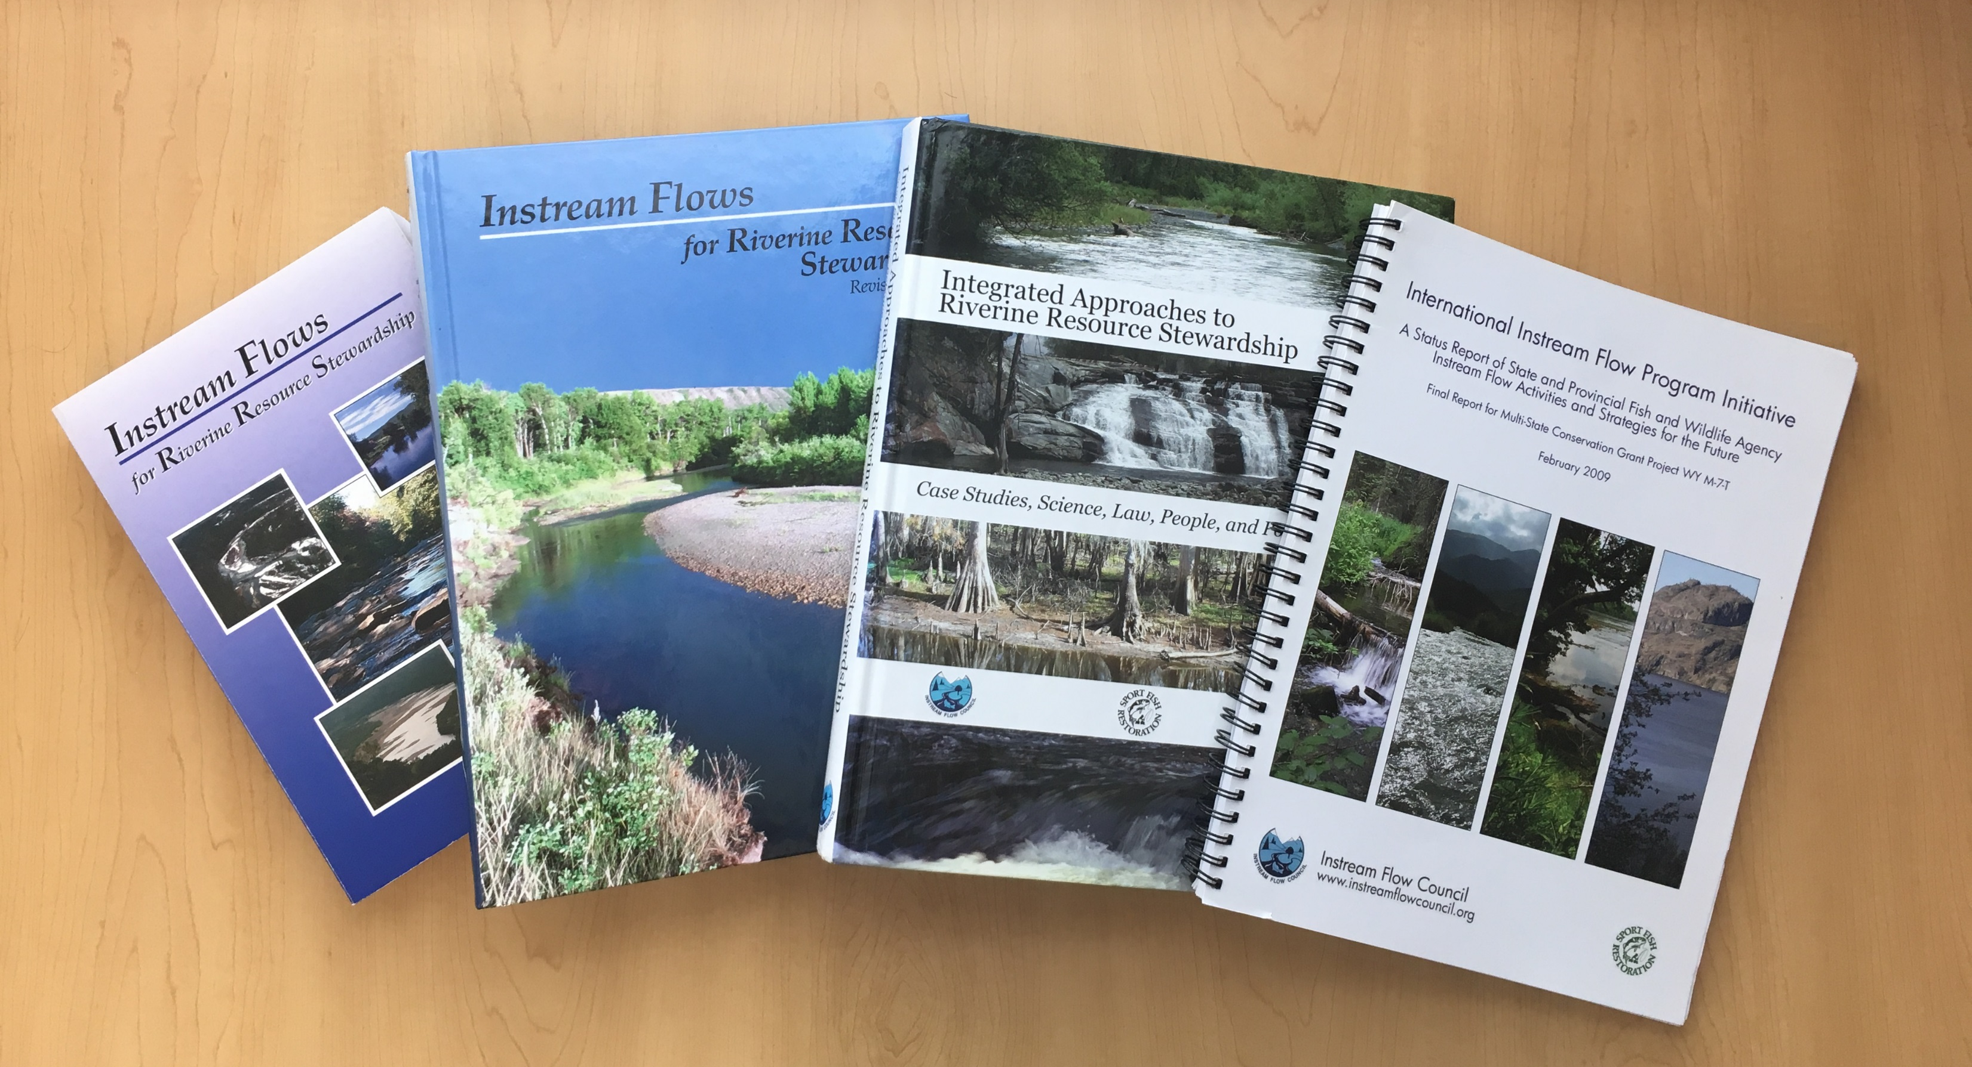
IFC Publications
2002: Instream Flows for Riverine Resource Stewardship
2004: Instream Flows for Riverine Resource Stewardship, (revised ed.)
2008: Integrated Approaches to Riverine Resource Stewardship:
Case Studies, Science, Law, People, and Policy
2009: International Instream Flow Program Initiative

Slide 12
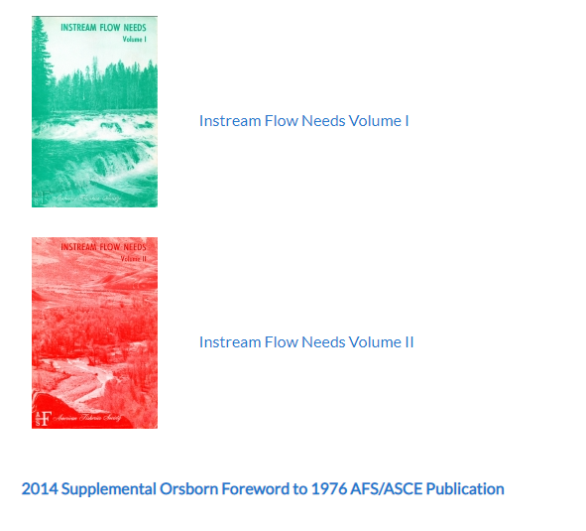
Other Publications e-reprints of the classic 1976 two-volume American Fisheries Society/American Society of Civil Engineers publication on instream flows and water levels.

Slide 13
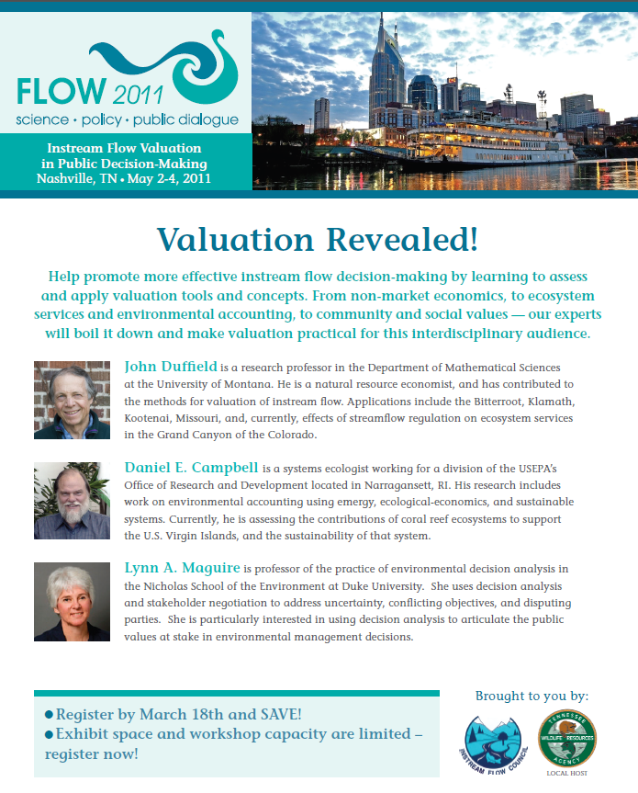
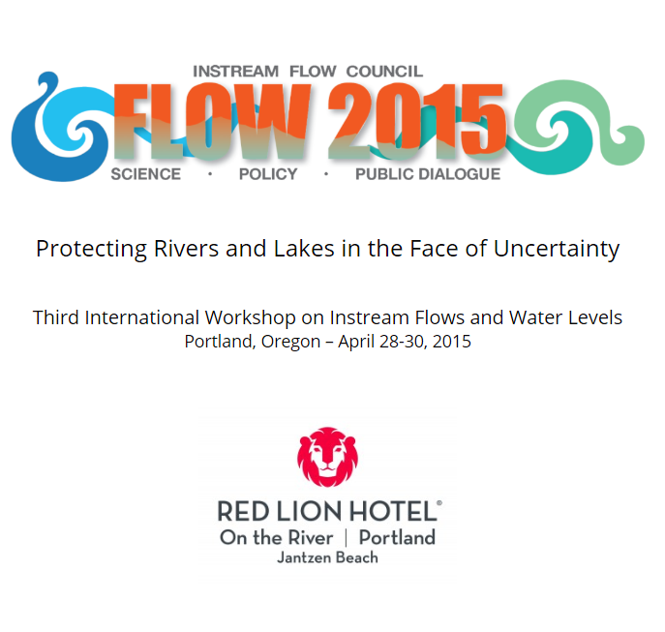
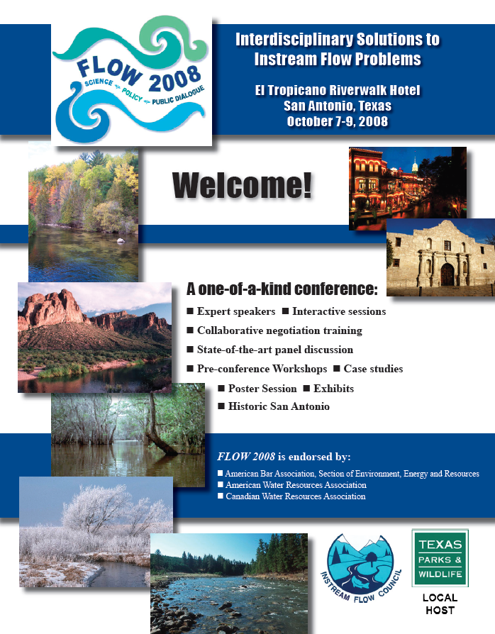
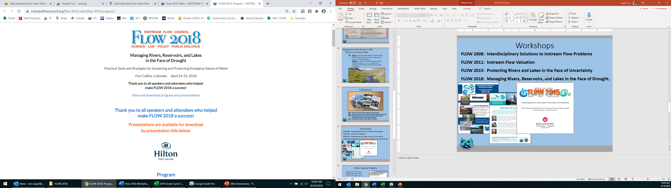
Workshops
FLOW 2008: Interdisciplinary Solutions to Instream Flow Problems
FLOW 2011: Instream Flow Valuation
FLOW 2015: Protecting Rivers and Lakes in the Face of Uncertainty
FLOW 2018: Managing Rivers, Reservoirs, and Lakes in the Face of Drought.

Slide 14
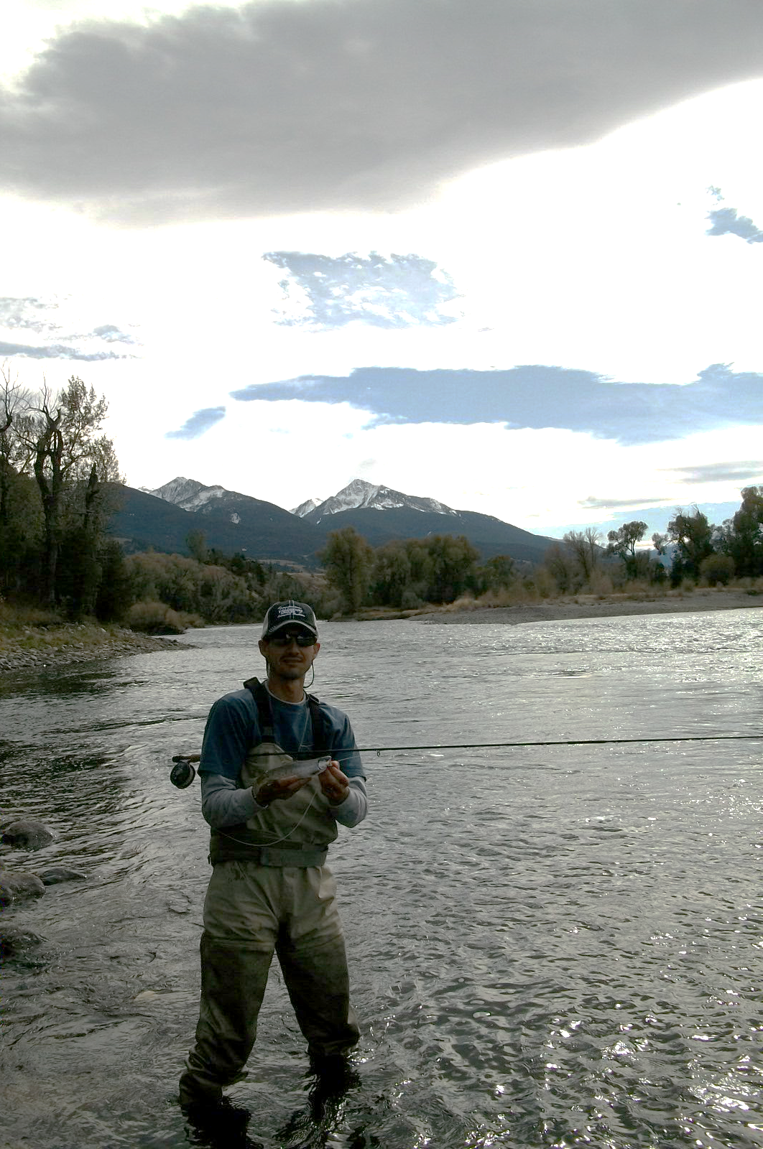
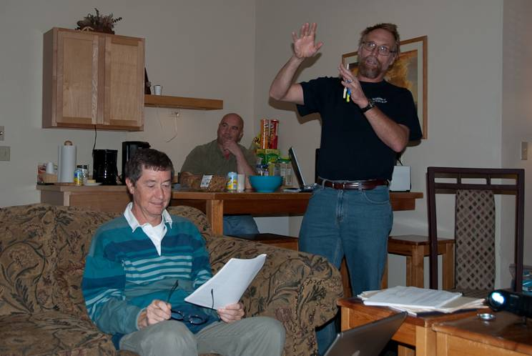
Other Special Projects
Strategic Plan 2005 to 2010
Strategic Plan 2010 to 2015
Strategic Plan 2018 to 2028
www.instreamflowcouncil.org/download/ifc-strategic-plan-2018-2028_final_3-26-18-pdf/

Slide 15
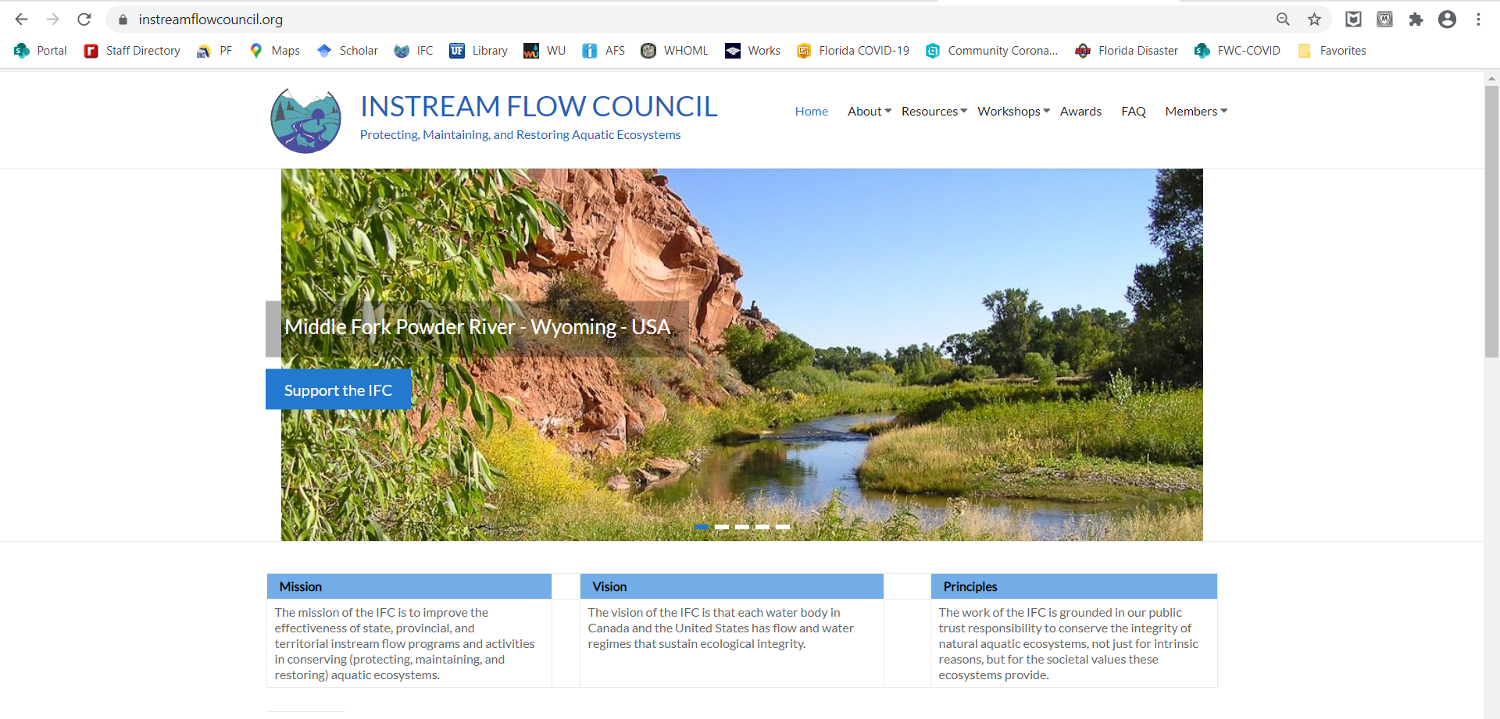
Member Services Examples
Peer Reviews Listserv Members only content

Slide 16
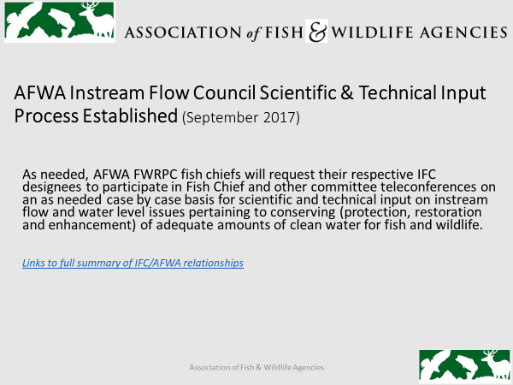
https://www.instreamflowcouncil.org/download/virgilmoore_slides_flow2018-pdf/?wpdmdl=11389&ind=5ccff16ab72bd
https://www.instreamflowcouncil.org/download/virgilmoore_slides_flow2018-pdf/?wpdmdl=11389&ind=5ccff16ab72bd
Notes:
Make sure this link is retained in body of slide so folks can click on it:
https://www.instreamflowcouncil.org/download/virgilmoore_slides_flow2018-pdf/?wpdmdl=11389&ind=5ccff16ab72bd

Slide 17
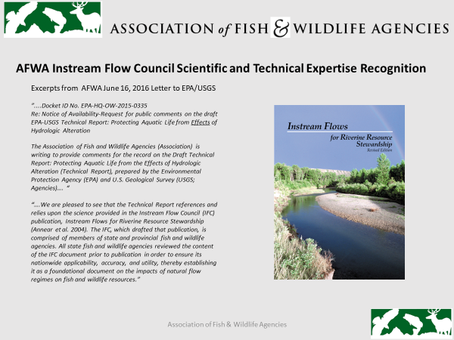
https://www.instreamflowcouncil.org/download/virgilmoore_dialogue_flow2018-pdf/?wpdmdl=11387&ind=5ccff167db4da
Notes:
make sure this is link retained in slide so folks can click on it and save
https://www.instreamflowcouncil.org/download/virgilmoore_dialogue_flow2018-pdf/?wpdmdl=11387&ind=5ccff167db4da

Slide 18
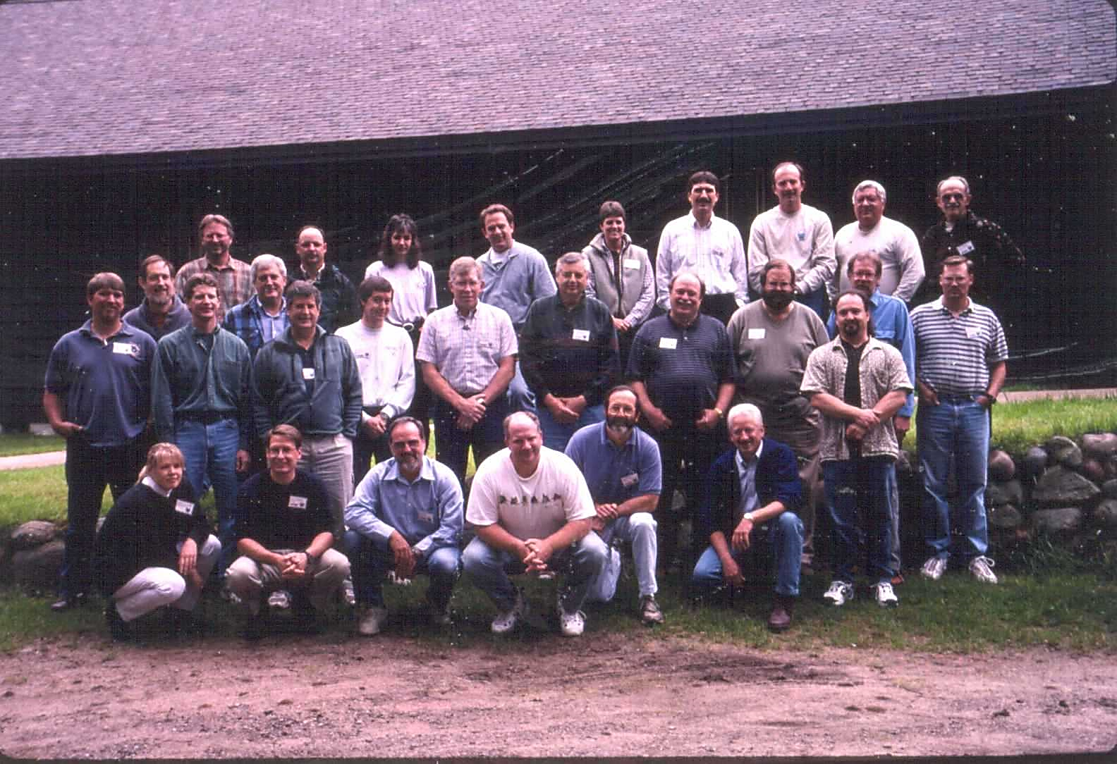
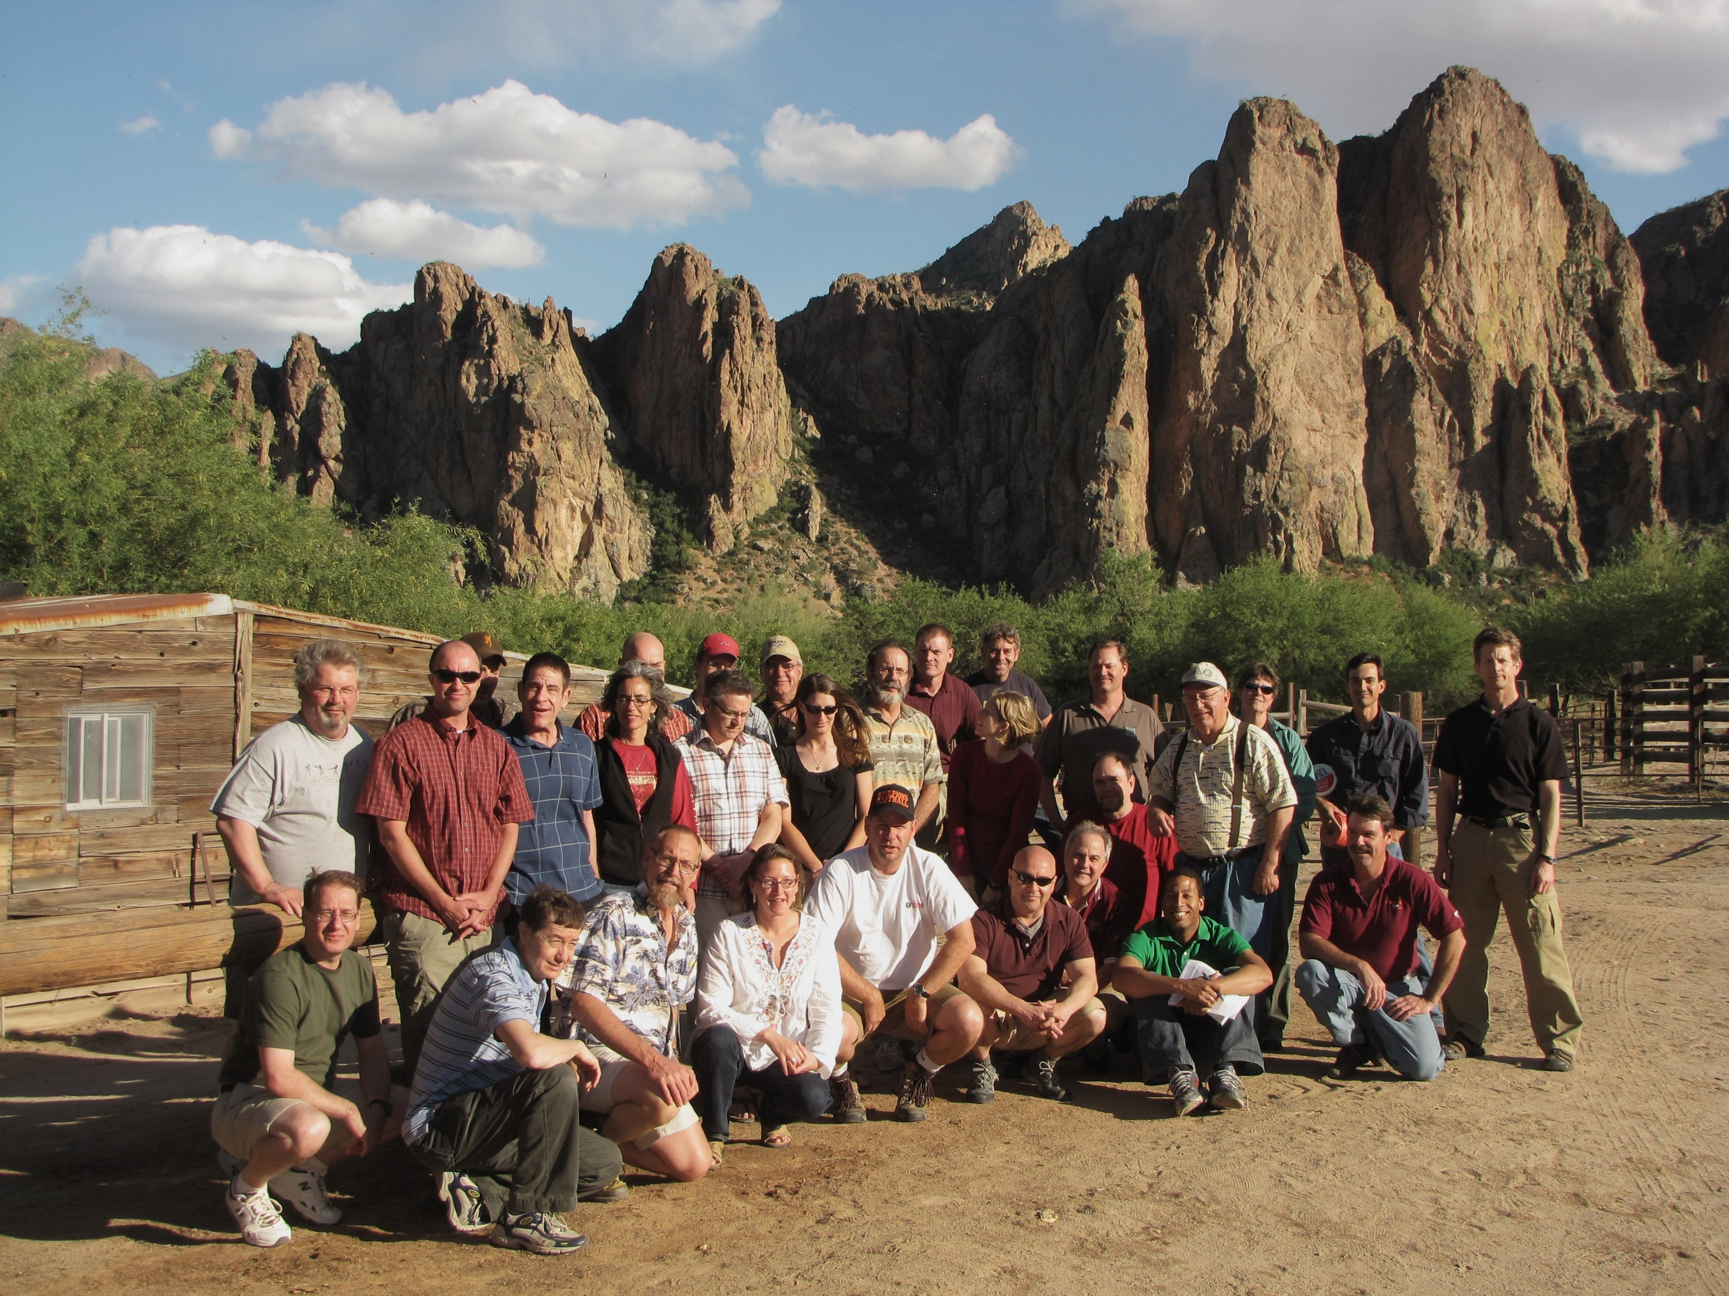
Biennial Meetings
1998 – Denver, CO
2000 – Grayling, MI
2002 – Crossnore, NC
2004 – Minnowbrook, NY
2006 – Vancouver Island, BC
2008 – San Antonio, TX
2010 – Mesa, AZ
2012 – Mahoney State Park, NE
2014 – Key West, FL
2016 – State College, PA
2018 – Fort Collins, CO
2020 – Virtual Business Meeting (Covid-19)
2022 – Columbia, MO Hybrid
Meeting

Slide 19
What Next?
Multi-State Conservation Grant (MSCG) in progress: IFWLC Training Center Project
2022 IFC Biennial Meeting
Regional Meetings (How to Improve next 2 years)
Special IFC Projects: PTD Case History Updates to 1990s Video and Report
FLOW 202X meetings (?)
Conversion of IFC book to electronic & updates
Other ?

