Slide 1
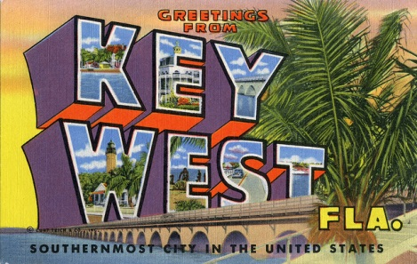
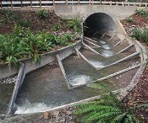
Fish Passage at Dams
Where are we?
Where should we be?
IFC
2014
Science
Economics
Policy
Rod Wentworth, Vermont Fish & Wildlife

Slide 2
IFC Fish Passage Survey Response by Region
Region | # Responses
1 - West | 10
2 - Midwest | 8
3 - Southeast | 11
4 - Northeast | 6
5 - Canada | 7
Total | 42

Slide 3
What kind of dams do you have in your state/province? (all that apply)
n=40

Slide 4
Listed as “Other” dams…
Recreation, fishing, swimming
Old mill dams, ponds
Navigation, locks, low water crossings
Wetland enhancement,
Aquatic invasive species barriers

Slide 5
How important overall is fish passage at dams for the fish resources in your state/province?
n=40

Slide 6
For each type of dam, indicate how you think your state/province is doing in terms of meeting fish passage needs.
Type | Excellent | Good | Fair | Poor | NA | Don’t know
Hydro | 2.5% | 12.5% | 30% | 45% | 7.5% | 2.5%
Flood control | 0% | 2.5% | 17.5% | 65% | 10% | 5%
Water supply | 0% | 5% | 15% | 60% | 7.5% | 12.5%
Irrigation | 0% | 7.5% | 15% | 40% | 30% | 7.5%
Other | 0% | 2.5% | 15% | 22.5% | 40% | 20%

Slide 7
Does your state/province have a policy or guidelines for…
When you require passage
Technical design criteria

Slide 8
Your state/province has provided passage at dams for the following fish: (all that apply)
n=40

Slide 9
Fishes that you have provided passage for at dams
Steelhead, sea-run brown trout, resident trout, Atlantic salmon, landlocked Atlantic salmon, pacific salmonids, bull trout, Yellowstone cutthroat, Bonneville cutthroat, brook trout, Artic grayling, whitefish
American eel, striped bass, channel catfish, lamprey, sturgeon (pallid, shovel nose, others), mountain sucker
American shad, Alabama shad, hickory shad, blueback herring, alewife, gaspereau
Walleye, sauger, northern pike, other coolwater species, leopard darter, Niangua darter, crappie
Nonmigratory resident species benefit, including gizzard shad, yellow perch, walleye, smallmouth bass, stocked and wild trout, cyprinids, catfish. Incidental passage for indigenous species
Attempt to design for a broad range of species. All species passed via rapids below dam or channel around it.
West Indian Manatee (not a fish but important)

Slide 10
What is your single biggest obstacle to securing fish passage where needed?
n=40

Slide 11
So how do we really make decisions?
Got the laws,
Got the policies,
Got the scientific expertise,
And maybe cost isn’t high.
But then there’s
Feasibility
Retrofitting
Prioritizing
Other things

Slide 12
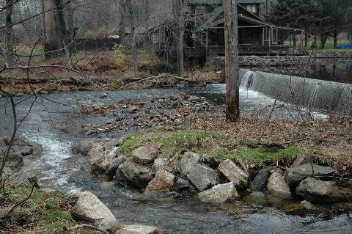
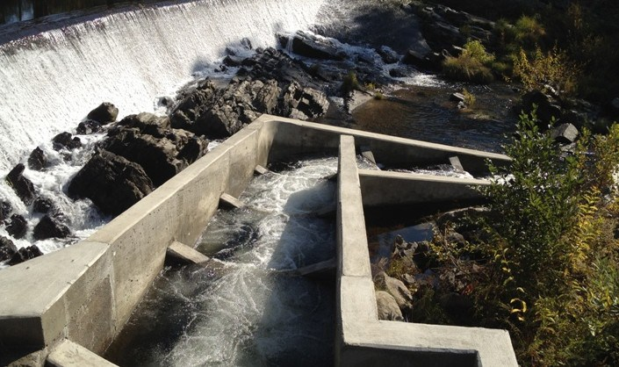
Fish passage at dams…
When is passage needed?
What kind?
Decision making -- the same for
upstream and downstream passage?
What are the considerations:
Aquatic resources?
Economics or cost:benefit?
Politics?
Other?

Slide 13
