Slide 1
Modeling Fort Peck Dam Operations to Simulate Physical and Biological Responses in the Missouri River Downstream
Brian Marotz
Andy Brummond

Slide 2
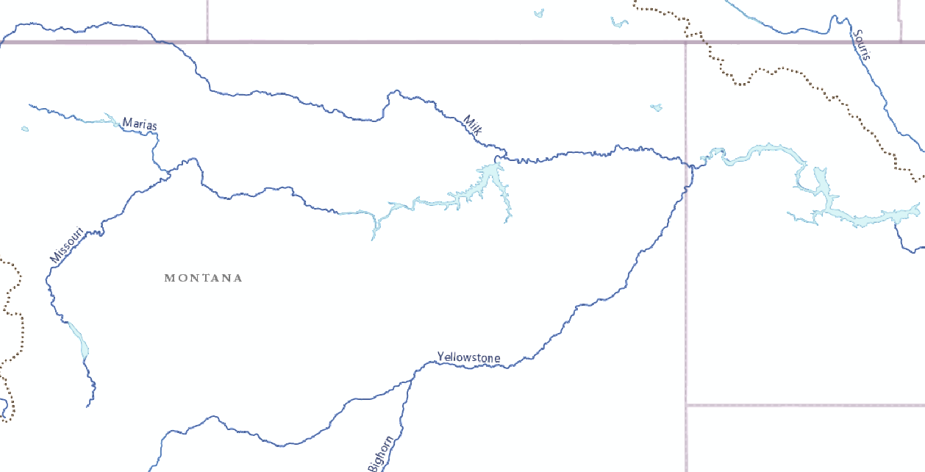
Ft. Peck
Intake
Garrison
Dams on the Missouri, Milk, and Bighorn rivers changed hydrographs and water temperatures.

Slide 3
Issue
Pallid sturgeon (Federally Endangered) have not successfully recruited in the Missouri River below Ft. Peck Dam for many decades.
Hypotheses: Larval pallid sturgeon drift a considerable distance before settling out of the water column. Fort Peck and Garrison dams created reservoir backwaters with predators and low oxygen zones that are unsuitable for young sturgeon; they do not survive.

Slide 4
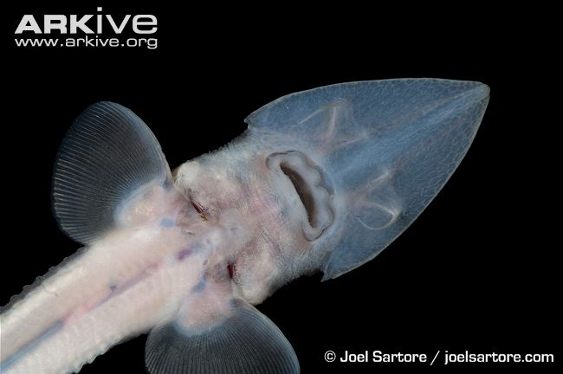
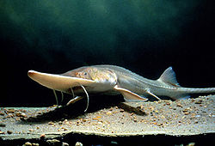
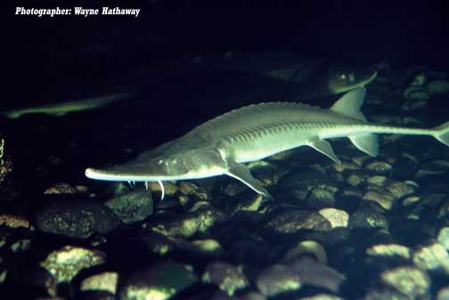
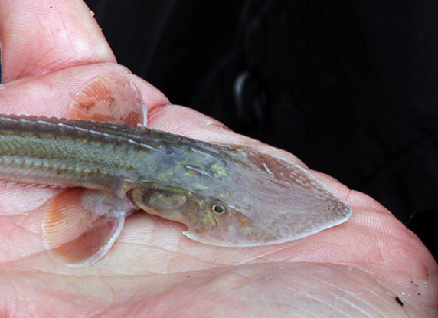
Pallid Sturgeon
Notes:
Pallid sturgeon are listed endangered under ESA.
Almost 50 other native fish species have been impacted by dam construction and operations.

Slide 5
2011
Garrison Dam completed
Fort Peck Dam completed

Slide 6
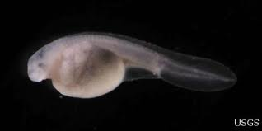
Cold water pollution
Interferes with spawning cues
Delays egg development
Modified hydrograph
Disrupts spawning cues
Increases drift distance of embryos
Habitat Loss
Low oxygen in reservoir transition zones?
Fragmentation
Notes:
Leading hypothesis is that delayed incubation and extended drift distances send embryos into Sakakawea Reservoir.
Recent findings from the head end of Ft Peck indicate low oxygen zone in the transition zone may suffocate embryos. Research continuing to see if low oxygen zones exist in SAK.

Slide 7
Comparison of Aerial Photographs Over Time
Notes:
Allows us to contrast stable and dynamic river reaches. Currently comparing 1980 and 2013 (post flood) aerials.
Side Channels # and total area increased but mean length decreased by 40% and mean area decreased by 63%
Backwater # increased but mean area decreased by 40%
Hypothesis-Quality of these habitats has decreased as evidence by characteristics.

Slide 8
Reservoir Operations Modeling
Notes:
HEC ResSim by Corps.
Excel model of Fort Peck Reservoir.
Reservoir rating curves were updated periodically. Digitized bathymetric maps not available yet.

Slide 9
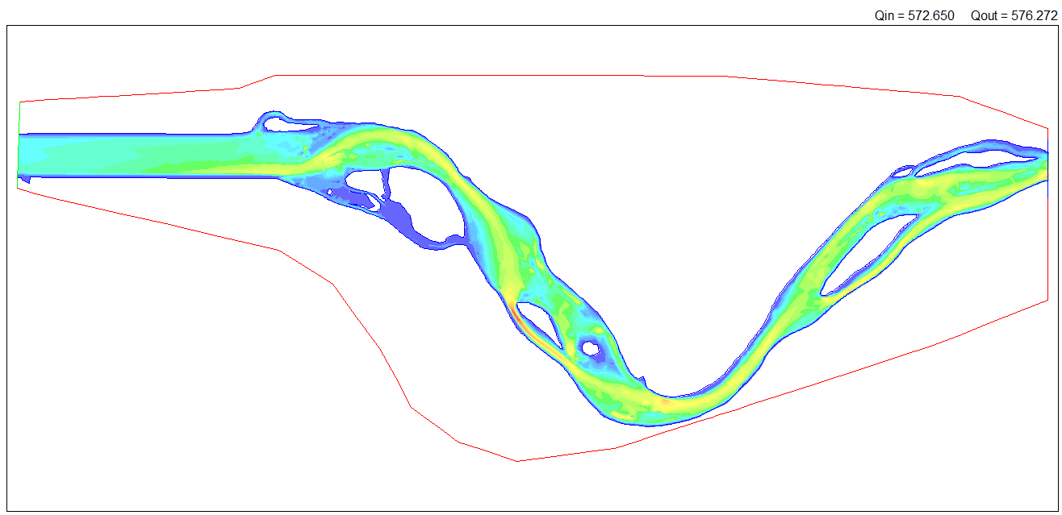
Missouri River Modeling
Notes:
USGS 2D river data are available for two reaches. – no corresponding substrate data
Future River Analyzer - depth, velocity, habitat at various flows of interest.
This data is over 10 years old – valid to use current substrate data? Valid after 2011 flood event?

Slide 10
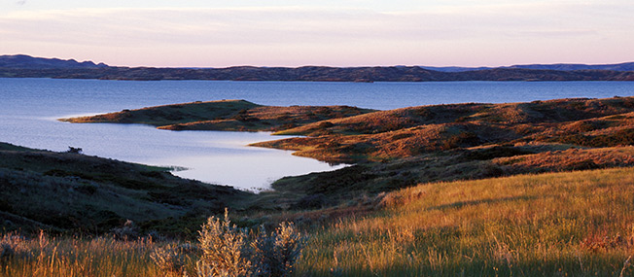
How should we proceed?
Clean Water Act – Can we get traction?
Move forward with analysis of River 2D data?
Adding model layers to existing Corps reservoir and river models.
Notes:
Will EPA defer to state statue regarding exemptions from CWA when it comes to a federal agency?
Is anyone aware of situations where EPA held a federal agency to a higher standard than state-law implementation of the CWA? Exemptions in MT law for water rights and existing dams.
Does an “existing use” (one that existed as of 1976) include pallid sturgeon that were using the river but by 1976 may have already been no longer reproducing?
River 2D- would it help? Do we already know the problem? (i.e. temp and spawning flow?)

