Slide 1
Strategies For Developing Environmental Flow Laws
Notes:
Managing water for environmental purposes is not an easy or simple business. Most state agencies have a long ways to go to better manage water for fisheries but the importance of environmental flow is of growing interest. Environmental flow management is one of the top priorities of the National Fish Habitat Action Plan and will be a focus of state efforts in the future. Regardless, when it comes to managing water for environmental flows, the job is made easier by having a structured plan and process.

Slide 2
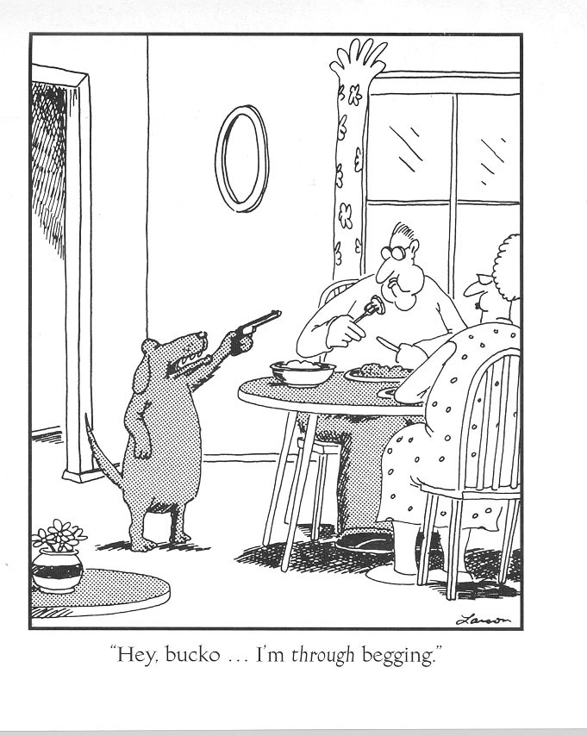
Notes:
When the science, the public, and the law don’t result in the desired solution of some groups (opponents or proponents), there’s always one more strategy.

Slide 3
When it comes to management strategies, water is different . . .
“Water wars” are real – competition for a strictly limited and essential commodity.
For every way you’ve been beaten there’s always one more way you haven’t thought of . . . and it will be used.
Though there are guidelines and protocols for negotiations . . . there are no rules in the trenches.
Notes:
Water is different – it is one of the very few things in life that is essential for life itself. As supply becomes less and demand grows, the stakes grow and strategies change.

Slide 4
Water Management Principles
Everyone is always playing for all the marbles . . . and they’re playing for keeps.
Nice guys always finish last.
When you think something’s going on, there’s something going on.
Compromise is an end point – not a starting point. (Which finger do you want to lose?)
When the world’s out to get you, being paranoid just makes good sense (Johnny Fever, WKRP)
Relationships and trust are a premium – earned over years and lost in an instant.
Notes:
Opponents don’t negotiate if they’ve already go everything they want
Nice guys finish last – don’t give away anything on the hope of gaining favor. Always get something for concessions.
There’s almost always something going on, silence is a sure indicator.
Compromise really is for losers – or people who are willing to give up things they value too early in discussions.

Slide 5
Notes:
This slide isn’t meant to judge one interest over another. Rather it’s a reminder of how important it is to be ever vigilant to preserve and develop relationships with those you work with. Both sides tend to see themselves as the naïve guy on the left.

Slide 6
The Importance of Time & Timing
Write laws for today . . . and the next 100 years.
17 years to get Wyoming’s original statute.
27 years for the next increment and we’re not there yet (temporary change of use).
Prepare for landscape action but be ready for individual opportunities.
Missed opportunities don’t come around again.
Good enough vs. perfection – know when to cut the deal.
Notes:
– change and progress takes time (decadal); be prepared to stay the course (cumulative impacts can happen in reverse – and be beneficial). Missed opportunities may be gone forever.
Don’t settle for good enough as that’ll likely be where you stay.

Slide 7
Basic Strategies To Manage Flow
Federal
Clean Water Act (EPA, TMDL)
Endangered Species Act
Federal Energy Regulatory Commission
Interstate compacts and decrees
Purpose and need for federal reservoirs
State
Laws
Policies
Public Trust Doctrine
Notes:
Most of the federal mechanisms are typically applied to individual projects or sites.
Interstate compacts often apply to annual volumes not instantaneous flow rates.
Only state laws can apply equally to the entire state.

Slide 8
Wyoming History
Application submitted in 1969
Denied in 1972
No quantitative basis to support the request
No diversion or storage
No way to test for abandon-ability
A right of this nature would be of such value that it should be vested in the state
Notes:
The very first instream flow filing was made by a group of private individuals and organizations for 200 cfs on a section of the Green River near Pinedale. This very thorough and detailed application was rejected by then-State Engineer Floyd Bishop because 1) the application didn’t provide a scientific basis for the quantity of water they sought, 2) there was no diversion or storage provided and it was thought at the time that such features were legal requirements of a water right, and 3) the belief that an instream flow right would be a very important one that should be held by the state in trust for the public.
In brief, the denial was based on all 3 features of instream flow – science (lack of it), law (abandonability) and public involvement (state ownership).

Slide 9
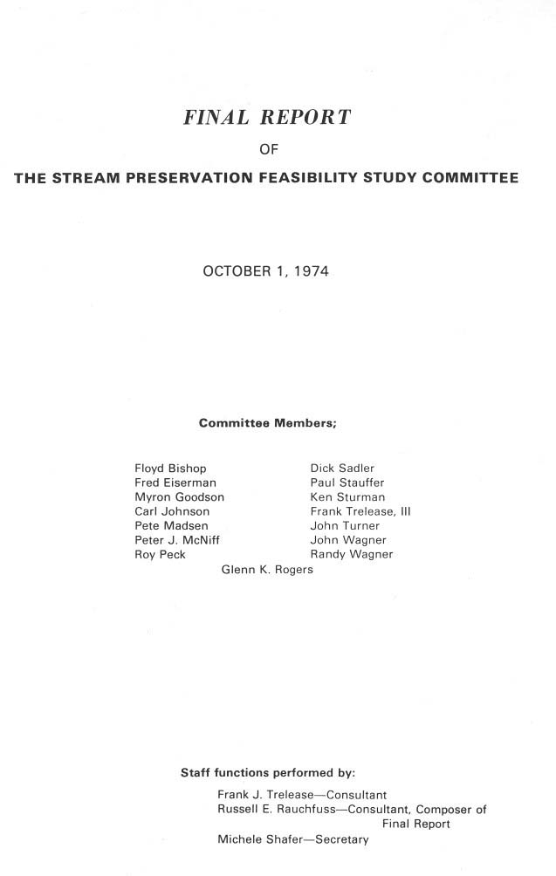

Slide 10
Wyoming History
First application submitted in 1969
Denied by State Engineer in 1972
17 failed laws from 1974 to 1985
Successful voter initiative led to . . .
Successful legislation in 1986
100th instream flow filing in 2006
Notes:
Wyoming has a long history of applying instream flows in streams for fisheries. Though there are some minor aspects of the law that are still be explored, the history is long enough that we have a pretty good idea of the impact such a provision has had or might have.
The very first instream flow filing was made by a group of private individuals and organizations for 200 cfs on a section of the Green River near Pinedale.
In brief, the denial was based on all 3 features of instream flow – lack of 1) science, 2) law, and 3) public involvement.
With a public referendum looming in 1986, the legislature finally passed the instream flow law we operate under today.
That law has remained basically unchanged and we have now filed for over 100 instream flow water rights, mostly on public land; all with current day priorities.

Slide 11
Since 1986
Water is being used to protect habitat in 130 stream segments (<3% of all stream miles)
Helped the state permit new dams
Helped keep 4 native cutthroat species from being listed as T&E
Notes:
For all the things that folks feared might happen, we’ve done a lot of things that truly did service the public interest – that we couldn’t have done if we hadn’t had the legal ability to file for and secure environmental flows.
You don’t have to have dams to provide most instream flows but if you don’t have a way to protect instream flow releases from dams as part of mitigation (preferably with a state legal mechanism), you won’t build many new dams.
Instream flows have proven an effective way of protecting habitat for important fishes in quite a few important recreational streams.
Filing state-owned instream flow rights on streams with native cutthroat trout have been a very effective way of proving the state’s commitment to maintaining and restoring species that might otherwise become listed as threatened or endangered. Had these species been listed, the state would have lost primacy over management of not only the fish, but water and land management practices in adjoining watersheds to the federal government.
We used a state administered instream flow to secure water for a wild and scenic river and avoided expensive court battles over the possible application of a federal reserved water right to do the same thing.
Though most filings are on public land, several private landowners have asked us to file instream flow rights through their property as a way to enhance their property values. We have complied with most of those requests but only do that upon a formal written request.

Slide 12
What Hasn’t Happened?
No injury has been documented
No call for regulation of an instream flow right
No one’s lost a water right to the government
No dams built just to provide an instream flow
No compacts or decrees have been affected
Notes:
Wyoming is no different than almost every other western state in terms of the impact of instream flows – or lack of impact. Briefly, instream flow opportunities have not been a negative issue in any state where they are recognized in the West.
There’s never been a call for regulation of an instream flow, but we have that authority. It’s just that most segments are not affected by existing diversions or water rights, and vice versa
Nobody has lost a water right, or will they. The state is much more interested in protecting fisheries than they are in grabbing someone else’s legal water right.
There hasn’t been one dam built solely for the purpose of providing an instream flow. Our goal has been to protect existing flows without flooding out more stream miles. We want to maintain rivers, not destroy them.
There’s been no injury or valid claim of injury associated with an instream flow water right. We haven’t changed water use patterns in state or out of state.
Principle of prior appropriation guarantees that can never happen.
For all the fear and suspicion about this “different” use, the reality is that instream flows really don’t change things very much. That’s just what we want to see happen . . . or not.

Slide 13
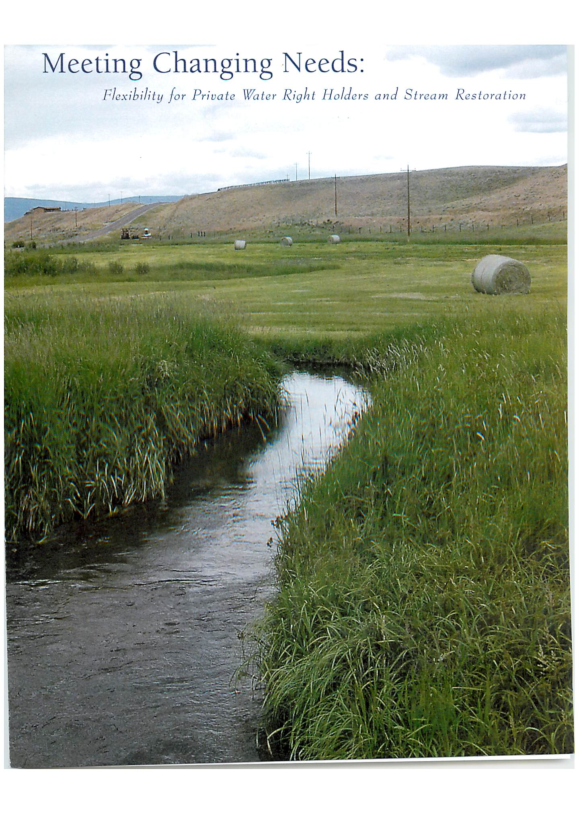
Temporary change of use legislation

Slide 14
Strategies to minimize the need for or value of instream flow
Notes:
And knowing how to deal with them.
Instream flow is still not a simple subject so it’s important to really understand the fine print that goes with some of the terms associated with this discipline.

Slide 15
Primary Elements
Fear
Change
Uncertainty
Complicated

Slide 16
Know baloney when you see it (the 2 second rule)
Notes:
When you’re advocating for instream flow, it seems you hear a lot of arguments against the idea but can’t always put your finger on what’s wrong until later. But it’s important to call baloney right away or you’ll spend the next decade beating down those wrong notions.

Slide 17
A few examples of baloney (and some possible answers)
We can put this off a while (we’ve already waited 100 yrs too long)
It’s gonna cost too much money (but less than developing water for anything else)
Fish don’t need that much water (may I see your data on that?)
This is a government plot to take water and land from private landowners (name one other state where you’ve seen this happen?)
An environmental agenda that impacts private property rights (over-emphasis on private property rights is what got us into this situation)
Federal mechanisms are the way to protect rivers (what don’t you like about state’s rights over water?)
They’re only important to a few people (please check the results of national surveys that show the number of people who value healthy rivers and lakes).
Notes:
This is just a partial list of the kinds of things people worry about that sound serious but really are just off the mark – sometimes more than a little.

Slide 18
Some more baloney
They’re OK, but we might need water for something else in the future. (instream flow is a use of water that’s needed today)
You’ve gotta have dams to have instream flow. (we’ve had instream flow for centuries without ‘em)
They’re dam killers. (actually you don’t build dams today unless instream flow is in the equation)
They’re an unneeded layer of government regulation. (these are permits or rights – not regulations)
There isn’t enough public input, the process is too secret (call me any time for info or go on line & check out our strategic plan)
Notes:
This is just a partial list of the kinds of things people worry about that sound serious but really are just off the mark – sometimes more than a little.

Slide 19
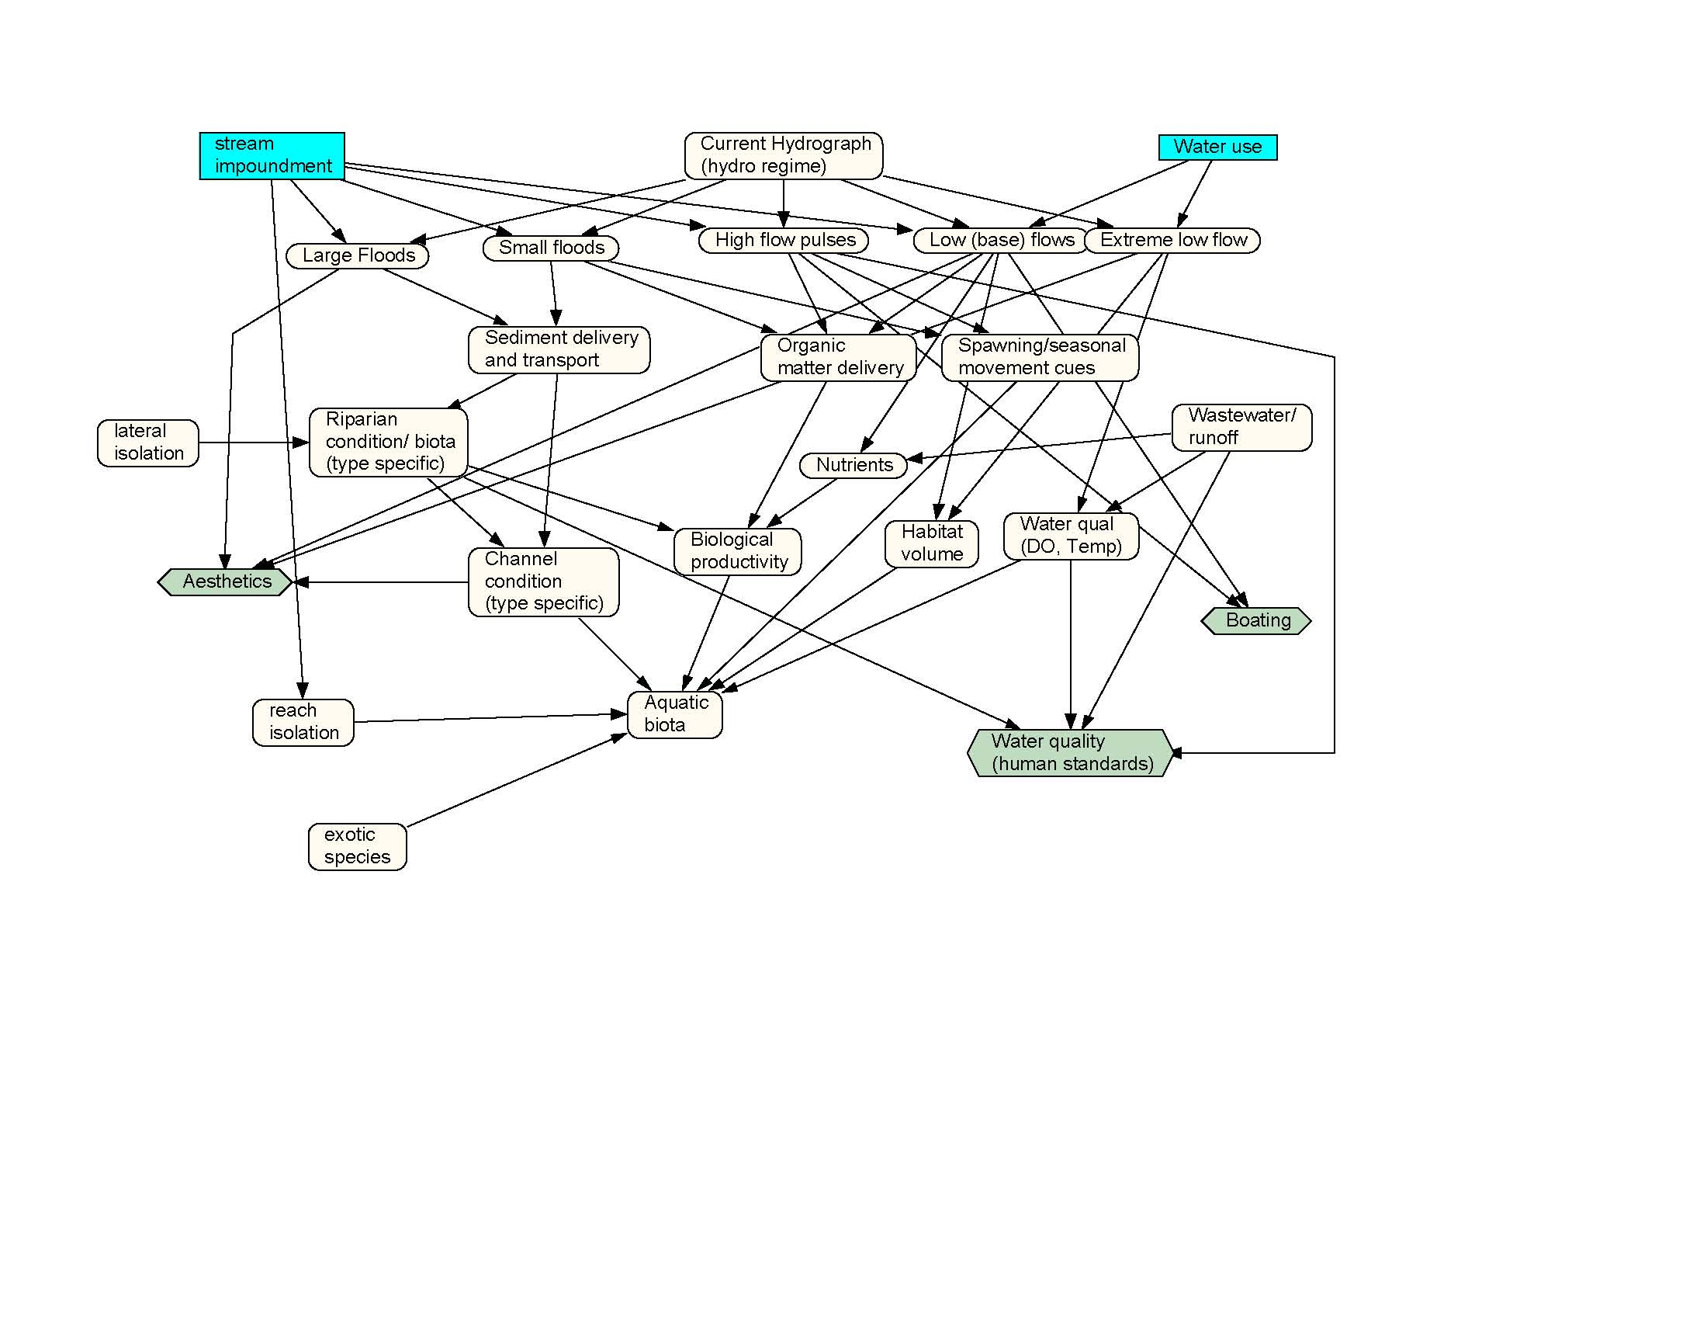
We need more data before deciding
Notes:
Asking for more data is always a winning strategy if instream flow opponents can get scientists to go along – because you can never have enough. Unfortunately, scientists being scientists like to fall for this suggestion in part because they like doing science and in part because they don’t have to decide anything.

Slide 20
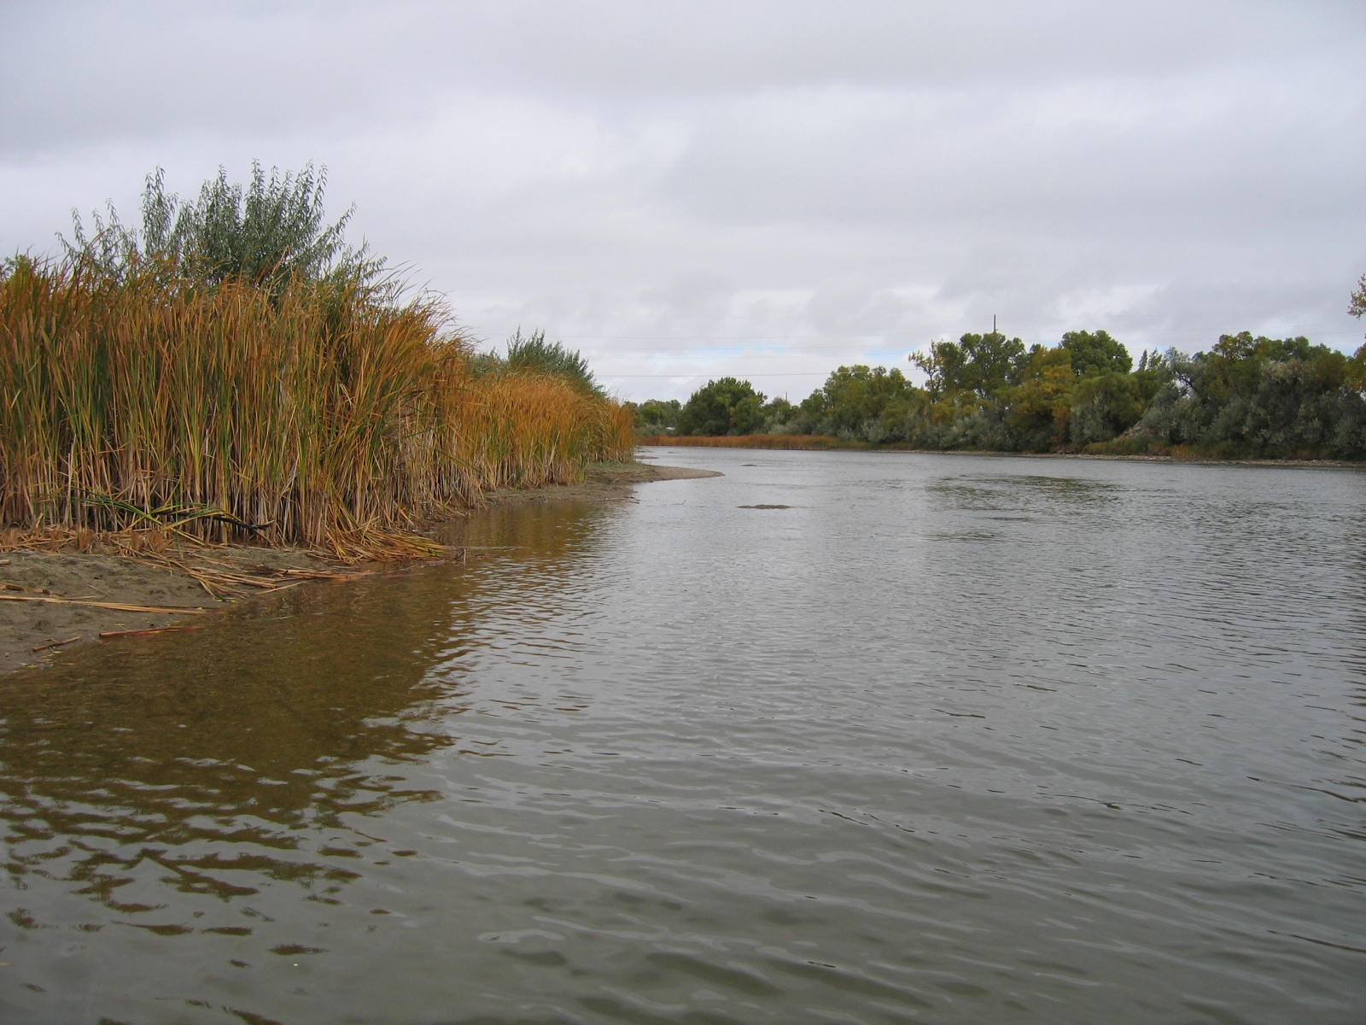
Saaay, you look different!
Notes:
One way to minimize the value of water for environmental flow is to characterize this use as fundamentally different than what we’re used to. When something can be shown to be radically different from the norm, it’s much easier to minimize it’s importance. The fact is, water has been used for environmental purposes for much longer than we’ve used it for commercial purposes. We just didn’t need laws to protect those uses until now.

Slide 21
Fear of the unknown (change)
As much as we value certainty and control, we really don’t like uncertainty about how things like flow management work.
Notes:
As much as we value certainty, we really don’t like uncertainty about how things (flow management) work. The fact is, we know very well how important water is to maintaining ecosystem services and playing the uncertainty card is simply a stalling tactic

Slide 22
People are more important than fish?

Slide 23
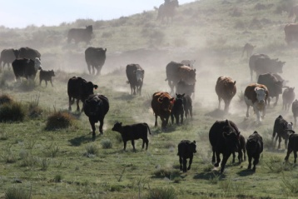
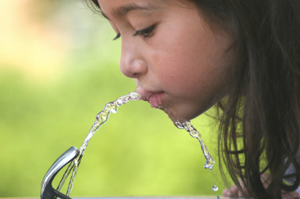
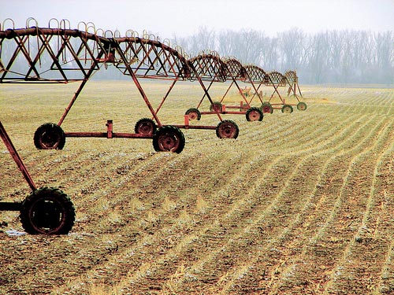
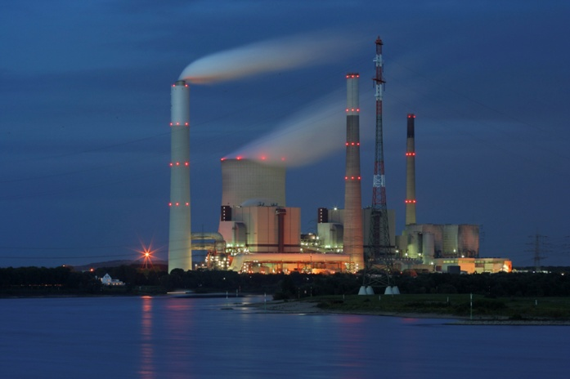
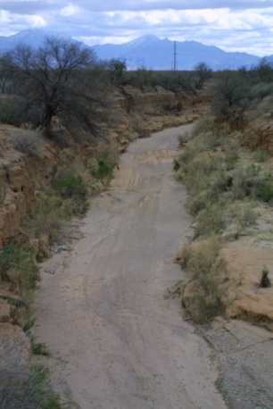
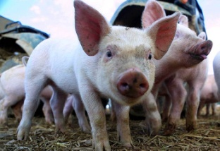
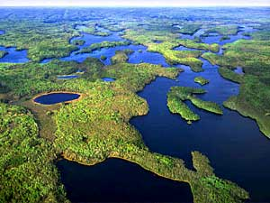
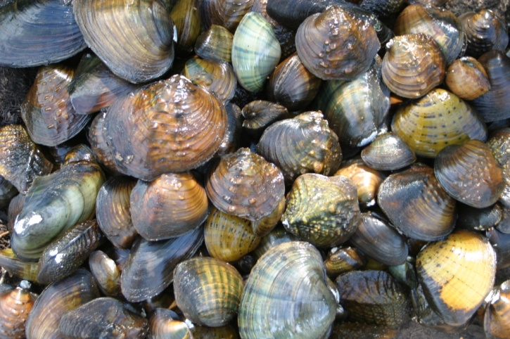
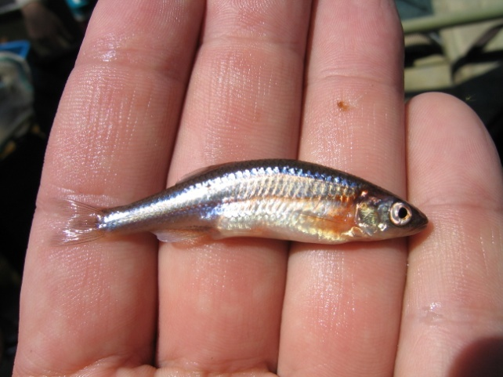
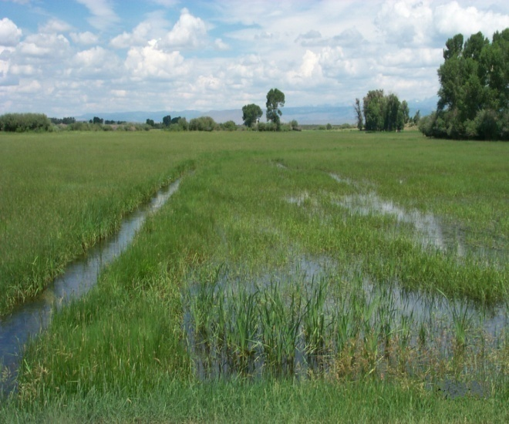
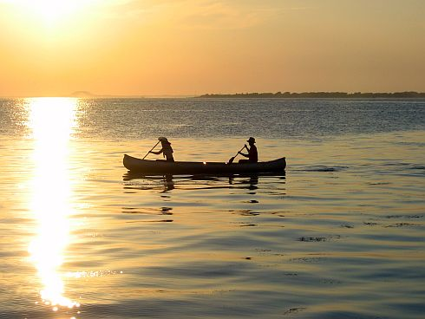
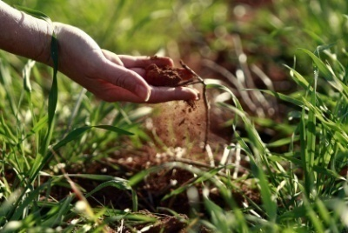
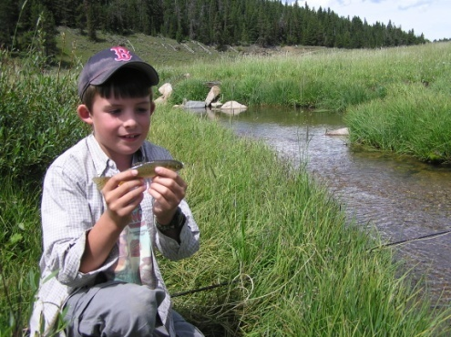
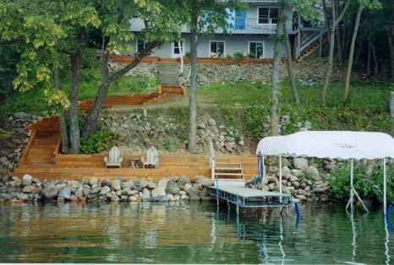
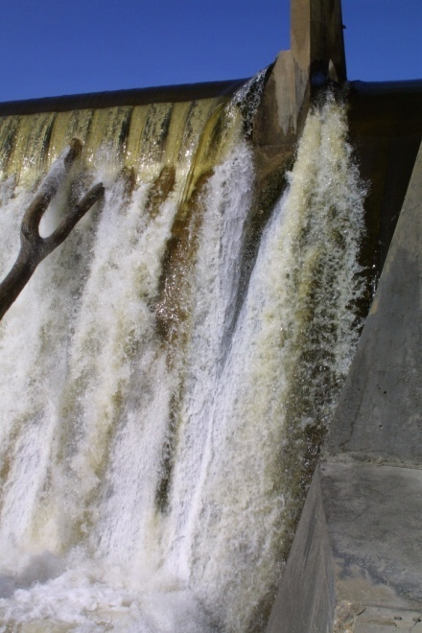
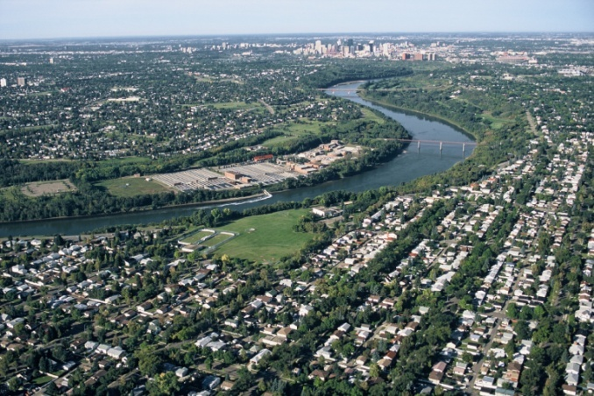
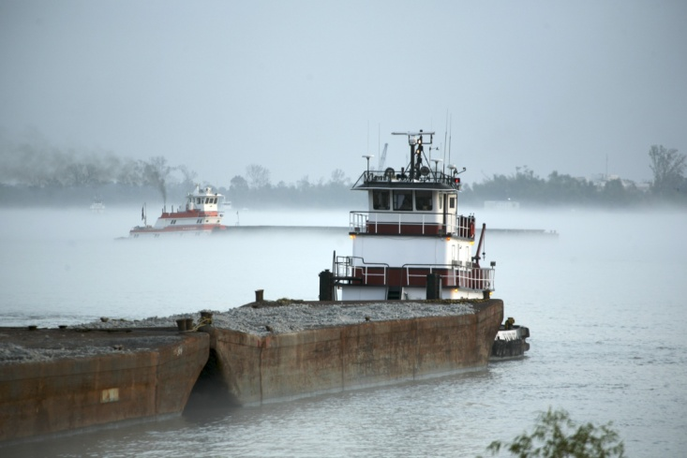
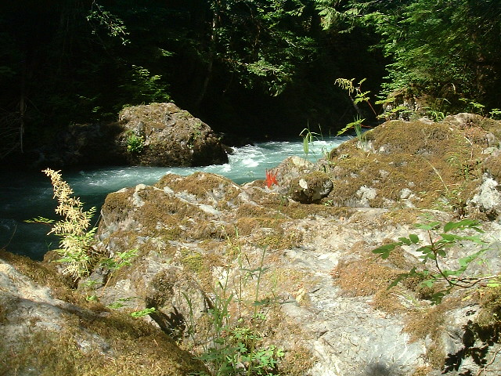
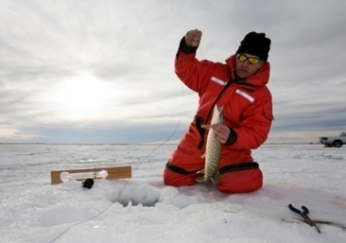
Instream flow is just one of many things people use water for
Notes:
There are 54 such uses that benefit all sectors of society that are recognized by the SEO. Using water to protect fisheries in streams is just one of those that is now recognized by priority just like every other kind of water right.
Instream flow is a use. Water gets used over and over and is then available for other uses.
There are 150 years of water rights ahead of instream flow. It’s not

Slide 24
Remain Vigilant
Wyoming
Alberta
Minnesota
California
Oregon
Alaska
Notes:
Each of these states and provinces has seemingly effective instream flow legislation and institutional capacity. However each has also seen their programs threatened or limited by pro-development interests within the past decade. So just because you get effective environmental flow legislation doesn’t mean the job is done. (WY – Less and Tracy, Lincoln Co; AB – tar sands; MN – in-house; CA – elim ISF program); OR – didn’t fund program; AK – challenges to law that took 20 yrs to get in place). All in seemingly strong states.

Slide 25
Basic Strategy
Identify outcomes – what do you want rivers to look like in the future?
Develop measurable outputs that lead to outcomes
Establish appropriate activities to achieve outputs
Strategic plans
Design and implement studies
Involve the public or at least key partners/sister agencies
Provide adequate resources (inputs)
Staff (should be full-time, dedicated to ISF)
Budgets
Training
Equipment
Notes:
To be truly effective when it comes to managing riverine resources, it’s important to decide what you want your streams to look like and how you want them to function. Once you’ve got a vision of the outcomes you want to achieve, then you need to assess the resources, or inputs, at your disposal to achieve that goal. These can include things like recognizing water management needs in fishery management planning documents, developing staff, providing them a budget for training and performing their duties. This can also include lining up partners and securing public support. You’ll also need to decide what activities of the many possible things out there where you want to spend your time. Lastly, you’ll need to develop measurable outputs to gage your success and help determine when you’ve achieved the level of protection or restoration you’ve set out as a goal.
This is not an easy business but there’s a better chance of restoring or protecting environmental flows if you have a plan and know what you’re up against than if you just charge off like every other state and provincial fish and wildlife agency has done over the past century.

Slide 26
Dealing with the public
Simplify problems and solutions.
Use concrete images (minimize words).
Identify real things, local needs and stories.
Use action words that stimulate senses, feelings.
A message for everyone is a message for no one.
There is no general public.
Who takes the lead on this?

Slide 27
The Power of One (Champions and Assassins)
Patience
Persistence
Professionalism
Notes:
For all its complexity, instream flow progress and failures often come down to the role of individuals or groups. One person or group can advance instream flow a long ways. Conversely, it only takes one person or group to bring down instream flow progress too. Patience can mean waiting decades. Persistence means more than one letter or phone call. Professionalism means knowing your points, not backing down, and doing business with a smile.

Slide 28
Conclusions
Science is necessary and important but seldom compelling by itself
The law is important but can be limiting
Institutional processes are needed
Effective public involvement drives the system

Slide 29
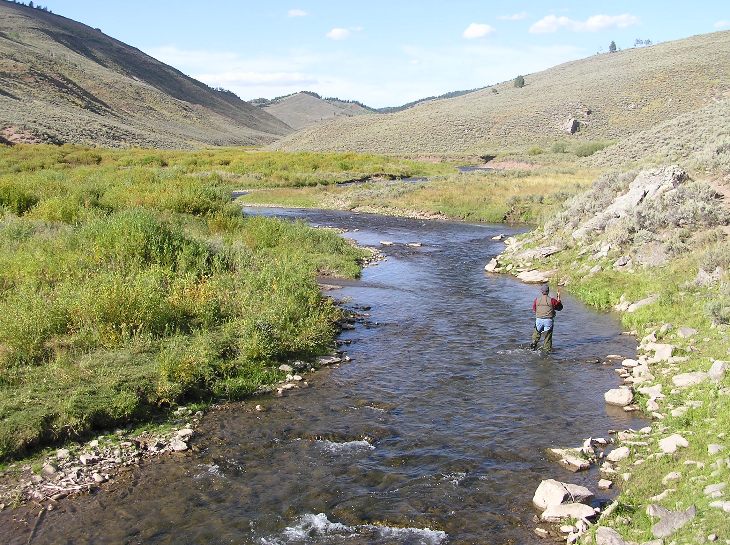
Notes:
Even the ugliest baby that you my not feel very close to now, can grow to be a responsible, contributing individual that you’re proud of if he’s provided effective rules and support. That’s the challenge with instream flow – to provide firm guidance and the opportunity to maximize the beneficial uses of water for the state’s citizens.

Slide 30
So What?
Did your understanding or opinion(s) change?
What messages resonated?
What challenges seem bigger (or smaller)?
What are the most important things to work on?
What are you going to do tomorrow?
Notes:
What challenges seem bigger (or smaller) – Legal? Institutional? Science? Public?

