Slide 1
Developing Laws and Policies
If future generations are to remember us with gratitude rather than contempt, we must leave them more than the miracles of technology. We must leave them a glimpse of the world as it was in the beginning, not just after we got through with it.
President Lyndon B. Johnson upon signing the Wilderness Act in 1964.
Notes:
Writing laws is a considerable challenge. We must provide opportunity for societal benefit on several levels – both economic and environmental.

Slide 2
Outline
Status of legal opportunities in other states
Institutional capacity
Words and definitions matter
Characteristics and contents of good laws (ownership, level of protection, process,
Examples of legislation

Slide 3
Water laws are written to provide certainty and control
Weather variability patterns, water availability and changing human values and needs complicate things
Notes:
Certainty and control are at the root of all disagreements over water. Everybody wants the maximum but there’s only so much to go around.
Uncertainty is a huge driver in water negotiations and change is never a welcome player.

Slide 4
Good laws and protection?
 | Portion of miles of streams in unaltered condition | Portion of miles with no flow protection
Alberta | 26% - 75% | 26% - 75%
Minnesota | 6% - 25% | 76% - 100%
Wyoming | 6% - 25% | 76% - 100%
Washington | 6% - 25% | 76% - 100%
Notes:
Even in states with reasonably good laws, instream flow management has a tough time. Good laws don’t always make for good flow protection when most of the flow in rivers (and volumes in lakes) has already been removed.

Slide 5
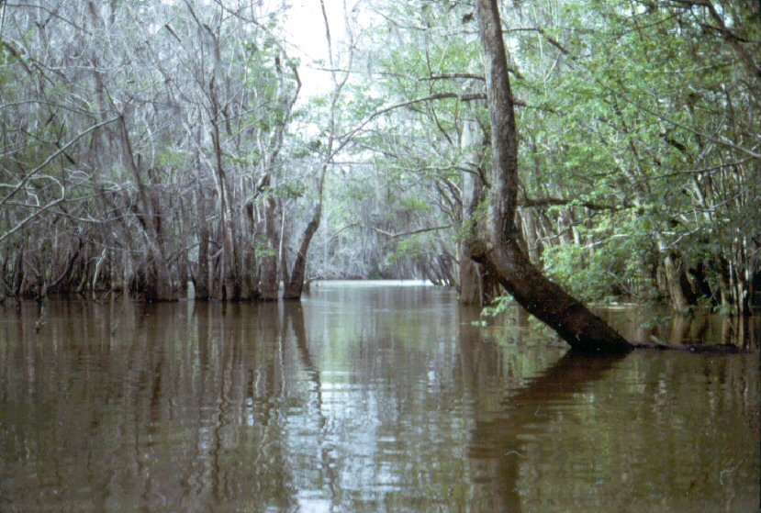
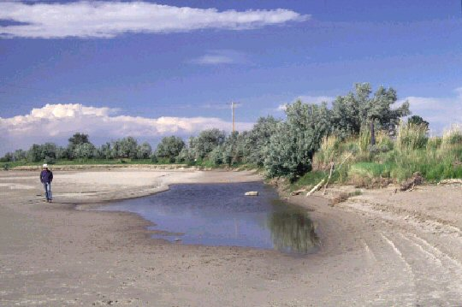
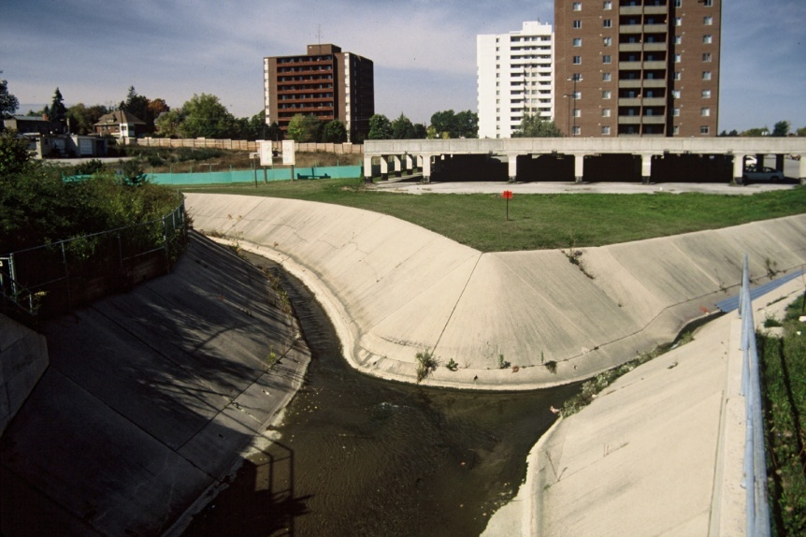
Goals: Protection vs. Restoration
Notes:
Bear in mind that laws need to address at least two aspects of instream flow management – protection and restoration. Unfortunately we’re getting a bit of a late start.

Slide 6
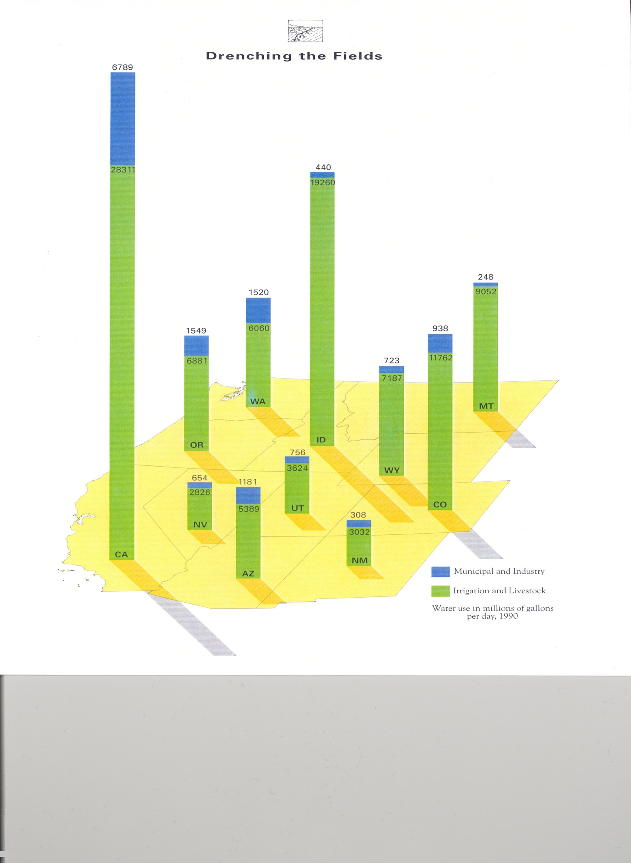
Notes:
The western U.S. provides an example of how far behind we are in terms of other uses already having full recognition and protection. Over 90% of all permitted uses of water are for out of channel uses such as irrigation and industrial. In spite of this daunting challenge, we must simply start where we are and protect what’s left and restore where we can.

Slide 7
Program inputs
Notes:
In virtually every state, the most needed tools to help manage environmental flow was more supportive regulations and policies, water management staff to implement those policies, more actively supportive public and better laws.
Most states think their staff is able to recognize needs, they just don’t have a vehicle to act on their knowledge.

Slide 8
Expectations for laws and public involvement

Slide 9
Expectations for flows and reservoir condition

Slide 10
Water Right Doctrines
Notes:
There are 3 primary water allocation doctrines in the U.S. and Canada. Riparianism (sharing), Allocation (first in time is first in right), and Regulated Riparianism that’s intended to borrow from both existing doctrines.

Slide 11
Regulated Riparianism
Combines elements of riparian doctrine with appropriation doctrine (e.g. priority dates)
Favors development interests who want to lock in guaranteed amounts of water (certainty and control).
Not much value to existing users.
Mechanism to take more water out of streams.
Uncertain how this doctrine could work for e-flows.

Slide 12
Institutional Structure

Slide 13
Key terms
Fish vs. fishery
Allow vs. require
Protect vs. restore
Feasible vs. available
Studies vs. assessments
Flow/volume vs. regime
Notes:
There are several key terms that need to be defined or otherwise addressed to remove any uncertainty about the scope of legislation.

Slide 14
Key components
Same status and process as all other water uses?
Who can hold or own the permit or water right?
What agencies are involved (does the same agency quantify flow needs that issues the permit)?
What resources exist or will be provided for staffing, funding, training, field studies?
Will flow quantification methods be limited or allow use of any methods?
What frequency of availability is needed, if any?

Slide 15
More key components
What about requirements for monitoring (and metering), enforcement, and penalties?
Allow flows for fish vs. all aquatic organisms vs. habitat vs. other values (wildlife, riparian vegetation, water quality, recreation, esthetics)?
Will protections have senior or junior priority status?
Permanent vs. temporary opportunities . . . or both?
What about conservation incentives?
What role / opportunity exists for public input?

Slide 16
Level of Stream Flow Protection
Full flow protection
No allowances for additional withdrawals or manipulations. Hands-off strategy.
Comprehensive ecologically based
Protection based on all 5 riverine components, varies seasonally and between years.
Partial ecologically based
Protection based on one or more of 5 riverine components
Threshold protection
Baseline protection that is less than the average natural flow remaining in the channel
Notes:
Protection is not protection. You need to clearly specify the level of protection opportunities allowed under specific conditions.

Slide 17
Effort needed for protection
Notes:
It helps to see that the less protection provided, the more effort is needed to ensure protection.

Slide 18
Water management options
Flow protection for a point vs. segment vs. system vs. regional vs. state-wide
Individual studies vs. regional or statewide thresholds
Water level / storage volume in standing waters
Notes:
When crafting laws to enable environmental uses of water, there are several aspects to consider that relate to both flowing and standing waters.

Slide 19
Lake and reservoir level protection
Distinguish between natural lakes and reservoirs?
Protect any amount of storage in reservoirs?
Protect only minimum pools in reservoirs?
Protect any amount of water up to full level in natural lakes?
Balance volumes in lakes with flows in streams?
Emulate natural fluctuations?

Slide 20
Wyoming’s Instream Flow Law
Instream flow is a beneficial use of water
Instream flow rights are junior rights
Cannot obtain by filing abandonment
Can acquire existing rights & convert to instream flow
Available for other uses when water leaves a segment
No conservation incentive
Notes:
In spite of all the debate about what instream flows do or don’t do, the reality is that the law addresses a simple problem. The law, in its first few lines, establishes that water left in the stream channel for fisheries is a beneficial use of water. The bulk of the rest of the law deals almost entirely with matters of process – most of which are already addressed in other areas of state water law.
But most of all instream flow is just a water right – not another layer of government regulation.

Slide 21
Wyoming’s Instream Flow Law
Only the State can own an ISF right
Can come from direct flow or storage
Public hearing is required (paid by WGF)
Water is available after leaving ISF segment
Purpose = “minimum amount necessary to maintain or improve the existing fishery”
Notes:
Our instream flow law deals mostly with matters of process and detail in addition to specifying that instream flow is a beneficial use. While the law does sort of address the matter of stream restoration (putting water back in the stream), it’s mostly about protecting what’s left.

Slide 22
Minimum flow
No more than models show is needed to provide the desired level of fishery management? Or
The least amount of water needed to keep fish alive?
This is a biological standard – not hydrological

Slide 23
Maintain or Improve
No guidance on how much “improvement” is allowed. Seems very empowering and enabling. Or
Just a base level flow that doesn’t really offer more than the lowest levels of recorded flow.

Slide 24
Existing Fishery
An existing fishery is technically a dynamic metric. Fish populations are by their very nature in a kind of dynamic equilibrium over time – so the “existing” fishery relates to the dynamic maxima and minima in normal density levels. OR
The number of fish found in the stream right now, regardless of where the normal cycle is?

Slide 25
Existing Fishery
The accepted scientific definition of a fishery is the community of organisms, their habitat, and human users. Or
Does this relate to just persistence of fish?

Slide 26
Legislative Intent
Beware of the stuff that lies between the lines in printed statutes.
Notes:
The take home message with these interpretations is that regulators tend to fall back on implied intent (that not everyone else is aware of). This is why it’s so important to get as much clarification in print as possible.

Slide 27
The Process in Wyoming
WGF water plan guides stream selection
WGF conducts studies
WWDC files application
WWDC conducts feasibility study
SEO holds public hearing
SEO issues permit decision
Board of Control adjudicates water rights
Notes:
The process begins with a plan – WGF has had a guiding document since 1994 and posted them on our website so no reason for anyone to say they don’t know what we’re up to.
The entire process can take anywhere from 5 to 27 years or more to complete all these steps and cost all agencies involved between $30,000 and $50,000 or more.

Slide 28
There are at least 49 other ways to develop an instream flow (and lake volume) program

