Slide 1
Understanding Instream Flow
Terms and Concepts
Methods
IIFPI
Laws
Strategies
Tom Annear
Wyoming Game and Fish Department
Notes:
Over the course of my career I’ve come to learn that, among other things, everyone thinks their own definition of instream flow is the right one. But the fact is that there’s a wide range of ideas for just what instream flow means.
This talk is not a talk of protection or preservation. Rather it is an effort to look at what we mean – or think we mean – when we use the words “instream flow” as well as how we value the many services of water and offer some ideas for managing water resources in the future.
Much of the material in this presentation is from the Instream Flow Council

Slide 2
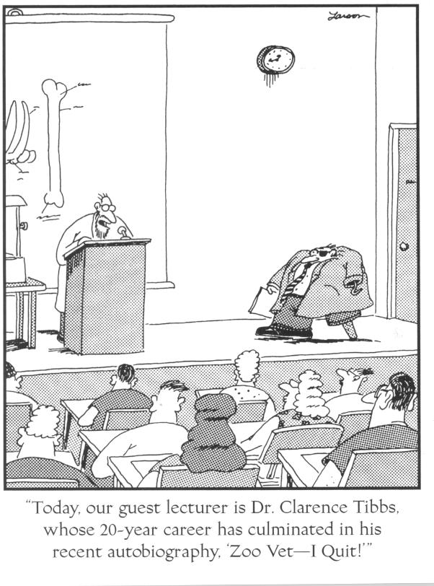
Notes:
Instream flow is an interesting and difficult field to work in. Everyone who’s worked with water very long can probably identify with Dr. Tibbs. But he didn’t last very long. Often times a long career is needed to be more effective.

Slide 3
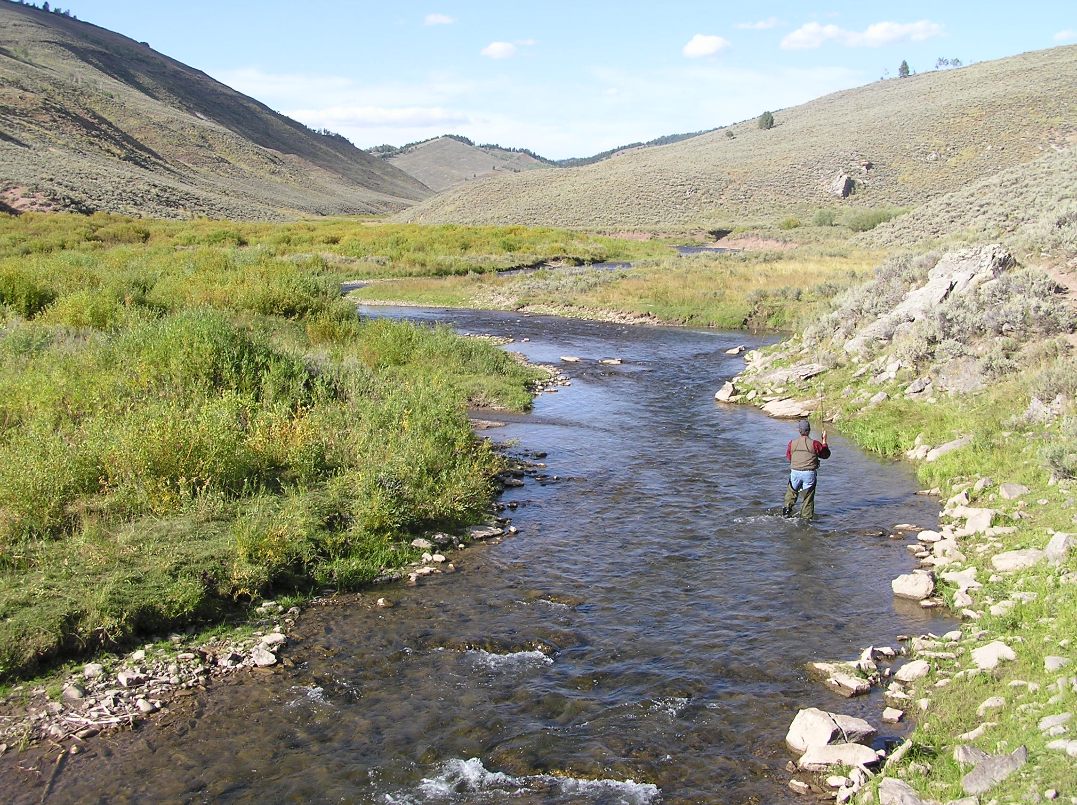
Notes:
Instream flow has a lot in common with puppy dogs and cute babies. How can you not like it? But the reality is that some people just don’t like cute babies . . . Or instream flow.

Slide 4
Notes:
We start with the big picture, and things we already know. In spite of the seeming abundance of water on the planet, we must deal with a strictly limited resource of which there will never be any more. Water management isn’t an issue of “more”. It’s a matter of managing and sharing the limited resource we have to do all the things we demand of it.

Slide 5
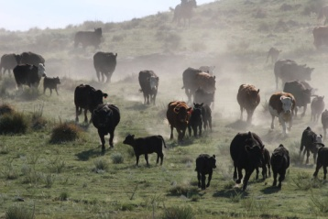
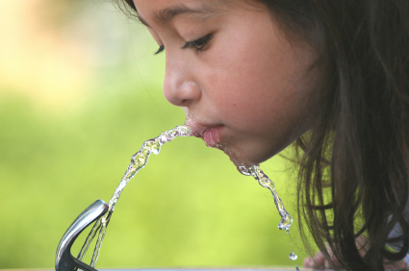
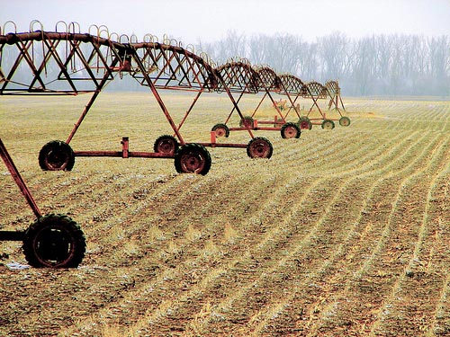
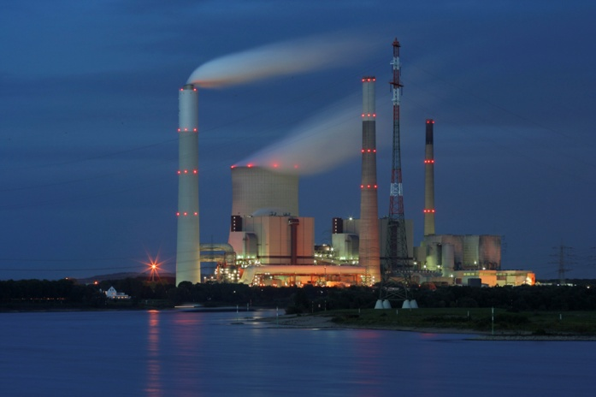
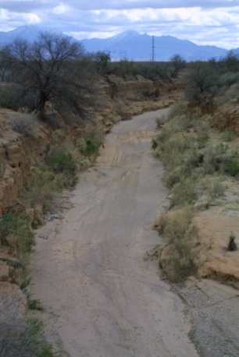
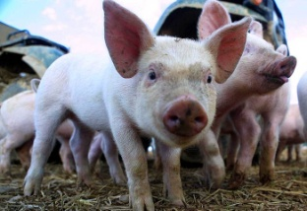
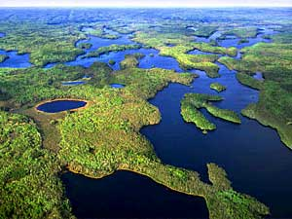
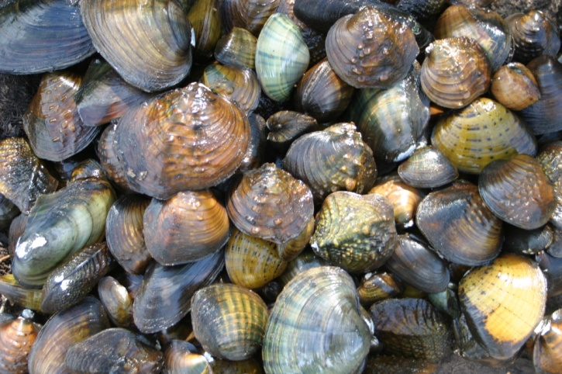
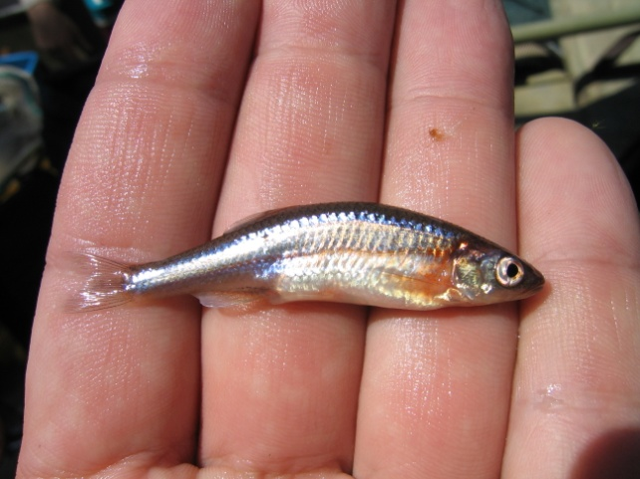
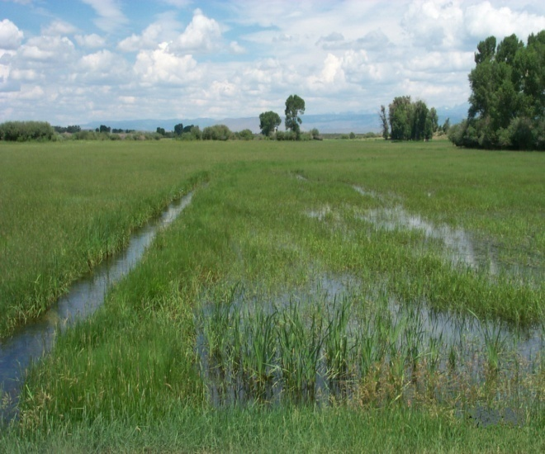
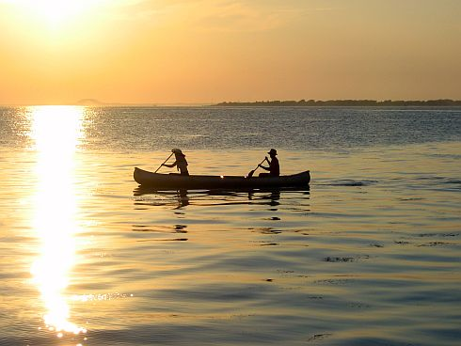
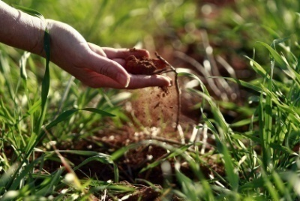
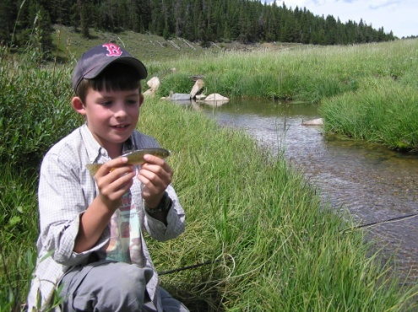
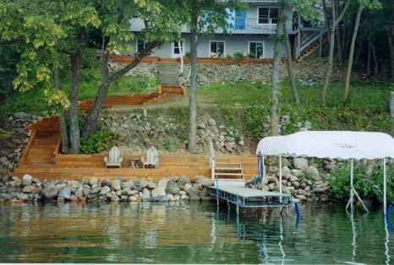
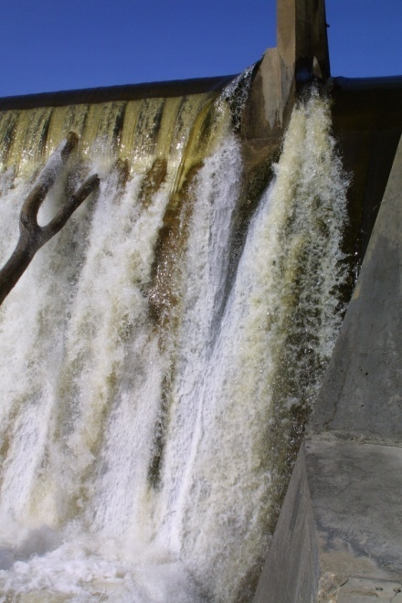
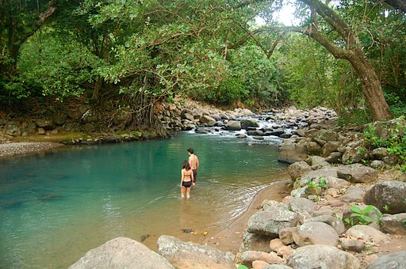
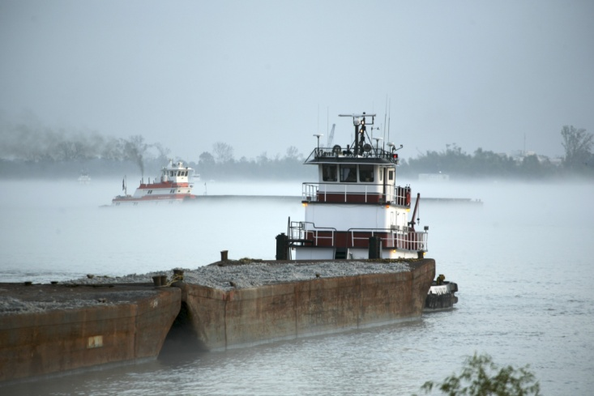
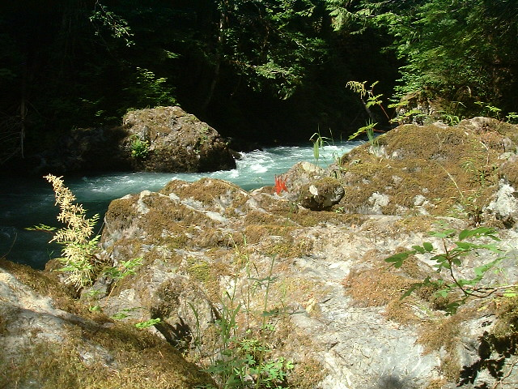
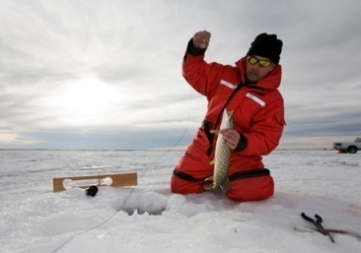
People value flowing water
Ecosystem Services
Notes:
Indeed we have a strong relationship with water. We are drawn to water and have an almost spiritual attachment to the rhythmic pulsing of flowing water. We settle in places where it is clean and abundant. We drink from it and water our fields from it. We also turn our waste into it. It has great value for all of these ecosystem services And then when it’s gone or contaminated we long to have it back. It’s at this point that we start thinking we should maybe leave a little water in the stream for fish.
These “products” from the ecosystems we live within are termed “ecosystem services”. When we talk about ecosystem services, it isn’t a protectionist perspective that excludes any consumptive human use. Rather it’s an awareness that we are part of – not separate from – the ecosystem in which we live.

Slide 6
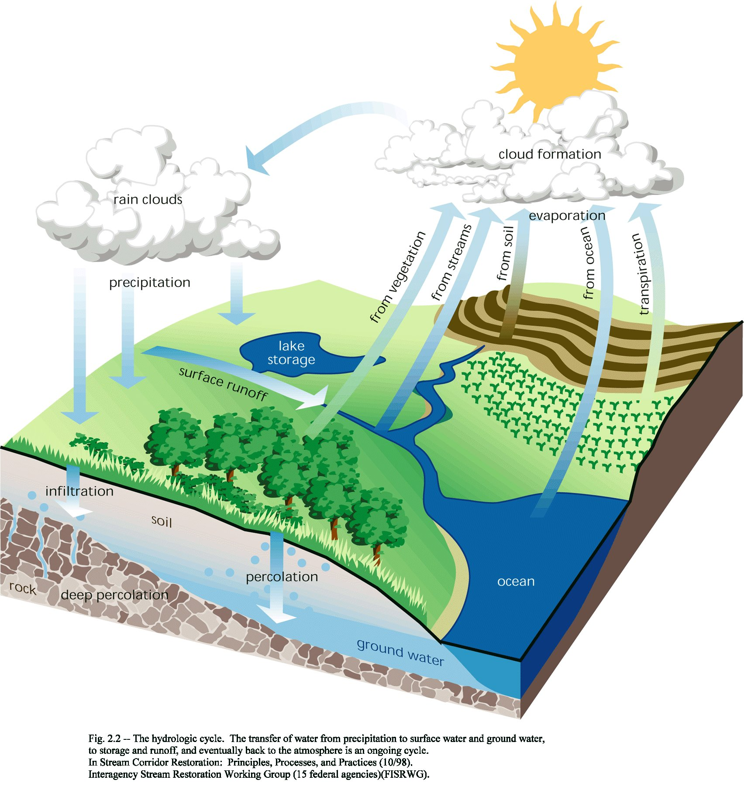
The land
and water . . . and people are intimately
connected.
“When you pull on one string in nature, you find it is connected to everything else”
John Muir
Notes:
Intellectually, we know our water and land are intimately inter-connected, as we are as individuals and a species to both. Virtually every action we take that affects water or the land ultimately comes around to affecting us as a species. Sometimes, the outcome is not so clear at first and may take a while to play out, but the connection is inescapable. So we must pay close attention to everything we do that affects the hydrologic cycle.

Slide 7
All water users strive for certainty and control
Weather variability patterns, water availability and changing human values and needs complicate things
Notes:
Certainty and control are at the root of all discussions about the use of water. “Certainty” of how much water we have the use of and the ability to “control” when we get our share are key drivers in water allocation.
Uncertainty is a huge driver in water negotiations and change is never a welcome player.

Slide 8
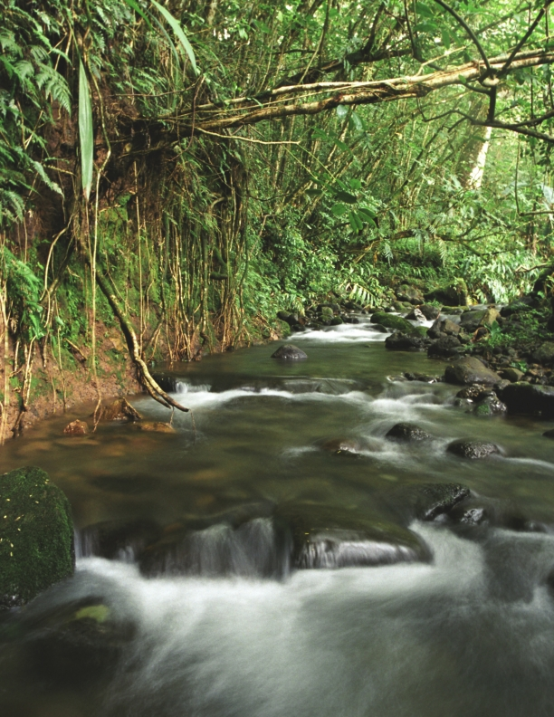
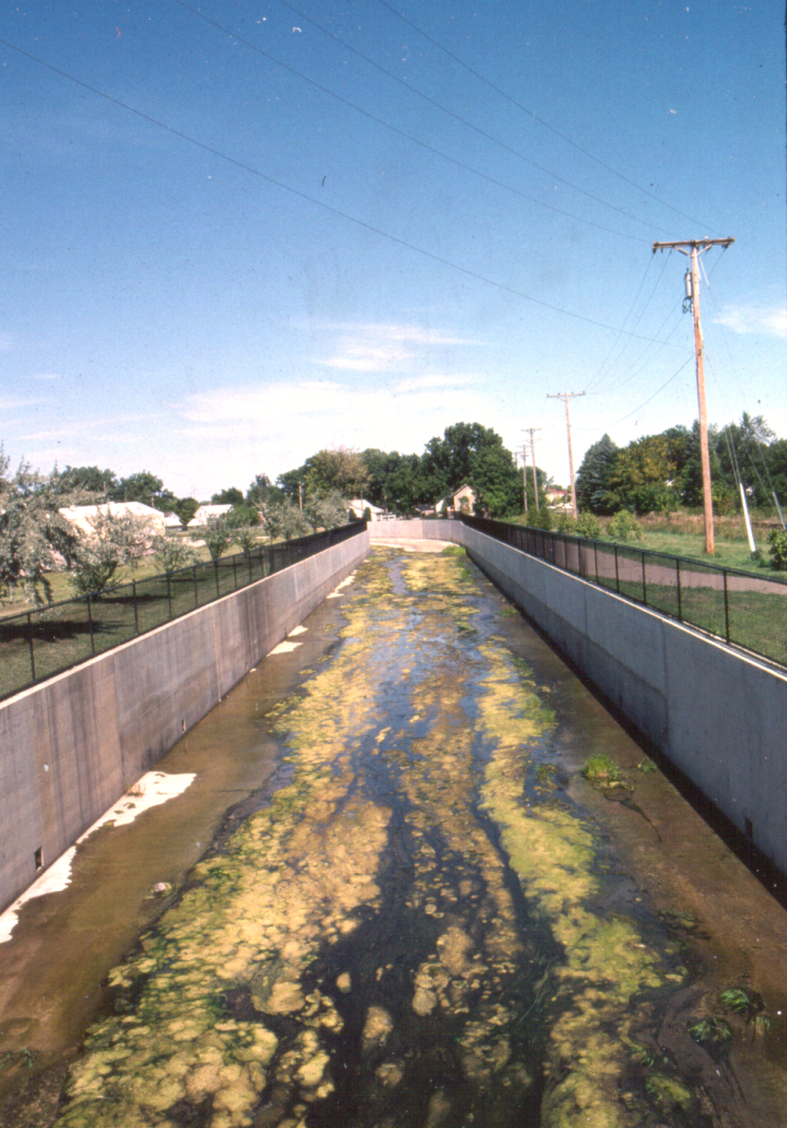
?
Public
Involvement
Legal/
Institutional
Science / Riverine
Components
How well we integrate each element will affect how the world looks and our quality of life.
Notes:
The decisions that all resource managers make are driven by the complex interaction of public input, laws and policies, and science. The manner in which managers integrate information from each of these elements will determine what our planet and our quality of life looks like.

Slide 9
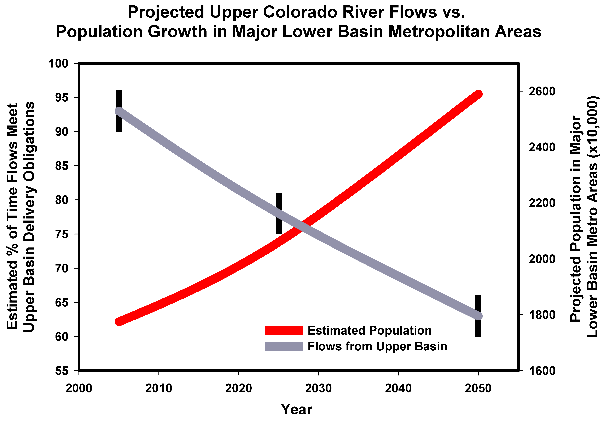
Opportunity
Change
Source: McCabe and Wolock 2007
Notes:
Many of us think the rivers and lakes around us have always looked the way they look today – and that they’ll always look this way. In some places that may be true. But we can all point to other places where severe changes have occurred and more changes are not only likely – they’re certain to come.
A paper by McCabe and Wolock in 2007 illustrates well the dilemma facing the western states and indeed the nation. The situation in the Lower Colorado River is not unique but clearly shows a trend of increasing demand contrasted by a declining ability to meet that demand with existing sources and patterns of water use.
Projections show that in 2050 the global human population will have increased to 9 billion people and 70% more food will be needed. Over 70% of global water availability is used for agricultural production. Electricity generated from water, hydropower, provides 20% of the world’s electricity and is the main energy source for more than 30 countries. Faced with these looming eventualities, we have opportunities to set things in place today that won’t exist in even 10 years, let alone the next 20 or 50. The reality is that change will come whether we want it or not and we would be wise to act today to affect the face of that future change in ways that benefit rivers and people.

Slide 10
Anything else you’re interested in is not going to happen if you can’t breathe the air and drink the water. Don’t sit this one out. Do something. You are by accident of fate alive at an absolutely critical moment in the history of our planet. Carl Sagan, astronomer
It's far too late, and things are far too bad, for pessimism. Dee Hock, VISA credit card founder
When you realize the value of all life, you dwell less on what is past and focus on preservation of the future.
Dian Fossey, American zoologist
Notes:
Lest one feel that all is lost and we’re in a hopeless situation, it helps to consider the words of others that seem to capture some of the basic tenets of instream flow. Dee Hock notes that this is not a game for pessimists – you must have a positive outlook to be effective. Dian Fossey wisely notes that it does no good to worry about such matters as how we wish things were. They are as they are and our energy will be most productive to face forward. And Carl Sagan correctly notes that there’s no better time than right now – today – to begin to act. Indeed if you can’t breath the air or drink the water, not much else really does matter.

Slide 11
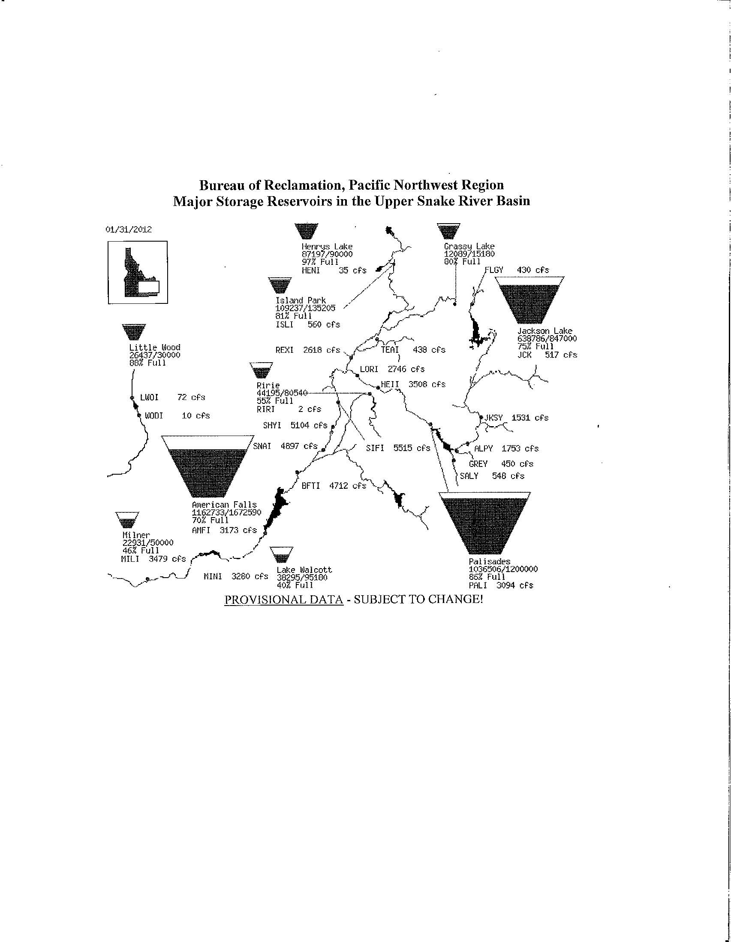
Effective water management is more than building “buckets and pipes” and delivering commodities.
Notes:
Historically water managers have managed river systems as if they were discrete entities like buckets and pipes. They paid little attention to how dams affect organisms and the rivers themselves when water is stored and hydrographs are changed.

Slide 12
Once a stream is lost, it’s difficult to restore it – and much more costly than maintaining the original service or function
Notes:
And we all know it is much more cost effective to keep what we have now than to allow it’s destruction and then attempt to restore it. Such practice assumes we know exactly how to restore the structure and function of a river, but history shows that such skill is in short supply.

Slide 13
Finding Balance is a Matter of Value
Valuation, in practice, involves some of the oldest problems in economics – revealing and aggregating preferences and addressing uncertainties
from Daily et al. 2000
Notes:
Finding balance among all water uses is a necessary goal that is inherently driven by the way we value this limited resource. Valuation is something society has done for a long time but establishing the value of water in rivers and lakes is not easy when there are multiple values and more than one person with an opinion.

Slide 14
Economic valuation alone can not be used appropriately to evaluate environmental capital, its contributions, or its impact.
from Odum and Odum (2000)
Notes:
It truly is a matter of comparing apples to oranges . . . Or more specifically comparing services to products. Environmental services are not always discrete, tangible products

Slide 15
Emergy: embodied energy
The energy of one type that is embodied in any form of energy, good, or service.
EMPOWER = emergy per time
EMPOWER DENSITY = empower per area
www.EMERGY.com
from Odum (1996)
Notes:
But there are ways to do this. There is an emerging discipline called Emergy – embodied energy that offers context on how to integrate values of commodities with the value of services of ecosystems. Emergy was the focus of a half day workshop at the IFC Flow2011 conference in Nashville (by Dr. Dan Campbell of EPA). Anyone interested in learning more about this subject will find a wealth of information at the Emergy.com web site.

Slide 16
Ecosystem Structure
&
Process
Ecological Values
based on ecological sustainability
Decision making process to determine policy options & manage-ment measures
Ecosystem Goods & Services
Socio-cultural Values
based on equity and cultural perceptions
Total
Value*
Ecosystem Functions
Regulation
Habitat
Production
Information
Carrier
Economic Values
based on efficiency and cost-effectiveness
from de Groot (2005)
Notes:
This framework by de Groot provides a simplified schematic display of how assessment and valuation of ecosystem functions, goods and services is done.
The value of ecosystem services is driven by the structure and function of the overall ecosystem.
The condition of the ecosystem yields ecosystem services and goods.
These have value that is determined by the combination of 3 key elements.
In principle, each of the 3 key elements of establishing the value of healthy rivers or ecosystems is equally important. The decisions managers make about water affect ecosystem structure and function and the cycle adjusts accordingly. Unfortunately the real world isn’t quite this simple.

Slide 17
But there are problems:
Notes:
In fact there are significant challenges and problems that we must always deal with.

Slide 18
Key Market Failures in Ecosystem Valuation
1. Decision-makers have imperfect understanding of ecosystem services and their value (e.g. impacts associated with Columbia River dams)
from Chan et al. (2007)
Notes:
Understanding how riverine ecosystems function is difficult enough for professionals who work in this field full time but it is nearly impossible for decision makers to fully appreciate the significance of actions that affect those processes even by small amounts. As a result, it can be very important to develop relationships with those individuals and agencies so that you can provide assistance when it’s needed.

Slide 19
Key Market Failures in Ecosystem Valuation
2. There are often considerable positive externalities of conservation that have no market value (e.g. the inherent value of a species), whereas resource consumption often yields immediate, tangible market rewards.
from Chan et al. (2007)
Notes:
Preventing a species from becoming extinct can have a wide range of positive effects (avoidance of cost) that are not always obvious.

Slide 20
Key Market Failures in Ecosystem Valuation
3. There are often intervention failures (e.g. “perverse subsidies" that favor economic gain but have negative environmental consequences.)
from Chan et al. (2007)

Slide 21
Other Problems
Some ecosystem services may not be viewed as important (e.g. droughts and floods provide vital functions that may not be appreciated or understood)
Impacts of climate change on ecosystem services are unknown

Slide 22
Defining Nature
(An Even Bigger Problem)
1
Wilderness
0
3
Human view
2
0 – Original nature (wilderness)
1 – That nature which is perceived and described;
2 – The nature configured in laboratories or models;
3 – The nature constrained by laws & policies.
Adapted from Kull (1998)
Notes:
Another most basic problem is that society and scientists have an imperfect understanding of nature. When we are modeling ecosystem processes it is important to realistically identify what we are modeling and what we are omitting and realize the limitations of our efforts. This awareness is the basis of the precautionary principle that says we must always err on the side of caution to avoid the need to reverse a decision when future information reveals the error of our ways. This challenge also speaks to the great need to develop laws that enable, not limit, the opportunity to manage riverine resources and processes in ways that are consistent with their basic “nature.” Unfortunately, most laws have proven to greatly hinder those opportunities in many states and provinces.

Slide 23
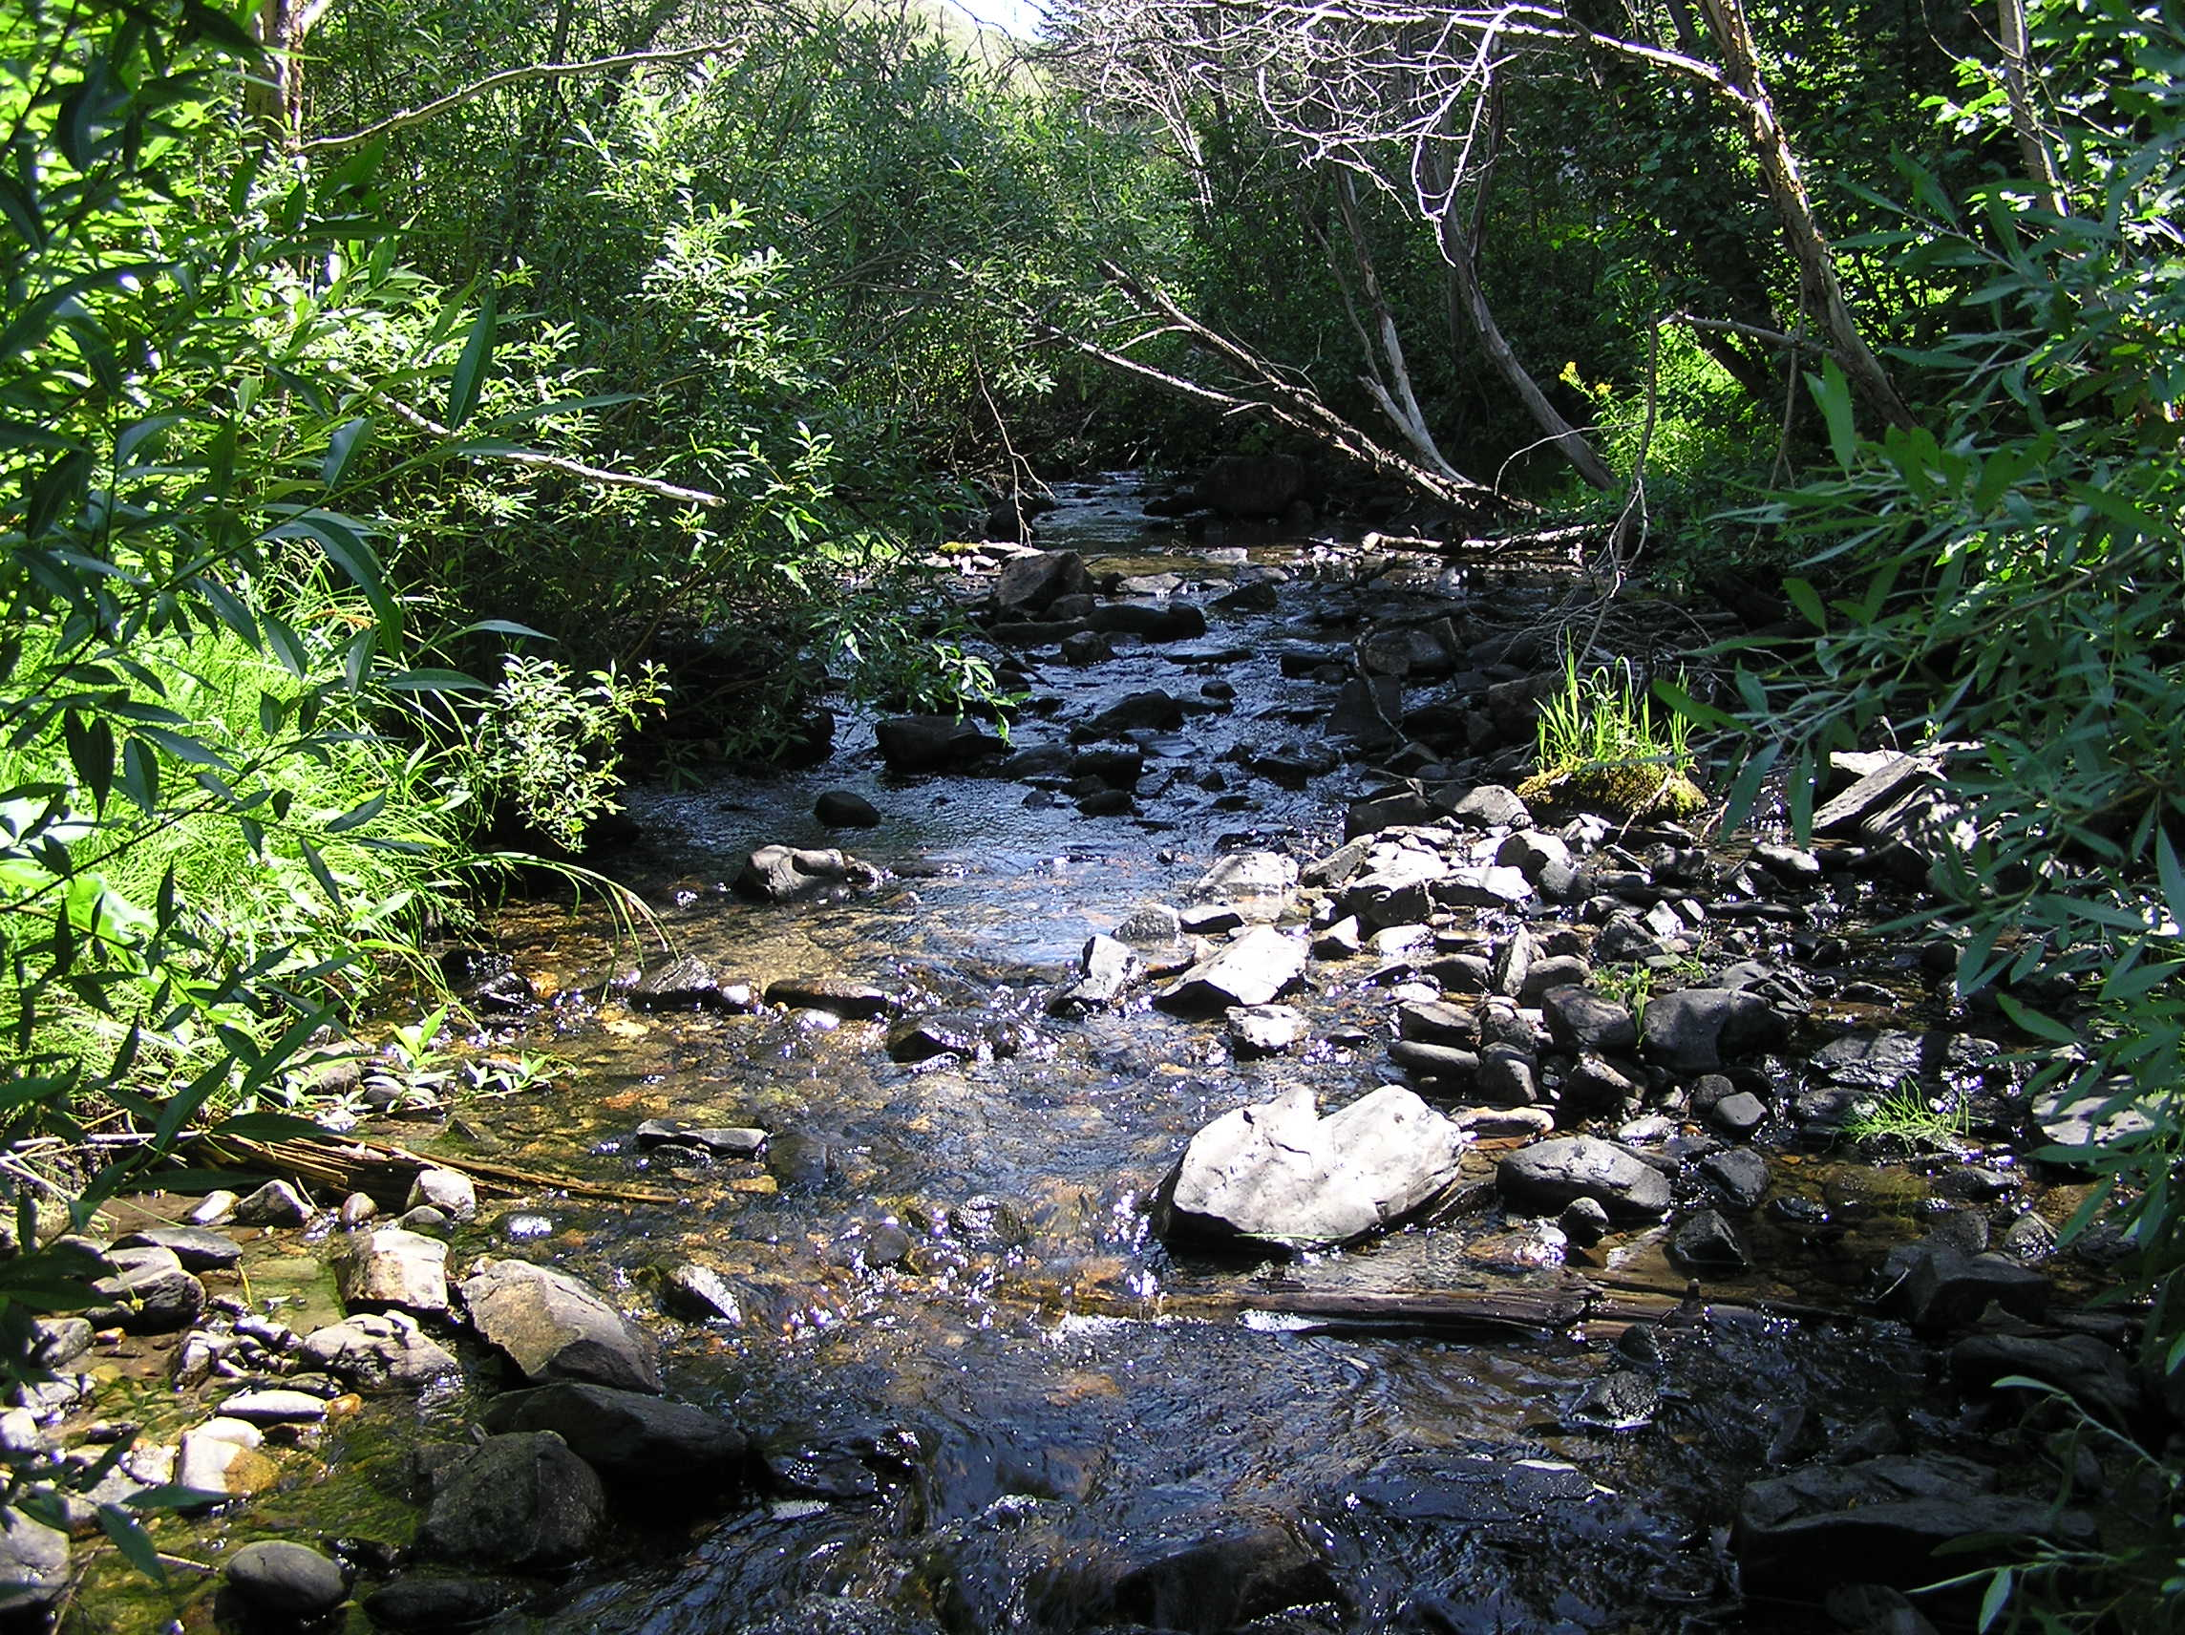
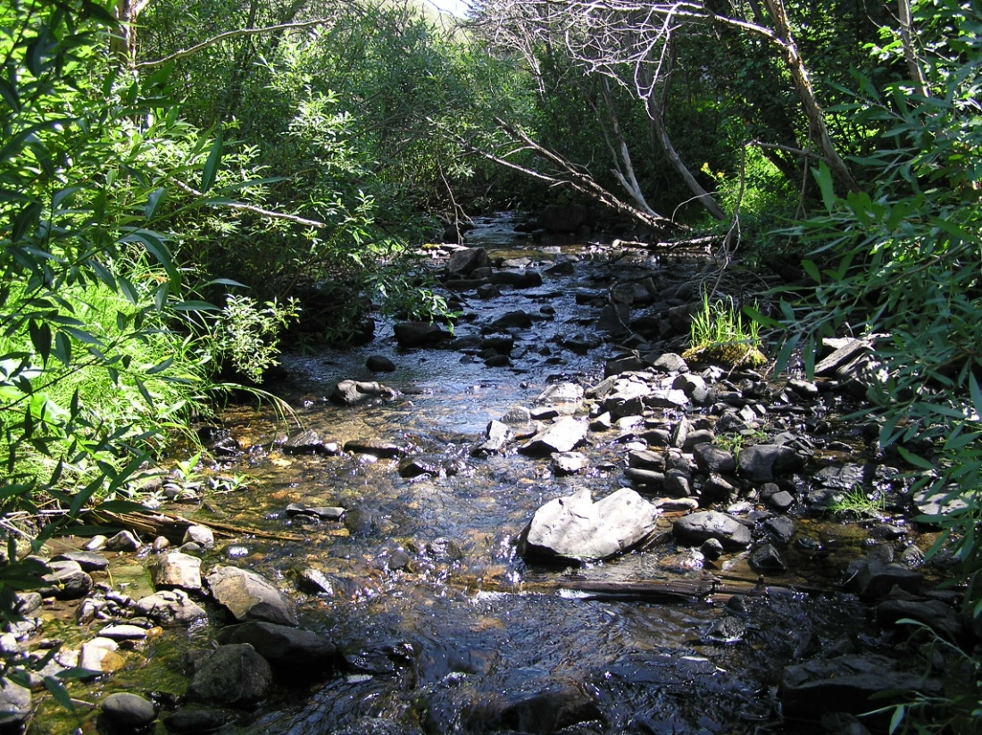
Defining Nature
Legal Nature
Modeled Nature
Observed Nature
True Nature
Adapted from Kull (1998)

Slide 24
What’s the Goal?
Maintain or restore the original state as much as practically possible.
Fine tune legal & institutional opportunities to maximize ecosystem services .
We are, after all, human – and we want it all.
Notes:
The message from this series of observations is not that we should return all rivers to their pre-settlement condition. Humans need water to support our quality of life and our numbers are growing. The key point is that we need laws and policies that allow managers the ability to balance ecological needs on an equal basis with other needs.

Slide 25
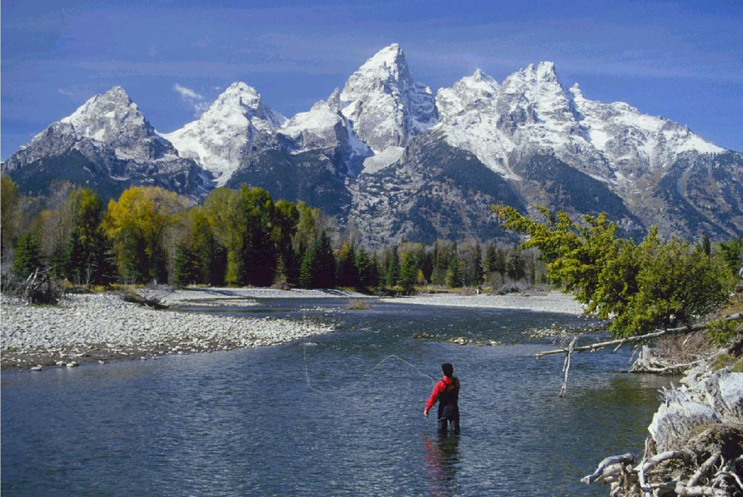
What About Instream Flows?
Notes:
Instream flows, as broadly defined, play a critical role in supporting ecosystem services. Water in the creek is, after all, the way water moves from one point to another and that produces the diverse environments and community assemblages along the way that river managers are charged with managing. They are also the element that helps sustain the full range of broader ecosystem services.

Slide 26
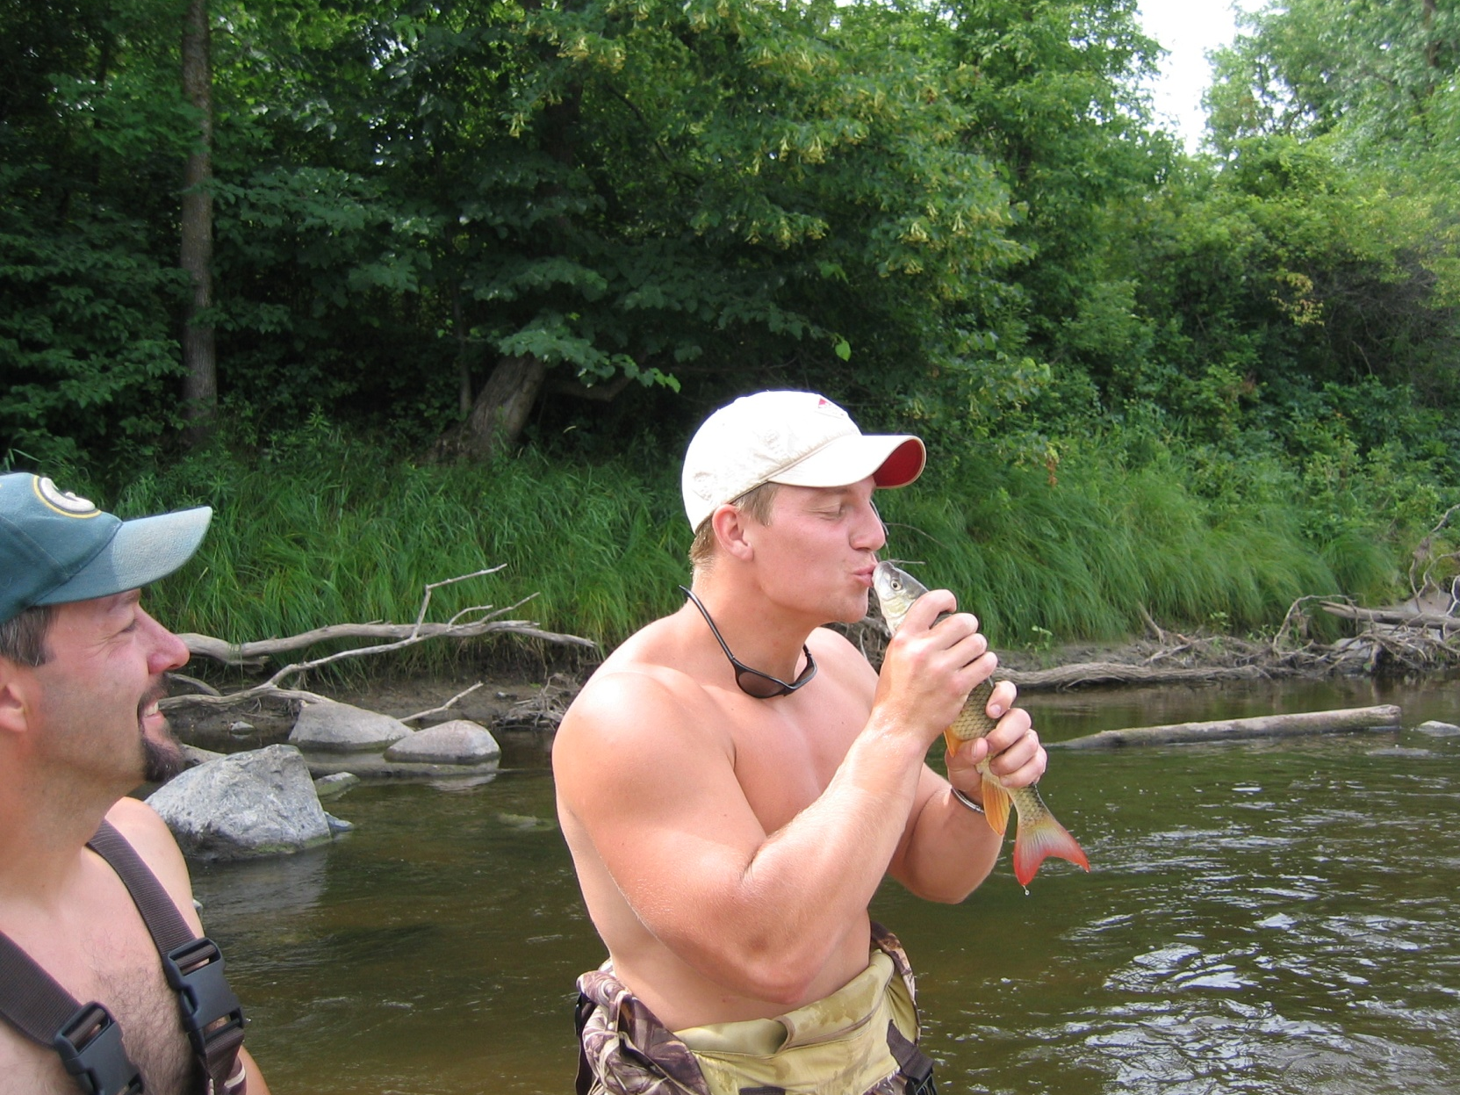
Instream flow isn’t just about the fish
Notes:
Though fish receive the majority of our attention when managing flow in rivers and in spite of the affinity that people (including biologists) have for these organisms, the reality is that instream flow is about much more than fish.

Slide 27
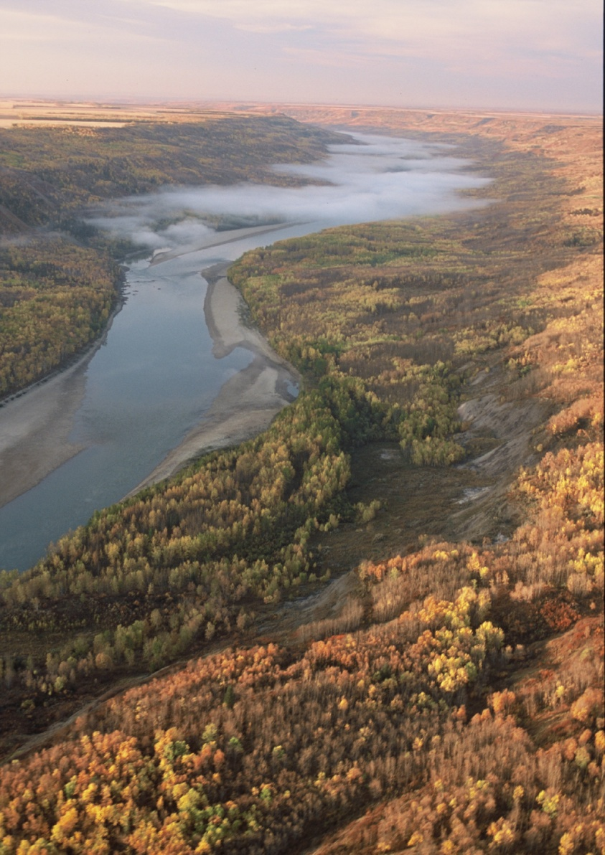
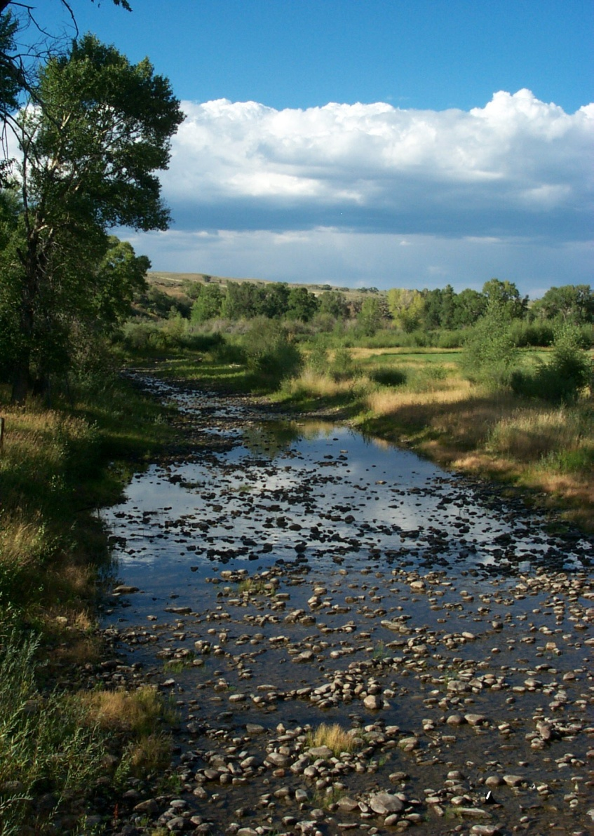
?
It’s an issue of world view and quality of life.
Notes:
The discipline is in fact much more about our decision that affect how the world looks and our very quality of life. Fish are simply one needle on one of many gages on the proverbial control panel of a river to tell us what’s going on. To be most effective, and to manage fish wisely, we need to know much more than how many fish are in the river.

Slide 28
Definitions and Concepts
Notes:
Instream flow is still not a simple subject so it’s important to understand the considerable fine print that’s associated with this discipline.

Slide 29
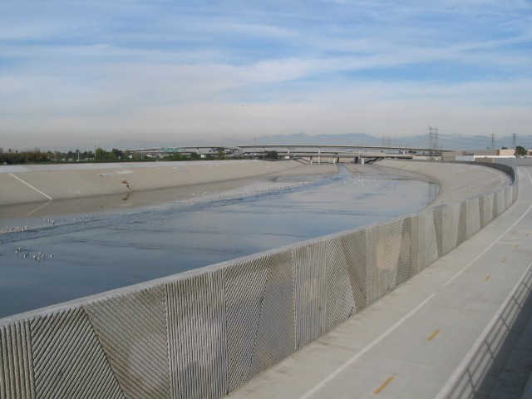
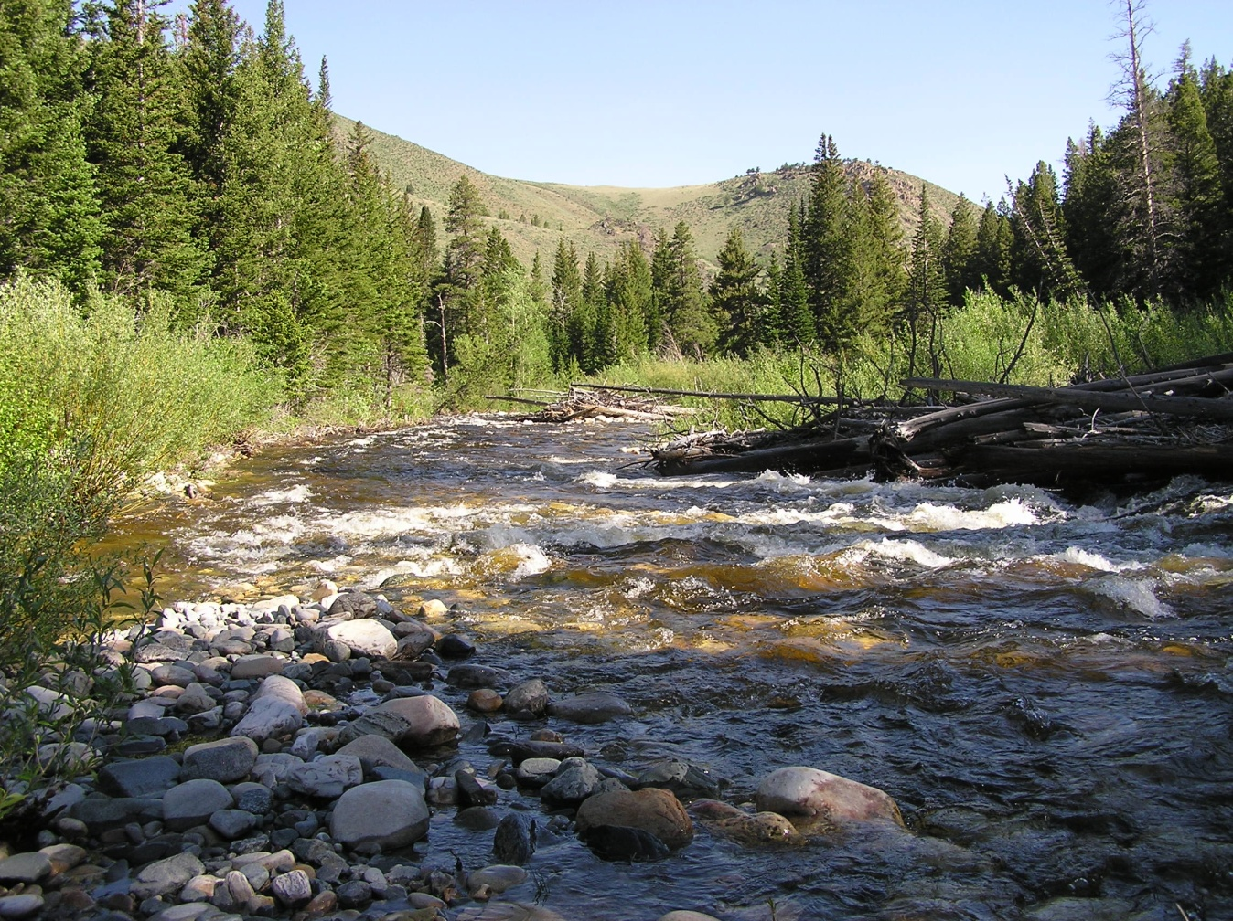
What is instream flow?
Notes:
Most likely, everyone in this room has a different image of instream flow. The fact is that the Los Angeles River in California has an instream flow and Rock Creek Wyoming has an instream flow. Though we use the same term in each case, the reality is that instream flow is very different in each setting. You can like instream flow in one of these settings but not think very much of it in the other.

Slide 30
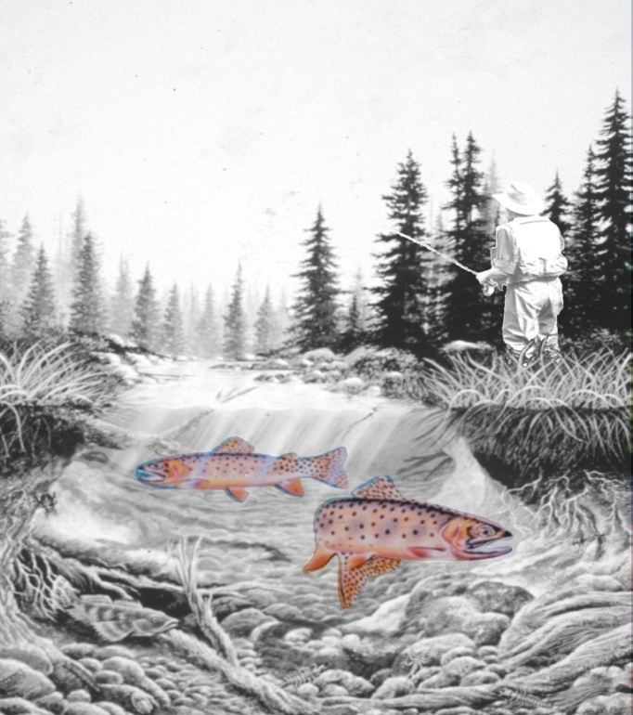
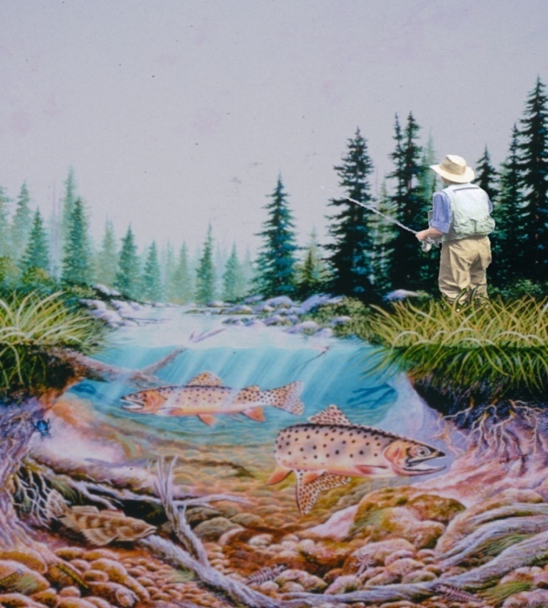
Fish or Fisheries?
Notes:
In some situations, when we refer to instream flow we’re just talking about the amount of water needed to support a single species or life stage of fish. In other settings instream flow relates to an entire fishery – the community of organisms in and adjacent to the stream, the physical habitat, and human users. Both uses of the term can be correct – they just need to be defined.

Slide 31
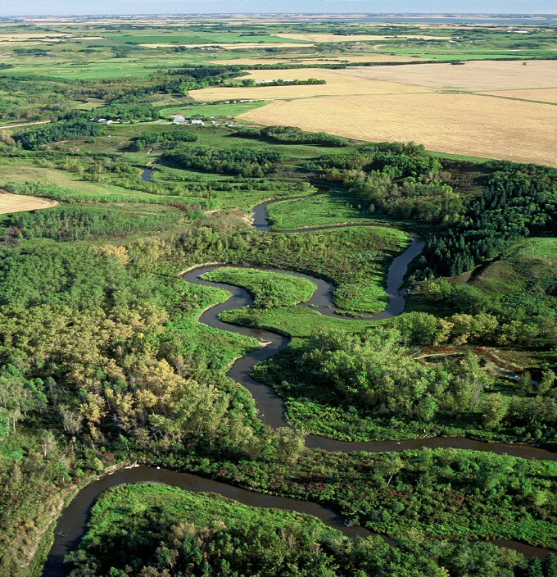
River system or just a segment?
Notes:
In other situations when we talk about instream flow we’re talking about the needs of water to maintain an extended river system (possibly including tributaries). However we might also be talking about the instream flow needed in a discrete portion of a longer river – as if the flow there occurs independent of the watershed upstream. Again, qualifying what you mean can make a big difference in what you’re talking about and the adequacy of the instream flow for the intended purpose.

Slide 32
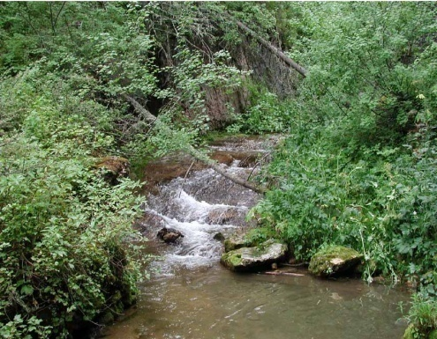
Instream Flow Can Mean:
Water in the creek but no regulatory mechanism
Enforceable regulatory mechanism but no water
Water in the creek that’s protected by an enforceable regulatory mechanism
Notes:
Instream flows come in a variety of forms - you can have an instream flow (water in the creek) without any regulatory mechanism, or you can have an instream flow (agreement) without any wet water (little or no certainty or control), or you can have an instream flow (water in the creek) with regulatory protection (some level of established certainty and control).
This is an important thing to keep in mind because, if not clearly articulated, negotiators can be talking about very different things – “we’ll give you an instream flow (agreement) but you go find the water.” Or perhaps, “that stream’s already got an instream flow” (just no certainty or control about how much or when to expect it).

Slide 33
A little water, some of the time?
Notes:
Instream flow also has reference to amount as well as the pattern of availability. At it’s simplest definition, “instream flow” just means “water in the creek” in any amount at any time and any pattern.
Often times, consumptive water users tend to think that if they leave any water in the stream that they’ve provided an acceptable flow volume.
They may think they just need to leave a little water in the stream for the fish without thinking more broadly about other organisms or habitat forming processes.

Slide 34
All the water, all the time?
Notes:
Instream flow can also mean all the water, all the time.
Water developers fear that this is what environmentalists really want and it’s possible that some environmentalists may actually have this ambition.
Again, this perspective is largely derived from how people think a river should look, without thinking about how the river functions.

Slide 35
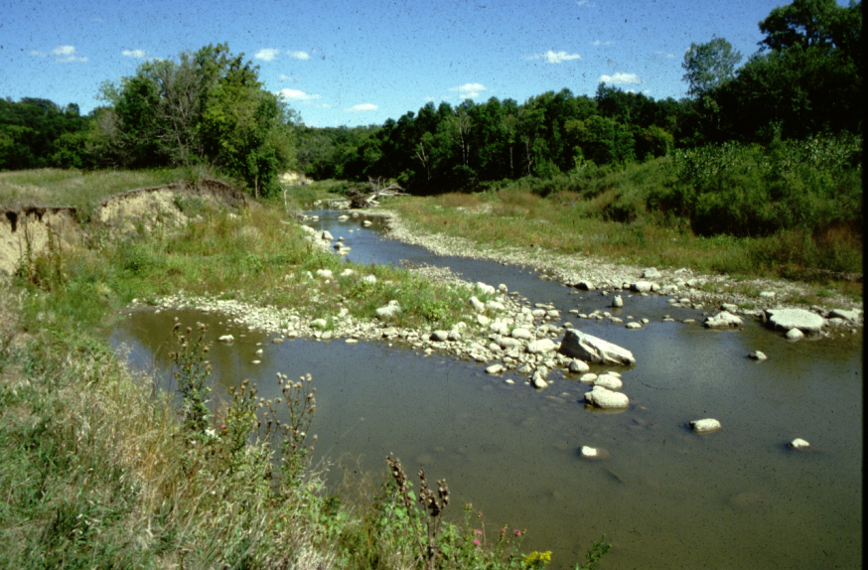
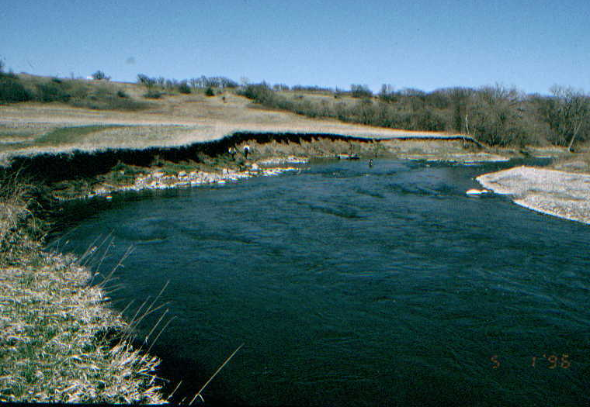
A seasonally adjusted flow regime?
Notes:
Of course an instream flow can also refer to a seasonally adjusted flow regime that provides the proper amount of flow at the proper time of year for the proper duration to maintain the river’s ecological structure and function.

Slide 36
Protection or Restoration?
Notes:
Instream flow can also refer to the purpose of the flow. For example it’s important to distinguish between whether we are trying to protect part or all of the flow regime that’s still in the stream or if we’re trying to restore some measure of flow regime to a stream that experiences some level of depletion. There can be a big difference between these two concepts depending on the desired outcome.

Slide 37
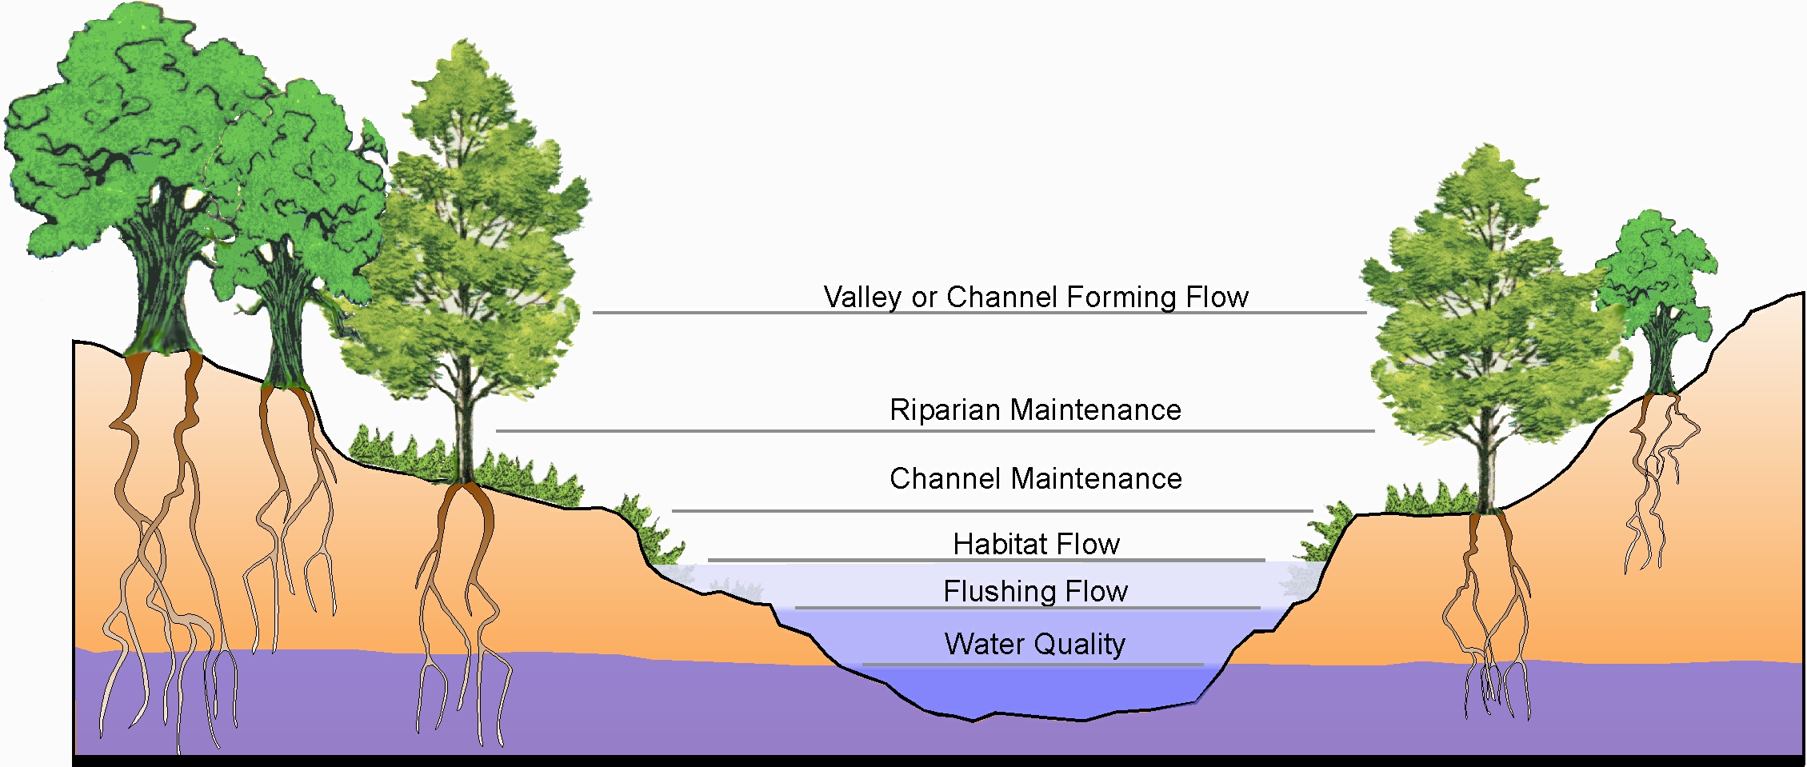
Flow Protection
Upside Down Instream Flow
Water is usually available
Public land issue
Notes:
Flow protection usually refers to identifying an amount of water that can be removed from the hydrograph that will minimize or avoid negative effects on the stream and the organisms that reside there. This is also referred to as an upside down flow because it is viewed by some as the opposite of traditional views on e-flow management. These kinds of opportunities often occur on public lands, upstream from where most water is diverted for human use. Flow protection may require more water than flow restoration but the precise amount depends on how degraded the stream is already (for restoration) as well as the level of protection or restoration that is desired by the public and water managers.

Slide 38
Flow Restoration
Bottom up instream flow
Need to find water
Private land issue
Notes:
Flow restoration may be the more traditional view of instream flow management. When restoring flow and riverine function to a stream, almost any level of increased flow will be beneficial for environmental purposes. These situations typically exist on private lands where water has been allocated for consumptive human uses and involve finding ways to put water back in the stream – either by creative management plans or re-direction of existing water rights or permits. Because most of the streams and rivers in need of habitat restoration are on private lands, it can be important that private landowners have a role in this flow management strategy.

Slide 39
Instream Flow
Science
Institutional Capacity
Public Involvement
Laws & Policies
Notes:
Implementing an instream flow is a product of the combined interaction of 4 primary components.
Each is critically important and should be specifically addressed to increase the odds of effectively securing an adequate instream flow. This next section focuses only on some of the scientific considerations of instream flow needs assessment.

Slide 40
Instream flow is more than keeping a little water in the creek for fish
Notes:
There is a well developed and evolving science associated with the business of determining how much water you need.
It is definitely more complex than the commonly held belief that instream flow is just a matter of keeping a little water in the creek for fish.

Slide 41
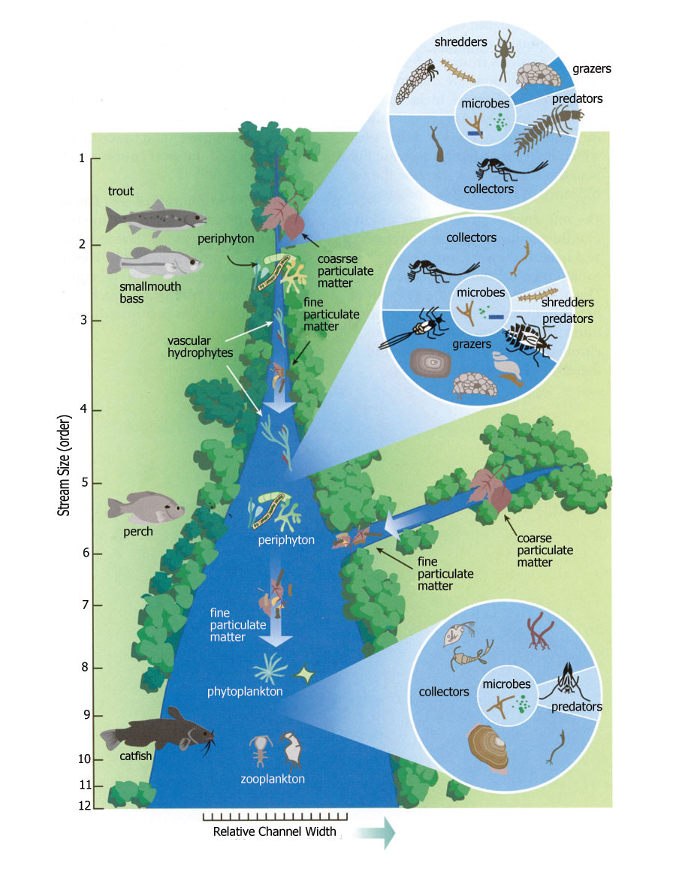
Each Situation is Unique
Rivers and the species that live there change in predictable ways over distance.
Notes:
All riverine components (and thus their habitats, organisms present, and flow needs) change in predictable ways over the length of the river and over time. This dynamic nature of rivers is one important reason why we can’t always do the same kinds of studies in every situation.

Slide 42
Overall, ecological response to anthropogenic-induced flow alteration is almost always detrimental regardless of the mechanism (storage or diversion). Ashston, M. J. 2012
Notes:
In spite of our desire to think that our actions and extractions related to flow are benign or even beneficial, it is an established fact that in the majority of cases those actions are usually detrimental to existing conditions and communities - based on review of 124 cases.
Ashton, M.J. 2012. Ecological responses to flow alteration: A literature review within
the context of the Maryland Hydroecological Integrity Assessment. Maryland
Department of Natural Resources, Monitoring and Non-Tidal Assessment Division.
RAS-MANTA-AIM-13-01, 45 p.

Slide 43
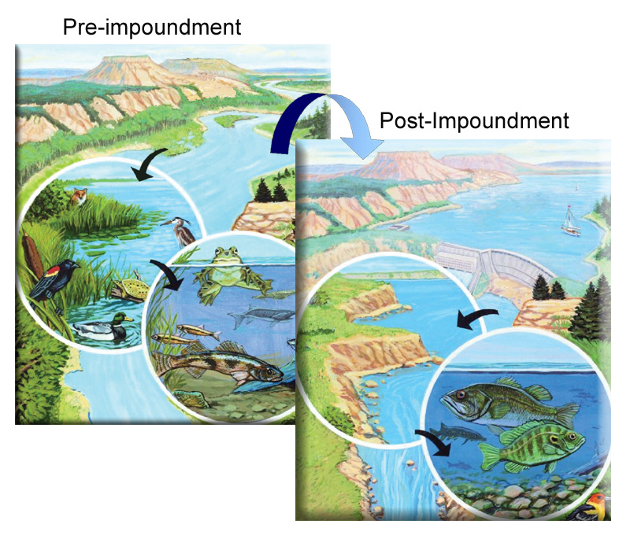
Dams don’t affect one thing . . .
Hydrology
Biology
Geomorphology
Water quality
Connectivity
Notes:
But the fact is that dams do have broad effects and don’t modify just one thing – they modify everything. When you change any or all of these riverine characteristics, you invariably change not just the number of organisms that live below dams, you risk changing the species that are found there as well. In some situations projects have been built that had such a great impact as to turn once abundant, non-game species that didn’t get much attention into relatively rare species that became the focus of great attention and monetary expense.

Slide 44
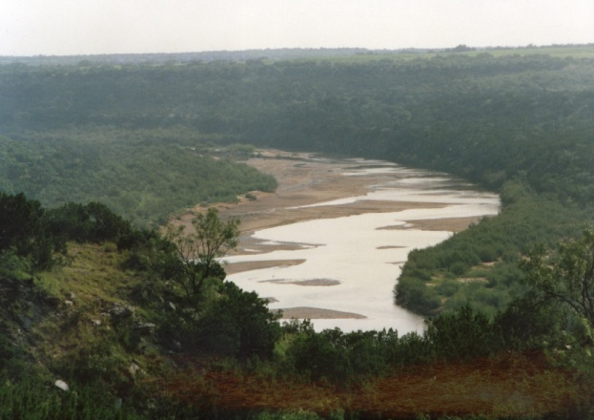
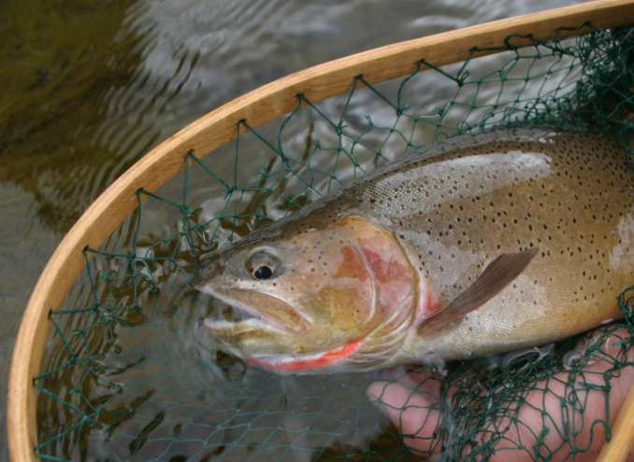
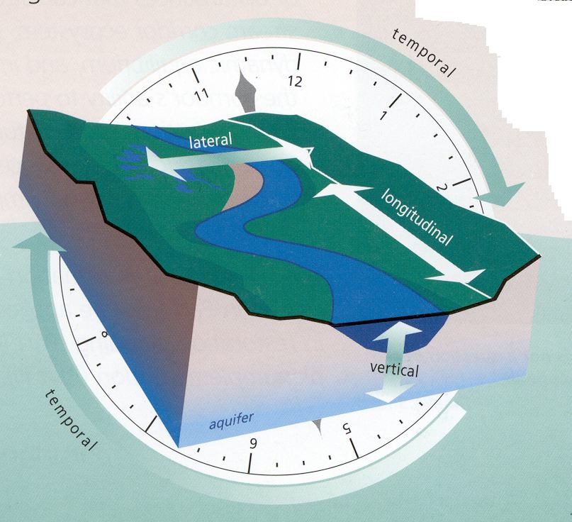
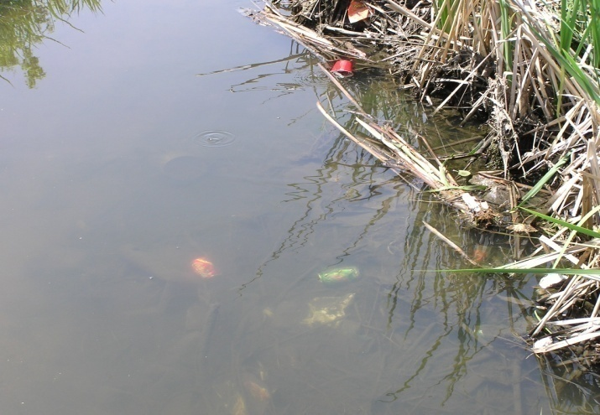
Geomorphology
Biology
Hydrology
Connectivity
Water Quality
Notes:
Hydrologic pattern (flow) is the master variable that shapes and sustains stream habitats and organisms. Quantification of instream flow regime needs is the integration of these 5 riverine resource characteristics. While hydrology is the main driver, all five of these characteristics are inter-related in complex ways that we do not always fully understand. The take home message is that the science of quantifying instream flow needs depends on knowing a lot about a lot of things – there isn’t just one thing we need to know or take care of (there’s no silver bullet).

Slide 45
Models tell us about:
Hydrology
Short and long-term water availability
Biology
Short-term physical habitat availability
Geomorphology
Long-term trends of channel conditions
Connectivity
Multiple elements and concepts
Water quality
Short and long-term
Notes:
Models have been developed to provide information about rivers and river processes that is associated with each of these elements and generally relate to:
Short term survival of organisms
Long-term persistence of habitat and habitat processes
Long-term persistence of organisms and population dynamics

Slide 46
Habitat Modeling Caveats
Models manage uncertainty – don’t eliminate it.
No model tells us everything we need to know
Relationship between flow & habitat isn’t linear.
A flow that’s good for one species may be detrimental to others.
There isn’t a single “best” flow – think flow regimes.
Notes:
Instream flow models have a few assumptions . . .
Models don’t provide the right, or best, answer. They simply help managers understand the consequences of their actions and thus help manage risk. They don’t eliminate the possibility of making a bad decision.
More water does not necessarily mean more habitat
A flow that is beneficial to one life stage or species may be detrimental to others
Various life stages and species may require different amounts of water at different times of the year
A flow that maximizes useable habitat in one part of the stream may not provide very much useable habitat in another part
No one flow is “best” for an ecosystem or a suite of organisms. In almost all situations, we need to manage for flow regimes.
Modeling output must be evaluated, often times with professional judgment drawn from extensive field experience, to determine if there are any inconsistent or alarming results.

Slide 47
Defining Nature
Legal Nature
Modeled Nature
Observed Nature
True Nature
Adapted from Kull (1998)

Slide 48
Hydrology
River systems were built and are maintained by different magnitudes of discharge occurring over time and space. (Hill et al. 1991)
Notes:
River systems are defined by flow regimes that occur within and between years (intra and inter-annual variability). The timing, duration and magnitude of flows that pass through its channels over long periods of time are key – begging us to understand that there is no wasted water in natural flow streams. Effective instream flow management involves more than keeping a minimum amount of water in the stream to maintain fish survival. A range of river flows provide specific, important ecological functions, which relate to the five riverine components. Preservation of river flow variability, properly timed, is essential to sustaining river structure and function and ecosystem health.
When you change the way that water passes through a river, the habitat form and function in the river will change which consequently changes the kinds and abundance of organisms that can live in the stream and along its banks.

Slide 49
Maximum flow
Minimum flow
The problem with minimum flows . . .
Notes:
In the early years of instream flow development, managers often referred to the minimum flow needed for rivers. Setting flow in this manner allows all the water above that point to be used for out of channel purposes, resulting in a flat-line hydrograph and eliminating intra and inter-annual variability. So the problem with the concept of minimum flow is that there really is no such thing for the simple reason that once minimum flows are set, they become maximum flows by default. To provide meaningful, long-term ecological protection, it’s essential to talk in terms of instream flow regimes, whether they are achievable in the short term or not and whether they approximate virgin flow patterns.

Slide 50
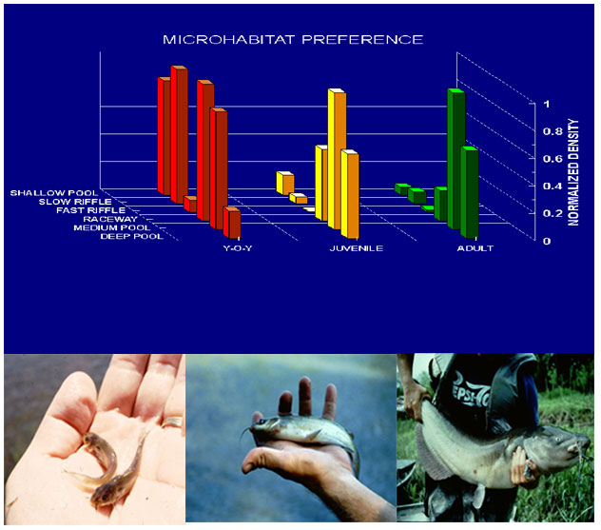
Variable flows maintain habitat complexity
Notes:
The diverse habitats created by variable flows are important to maintain the kinds of habitats that are used by different life stages of each species and different species.

Slide 51
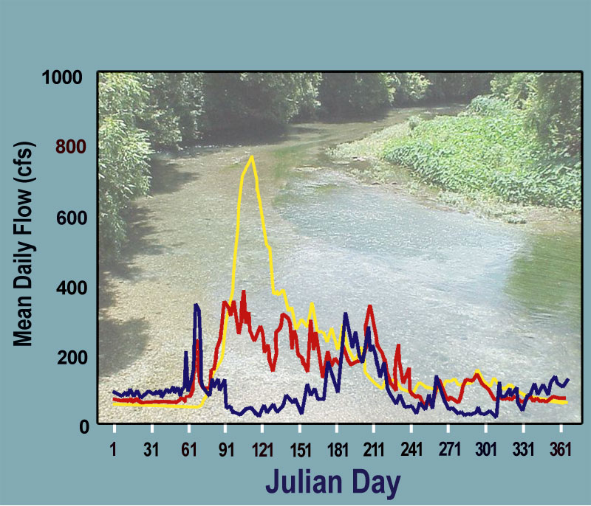
Notes:
Timing within the year is important to stimulate things like fish movement or riparian growth. Different flows in different years can be important too – so a single flow or single flow regime is seldom a goal for effective river management.

Slide 52
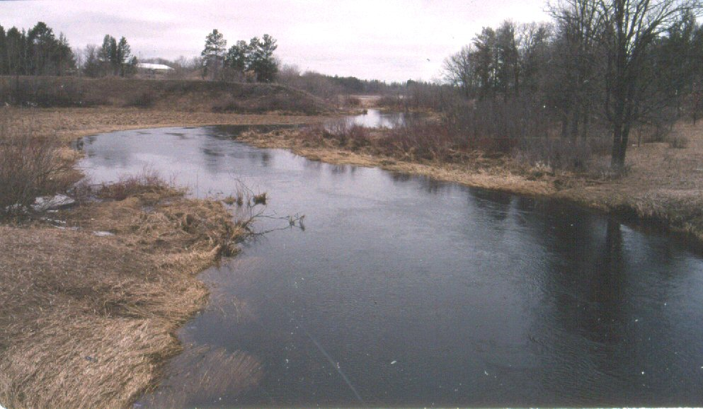
What about average monthly flow regimes?
Notes:
Some times, flow negotiations set out to secure an average flow regime, which is indeed an improvement over flat line flow recommendations. However average flow regimes, if experienced repeatedly over a number of years have their own set of considerations and issues.

Slide 53
Average flows = average habitat
Notes:
One flow or even one flow regime can’t benefit all species equally all the time. In low flow years, species that thrive under low, slow water thrive while others may not do so well. In high flow years, species that thrive under deep, fast waters thrive. So even having the same average annual hydrograph will compromise the community composition and abundance of fish and other aquatic organisms in rivers by altering normal population dynamics of natural flow regimes. Maintaining the diversity of flow regimes maintains diversity of habitat which maintains diversity of species.

Slide 54
Biology
Notes:
Over the years, the majority of instream flow models have been developed to address primarily fish species. But biology relates to all of the organisms that are associated with and help define a river – fish, aquatic insects, and vegetation along the banks.

Slide 55
Biology embraces all aquatic organisms in the stream . . .
and the riparian corridor
Notes:
When we talk about how much water is needed for the biology component of an instream flow we also need to talk about the other organisms that live in the stream. Flow regime supported vegetation in the riparian community also affects in-channel characteristics in terms of energy contributions, bank stability, and temperature (shading) as examples of its importance to instream flow management.
The fish we are often focused on are just one part of the energy web that is intimately tied to and affected by the health of the entire riverine community. The quantity and quality of instream flow affects all of these riverine elements.

Slide 56
Geomorphology
Notes:
There’s more moving in rivers than just water and fish.
Geomorphology tells us why a stream is as deep and wide as it is – as well as what’s on the bottom of the river. The amount and way that water moves through a channel affects the import and export of bed material (channel forming material).

Slide 57
Notes:
Lane’s Balance Equation has been used to show the concept of “stable channel balance”, depicting the relationship sediment load and sediment size to slope and discharge graphically. A change in any one of the parameters will set up a series of adjustments in companion variables and ultimately change the form and function of the river channel. For example, an increase in discharge in a river (e.g., through upstream watershed drainage or urbanization) will adjust channel dimensions and profile, increase the capacity of the river for work, and degrade the banks and bed.
Changes in sediment transport processes have led to narrowing and straightening of every major river in Wyoming (Green, Bighorn, North Platte). Studies by T. Wesche documented the loss of 25% of the wetted habitat in the Platte due to sediment entrapment and storage by Alcova, Pathfinder, and Seminoe dams.

Slide 58
Geomorphic condition is a function of:
Sediment addition or removal
Flow addition or removal
Channel form (alteration)
Notes:
You can see how alteration in channel characteristics associated with dredging and straightening changed this stream channel when the channel was straightened. It’s obvious that the habitat in the straightened channel is radically different than in the natural channel. Even a non-fishery biologist can surmise the obvious that the organisms and the number of organisms found in the channel on the right are probably a lot different than those that were found in the natural channel on the left before it was altered.

Slide 59
Water Quality
Pollutants
Temperature
Notes:
When we think of water quality we typically think of chemical pollutants, but silt and nutrients are among the most common pollutants nationwide. But water quality also pertains to other factors such as dissolved oxygen and water temperature. One standard often doesn’t work for all times of day and year – diurnal changes and patterns can be important and seasonal variation can be essential too in factors ranging from triggering seasonal movements of fish or aquatic insects or facilitating some aspect of spawning, growth or survival.
Different species have different preferences as well.

Slide 60
Connectivity
Notes:
Connectivity is perhaps the most complex of the several riverine elements discussed here. To begin, connectivity consists of 4 dimensions, each with their own range of considerations of hydrology, biology, geomorphology, water quality and energy. The ecological importance of these factors can vary seasonally and/or between years.
Longitudinal connectivity relates to the passage of water, organisms, nutrients and sediments in the main channel of a river and its tributaries. This can be viewed as simple hydrologic connectivity (flow or no flow), physical connectivity (dams, diversions, natural barriers), or qualitative connectivity (segments that exclude some species due to water chemistry temperature, or sediments)
Lateral connectivity of the river such as overbank flow to the flood plain and connectivity of the upstream watershed to the river.
Vertical connectivity to shallow groundwater
Temporal connectivity. Some systems are dependent on continuous and adequate flow but others are dependent on some manner of disconnectivity (dry stretches between pools help maintain native species or disfavor non-natives)

Slide 61
Notes:
We typically think of longitudinal connectivity issues in terms of physical barriers, but this kind of connectivity can also be affected by water quality or the simple lack of flow.

Slide 62
Losing to deep groundwater
Losing to shallow groundwater
Gaining from shallow groundwater
Losing and gaining from groundwater
Notes:
Groundwater connectivity can be very complex and consist of any of these 4 main forms. These kinds of connectivity can change rapidly over the course of a stream or over the course of time. Anyone who claims to know what the relationship is between surface water and groundwater should be able to show proof of the relationship they’re describing because the fact that groundwater issues occur out of sight means we don’t really know what’s going on unless we have conducted detailed studies over a number of years (and seasons).

Slide 63
Temporal Connectivity
Notes:
In some situations, organisms are highly dependent on the presence of continuous, adequate flow levels. But there are other situations where natural dis-connectivity can be important if the stream doesn’t go totally dry. Here on the Little Snake River in northwestern Colorado, residual pools harbor native fishes and disfavor introduced non-native exotic fish species. There’s a big difference between when a stream ceases flowing and when it goes dry. One would not prescribe this kind of flow level so that the frequency occurs more often than normal, but actions that enhance natural periods of low flow in rivers that depend on occasional periods of dis-connectivity might cause unintended negative impacts to native species. This is why it’s important to fully address and understand the complex hydrologic aspects of temporal connectivity along with the other aspects of connectivity.

Slide 64
Connectivity isn’t just about fish
Nutrients & minerals
Woody material
Sediment and bed material
Notes:
Connectivity doesn’t just pertain to fish and other biological organisms’ ability to access the entire river system and its tributaries. It also relates to the effects that result from connectivity patterns associated with the movement of nutrients, woody materials (energy), sediments, and chemicals throughout the stream system.

Slide 65
Holistic Methods
Notes:
Holistic methods seek to integrate information from all 5 riverine elements. Some do this better than others but these models are still in their early stages of development. Some show considerable promise for helping guide water management decisions.

Slide 66
Examples of Holistic Methods
Downstream Response to Imposed Flow Transformation (DRIFT)
Demonstration Flow Assessment (DFA)
Bayesian Probability Models
Ecological Limits of Hydrologic Alteration (ELOHA)
Notes:
The Downstream Response to Imposed Flow Transformation (DRIFT) Framework uses four modules: Biophysical, socio-economic (how common users are affected), scenario building, economics (strict monetary cost).
Demonstration Flow Assessments involve groups of experts agreeing on important riverine attributes or characteristics that change with flow and then making collective judgments on how those attributes actually change with flow. Attributes should be quantified as much as possible to allow repeatability of the assessments should others need to re-do the studies.
Ecological Limits of Hydrologic Alteration is designed to build on models like the IHA and add a measure of biological realism that is lacking with just hydrologic statistics alone. This tool is often referred to as a method when in fact it is primarily a template for making water management decisions. One of the limiting factors to this tool is that detailed ecological data related to flow variation is still required – just like every other method.
Bayesian Decision Models are the latest in this evolving trend. They may be based solely on data or incorporate professional judgment or a combination of both. Regardless, these models develop decision pathways based on relatively accurate probability outcomes rather than precisely determined outcomes.

Slide 67
Bayesian Probability Models
IF
Action A
70%
30%
THEN
Outcome C
Outcome B
40%
80%
20%
60%
Notes:
Bayesian decision models are essentially probability assessment tools. They can be as complex as one wishes to make them and can be designed to address any number of inputs and outcomes. At a conceptual level they work by identifying the probability of various outcomes as a consequence of a specified action. There can be multiple outcomes from any one action and each outcome typically leads to subsequent outcomes.

Slide 68
Even simple ecosystem modeling
can be complicated
Notes:
These models are intriguing because they can be worked both forwards and backwards to evaluate the relative importance of drivers and outcomes. This particular draft model was developed for the Flint River, Georgia and included consideration of the 5 riverine components identified by the IFC. In spite of the complexity shown here, this is still a relatively simple representation of ecological processes. As with all models, these too can be and are limited by the quantity and quality of information that is available. To be most accurate (effective) these models require huge volumes of data. Analysis of even this simple diagram shows why it’s such a challenge to link predictions of one particular outcome (like number of fish) with a change in just one ecosystem element like flow.

Slide 69
Instream Flow
Science
Institutional Capacity
Public Involvement
Laws & Policies
Notes:
To this point, we’ve focused largely on the technical, or scientific, aspects of instream flow. But effective instream flow management is actually a product of the combined interaction of 4 primary components. Each is critically important and should be specifically addressed to increase the odds of securing an effective instream flow regime.
The next section will look at the role of the public in securing conditions of favorable flow.

Slide 70
Public Involvement
Education
Input
Activism
Who takes lead on this?
Notes:
Public involvement is just as, if not more, important in managing instream flows as the science. The petition drive in Wyoming that put the instream flow initiative on the ballot in 1986 is a good example of active public involvement and was the key reason we have an instream flow law in the state today.
Public support and involvement is multi-faceted and dynamic. It changes in response to changing cultural, social and economic forces. Ultimately laws are changed to reflect changes in public values.
Public involvement takes at least 3 forms: education (what agencies and managers want people to know), input (what people want agencies and managers to know) and activism – what people are willing to do if the system seems to fail them.
Managing public involvement requires active involvement by someone. The trouble is that most agency I&E specialists don’t know enough about instream flow to articulate an effective message (or program) and biologists who are skilled in the instream flow discipline don’t know enough about dealing with the public to effectively motivate them. Even more importantly, neither of these groups typically has enough time to really work with the public. This is ostensibly one of the more important reasons why it’s so difficult to motivate and manage public input on instream flow issues.

Slide 71
Instream Flow
Science
Institutional Capacity
Public Involvement
Laws & Policies
Notes:
The challenge of securing adequate instream flow protections for rivers and lakes becomes even more difficult when we realize that we must also deal with the institutional capacities of agencies within a limiting construct of laws and policies. Effective instream flow management mandates that we successfully negotiate favorable conditions in both of these areas in addition to dealing with the “easier” components like the science and public.

Slide 72
Legal
Doctrines
State laws
Federal laws
Interstate agreements
Notes:
Laws truly establish the sideboards of what can be accomplished with instream flow and directly affect the degree of certainty and control managers have over water. The reality is that the laws in every state make it more difficult to protect public fishery values than to take water out of the channel or lake for private profit. Each level of law has its own level of complexity that is further complicated in areas of overlapping jurisdictions. Doctrines set the general sideboards and include templates like a) public trust doctrine, b) riparian doctrine, c) appropriation doctrine, and the emerging discipline of d) regulated riparian doctrine that embraces elements of both b and c.
State laws often have greater influence over the allocation of water in individual states except in those instances where the public good of more than one state are involved like FERC projects where hydro power may be exported beyond a state’s boundaries. Likewise interstate agreements (compacts and Supreme Court decrees) can supersede state laws due to the multiple interests in the waters of interstate rivers.

Slide 73
Institutional
Policies
Staffing
Training
Funding
Interagency cooperation
Notes:
Institutional capacity is one area of instream flow implementation that agencies generally have much control over. However it is also an area where considerable potential exists to bring instream flow work to a grinding halt when political pressures become great. Policies, staffing, training, funding, and interagency cooperation are all key elements of institutional capacity but if only one or two of those elements goes away it can bring an agency’s instream flow work to a grinding halt. Similarly, agencies intent on effectively pursuing instream flow activities need to know that this is not something they can simply add to the duties of existing staff. A real, long-term commitment is needed to be truly effective.

Slide 74
Instream flow water rights are a valuable habitat tool
Notes:
Instream flow water rights actually have some very real benefits, or value, to the state. Take away the water from the stream and all the rocks and logs in the world won’t maintain a fishery.
Consider for example that tor the price of a $20,000 study we can protect the most important fish habitat element there is over miles of stream and never have to come back to do o & m or management – ever.
Instream flow, or a protected level of water in the creek, is “forever” habitat and a tremendous bargain.

Slide 75
Statutory recognition of environmental flow is critical to:
Affirm state’s rights and control over water for:
Permitting new dams and water projects
Wild and Scenic rivers
Endangered species
TMDL’s
Hydro
Notes:
The feds don’t trust the states and the states don’t trust the feds. But water is the property of states and state legal mechanisms are essential to prove to the federal gov’t that the state can and will address federal mandates using state law. In the absence of state laws for managing instream flow, the federal government will assert their standards and requirements for river and reservoir water management. These regulatory efforts may or may not be consistent with state objectives.
For example, instream flows are a requirement for every dam built where federal permits are required. They’re a critically important element in the permitting process that helps get water projects built – they are not an obstacle.

Slide 76
Notes:
So we’re back to the big picture. There’s only so much water but the good news is that we have opportunities to decide just how we’re going to go about sharing this limited resource. The process of making those decisions is not an easy one but does become more feasible when all interests are involved and when we know as much as we can about the consequences of our decisions.

Slide 77
Opportunity
Change
Source: McCabe and Wolock 2007
Notes:
But the clock is ticking and we need to figure out how to slice the pie and pretty quickly. Each jurisdiction, whether a watershed, state, or country, is on a different timeline with different issues. But the fact is that we all have more opportunities today than we’ll have in even the next decade. If we fail to proactively address water allocation issues for all interests, change will occur in how our streams and lakes look, the organisms that persist, and our overall quality of life.

Slide 78
It’s not an issue of whether we can have it all. We must have it all.
Notes:
We really are all in this together and need to strive hard to address all of our human needs in a sustained manner in order to preserve our way of life as well as the world we live in.
Having the full range of environmental services is crucial to long-term sustainability of our economy and quality of life. We need to work together in spite of – and because of – our individual values.

Slide 79
So What?
Notes:
So what is the take home message of this presentation?

Slide 80
Be Precise
Instream flow vs. instream flow regime?
Segments vs. systems?
Wet water vs. paper water . . . or both?
Water for fish vs. fisheries vs. rivers?
Maintaining vs. restoring flow?
Notes:
There are lots of places to stumble when discussing instream flow and much too much disagreement without making things worse by not first clarifying the specific issue we’re talking about. In order to have productive discussions about instream flow it’s critically important to clear articulate what aspect of instream flow we’re talking about.
For example are we discussing what the science says we should do?; what the public wants to do?; or what the law allows managers to do with water?
Are we talking about just how much water is flowing in the stream?; whether we have an agreement that a certain amount of water is needed (but no firm commitment to provide water)?; or are we talking about a water right or agreement that also has secured the necessary amount of water to provide the intended benefit?
And is the discussion about maintaining habitat and fisheries on public lands where adequate flow and flow patterns already exist or is the focus on restoring flow to dewatered segments of land on private land?

Slide 81
Thank you for listening . . .

