Slide 1
Strategies For Developing Environmental Flow Laws
Notes:
Managing water for environmental purposes is not an easy or simple business. Most state agencies have a long ways to go to better manage water for fisheries but the importance of environmental flow is of growing interest. Environmental flow management is one of the top priorities of the National Fish Habitat Action Plan and will be a focus of state efforts in the future. Regardless, when it comes to managing water for environmental flows, the job is made easier by having a structured plan and process.

Slide 2
Notes:
When the science, the public, and the law don’t result in the desired solution of some groups (opponents or proponents), there’s always one more strategy. But force is usually not a long-term solution for any perspective.

Slide 3
When it comes to management strategies, water is different . . .
“Water wars” are real – competition for a strictly limited and essential commodity.
For every way you’ve been beaten there’s always one more way you haven’t thought of . . . and it will be used.
Though there are guidelines and protocols for negotiations . . . there are no rules in the trenches.
Notes:
Water is different – it is one of the very few things in life that is essential for life itself. As supply becomes less and demand grows, the stakes grow and strategies change. Managing water for wildlife is fundamentally different than any other aspect of fish and wildlife management and requires skills and knowledge that are often different than most biologists have training in. The most effective resource managers posses reasonable understanding and aptitude in a variety of disciplines including fish and wildlife management, hydrology, water law and policy, and public engagement. The fact that so few people fit this mold speaks volumes about why it is so difficult to do a better job managing water for fish and wildlife.

Slide 4
Water Management Principles
Everyone is always playing for all the marbles . . . and they’re playing for keeps.
Nice guys always finish last.
When you think something’s going on, there’s something going on.
Compromise is an end point – not a starting point. (Which finger do you want to lose?)
When the world’s out to get you, being paranoid just makes good sense (Johnny Fever, WKRP)
Relationships and trust are a premium – earned over years and lost in an instant.
Notes:
In many (most) situations involving water management for environmental uses, there are several principles that seem to present themselves. To begin, it helps to keep in mind that opponents don’t negotiate if they’ve already go everything they want (water) and they’re only negotiating because they want more.
When it comes to water, most consumptive users of water really only have one interest at stake – theirs. Rarely do you encounter parties willing to work together to mutual benefit. In too many situations, it’s the nice guys who finish last. It’s important to engage in water negotiations or discussions with the clear goal that you should never give away anything on the hope of gaining favor. Always get something for concessions.
Many water deals are long term (years) so there are often periods where there appear to be lapses. These are sometimes true lapses but more often times for opponents to be developing new strategies. You may get a sense that there’s something going on that you just don’t know what it is. At these times it’s important to trust your instinct and know that there’s almost always something going on. Silence is often a sure indicator.
Most fish and wildlife managers are trained to find common ground and seek compromise. That’s not a bad place to wind up but it’s not a good place to start. Negotiators should almost always agree to compromise when it truly is the last thing . . . and the result provides a reasonable measure of the desired outcome. In a way compromise really is for losers – or people who are willing to give up things they value too early in discussions. You’ll never get them back once they’re gone.

Slide 5
Notes:
This slide isn’t meant to judge one interest over another. The fact is both sides see themselves as the naïve, young individual who’s being taken advantage of. Effective management is an outgrowth of effective relationships that are built on trust. Trust does not come easily and is one of the real rewards of a long association with other interests. It can be lost in an instant though so it pays to be vigilant to ensure neither of you unfairly takes advntage of the other.

Slide 6
The Importance of Time & Timing
Write laws for today . . . and the next 100 years.
17 years to get Wyoming’s original statute.
27 years for the next increment and we’re not there yet (temporary change of use).
Prepare for landscape action but be ready for individual opportunities.
Missed opportunities don’t come around again.
Good enough vs. perfection – know when to cut the deal.
Notes:
Change and progress takes time (decadal). Be prepared to stay the course (cumulative impacts can happen in reverse – and be beneficial). Missed opportunities may be gone forever. That’s why you should resist the temptation to settle for good enough as that’ll likely be where things stay for a long time.

Slide 7
Basic Strategies To Manage Flow
Federal
Clean Water Act (EPA, TMDL)
Endangered Species Act
Federal Energy Regulatory Commission
Interstate compacts and decrees
Purpose and need for federal reservoirs
State
Laws
Policies
Public Trust Doctrine
Notes:
The two main ways that water is managed to address fish and wildlife is according to Federal or State laws. Each suite of laws and policies are intended to apply globally according to each authority, however federal mechanisms are typically applied to individual projects or sites and may differ from situation to situation within a state.
Interstate compacts often apply to annual volumes not instantaneous flow rates and aren’t a good way to secure seasonally appropriate rates of flow (flow regimes)
In the U.S., the states have authority over all the waters within their borders that aren’t covered by interstate compacts, Supreme Court decrees, or other federal initiatives so as a rule, it’s usually best to seek protections that are respective of state laws and policies. State laws typically apply equally to water use across the entire state. In many situations (but not all) , state solutions may not be as protective as solutions achieved under federal authorities.
Often, the best solutions are a combination of elements from state and federal jurisdictions.

Slide 8
Wyoming History
Application submitted in 1969
Denied in 1972
No quantitative basis to support the request
No diversion or storage
No way to test for abandon-ability
A right of this nature would be of such value that it should be vested in the state
Notes:
We can learn a little bit about some of the many strategies for securing statutory or legal protection of instream flow from other states and provinces. Wyoming’s journey down that road is fairly unique but offers insights to some of the challenges to securing such status.
The very first instream flow filing was made by a group of private individuals and organizations for 200 cfs on a section of the Green River near Pinedale. This very thorough and detailed application was rejected by then-State Engineer Floyd Bishop because 1) the application didn’t provide a scientific basis for the quantity of water they sought, 2) there was no diversion or storage provided and it was thought at the time that such features were legal requirements of a water right, and 3) the belief that an instream flow right would be a very important one that should be held by the state in trust for the public.
In brief, the denial was based on all 3 features of instream flow – science (lack of it), law (abandon-ability) and public involvement (state ownership).

Slide 9
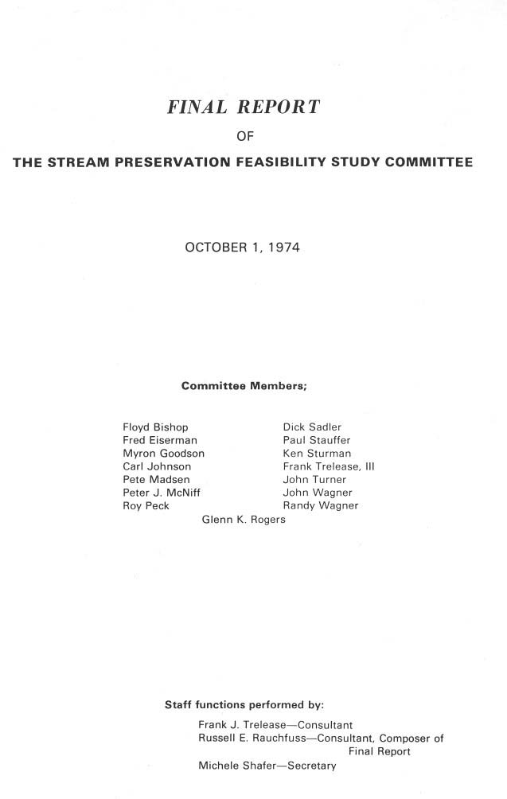
Notes:
In response to instruction offered by State Engineer Bishop, the sponsors attempted to pass legislation in 1972. The result of this effort came up short of the desired law but culminated in establishment of a stream preservation feasibility committee. This multi-disciplinary committee came up with draft legislation for an instream flow law that was actually more protective than the law we have today. They also crafted recommendations encouraging the state to identify some (unspecified) streams where no flow depletion would be allowed.
This draft legislation was offered for consideration in the ensuing legislative session only to be derailed in the House Agriculture subcommittee.

Slide 10
Wyoming History
First application submitted in 1969
Denied by State Engineer in 1972
17 failed laws from 1974 to 1985
Successful voter initiative led to . . .
Successful legislation in 1986
100th instream flow filing in 2006
Notes:
Over the subsequent 12 years, 17 laws were offered for consideration, and all were defeated in the House Ag subcommittee. In 1985 a diverse group of instream flow supporters collected enough signatures to place a draft law on the ballot (for the fall of 1986). This was the significant as it was the first successful initiative in the history of the state. With the public referendum looming in 1986, the legislature finally passed the instream flow law we operate under today. That law has remained basically unchanged and we have now filed for over 100 instream flow water rights, mostly on public land; all with current day priorities.
Given all the strident opposition and predictions of social and economic collapse predicted by opponents, it’s important to look at what kinds of things have happened over the ensuing quarter century that can be credited to instream flow legislation. Surely if good or bad things were going to happen, we’d know by now.

Slide 11
Since 1986
Water is being used to protect habitat in 130 stream segments (<3% of all stream miles)
Helped the state permit new dams
Helped keep 4 native cutthroat species from being listed as T&E
Notes:
For all the things that folks feared might happen, we’ve done a lot of things that truly did service the public interest – that we couldn’t have done if we hadn’t had the legal ability to file for and secure environmental flows.
You don’t have to have dams to provide most instream flows but if you don’t have a way to protect instream flow releases from dams as part of mitigation (preferably with a state legal mechanism), you won’t build many new dams.
Instream flows have proven an effective way of protecting habitat for important fishes in quite a few important recreational streams.
Filing state-owned instream flow rights on streams with native cutthroat trout have been a very effective way of proving the state’s commitment to maintaining and restoring species that might otherwise become listed as threatened or endangered. Had these species been listed, the state would have lost primacy over management of not only the fish, but water and land management practices in adjoining watersheds to the federal government.
We used a state administered instream flow to secure water for a wild and scenic river and avoided expensive court battles over the possible application of a federal reserved water right to do the same thing.
Though most filings are on public land, several private landowners have asked us to file instream flow rights through their property as a way to enhance their property values. We have complied with most of those requests but only do that upon a formal written request.

Slide 12
What Hasn’t Happened?
No injury has been documented
No call for regulation of an instream flow right
No one’s lost a water right to the government
No dams built just to provide an instream flow
No compacts or decrees have been affected
Notes:
Wyoming is no different than almost every other western state in terms of the impact of instream flows – or lack of impact. Briefly, instream flow opportunities have not been a negative issue in any state where they are recognized in the West.
There’s never been a call for regulation of an instream flow, but we have that authority. It’s just that most segments are not affected by existing diversions or water rights, and vice versa
Nobody has lost a water right, or will they. The state is much more interested in protecting fisheries than they are in grabbing someone else’s legal water right.
There hasn’t been one dam built solely for the purpose of providing an instream flow. Our goal has been to protect existing flows without flooding out more stream miles. We want to maintain rivers, not destroy them.
There’s been no injury or valid claim of injury associated with an instream flow water right. We haven’t changed water use patterns in state or out of state.
Principle of prior appropriation guarantees that can never happen.
For all the fear and suspicion about this “different” use, the reality is that instream flows really don’t change things very much. That’s just what we want to see happen . . . or not.

Slide 13
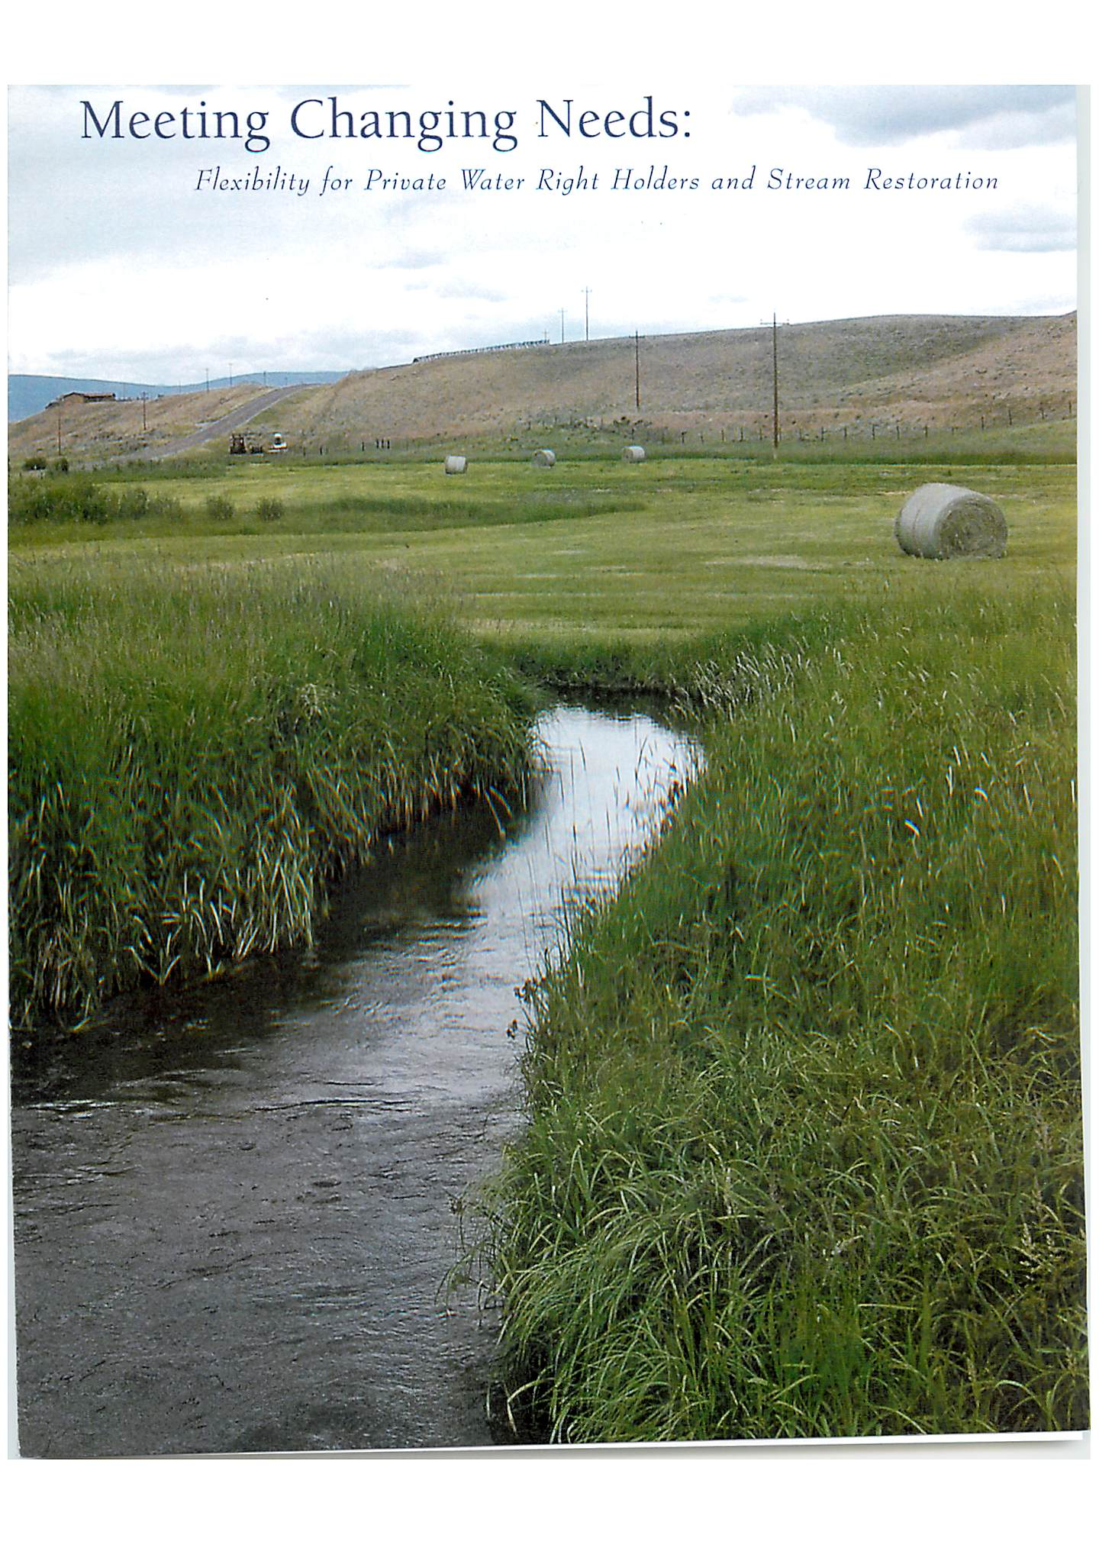
Temporary change of use legislation
Notes:
Our current law does a reasonable job of protecting fisheries and instream flow where unappropriated water is available. Most of those segments are on public land.
But our law is virtually silent on opportunities to restore flow on private lands where private landowners might wish to dedicate a portion of an irrigation right to instream flow. Groups led by Wyoming Trout Unlimited have sought passage of various laws dealing with temporary change of existing rights to instream flow (that would allow them to keep ownership and control over their rights without risking loss by abandonment). But over the past decade, every attempt has met the same fate as the original instream flow efforts – death in House Ag.

Slide 14
Strategies to minimize the need for or value of instream flow
Notes:
The primary ploy of instream flow opponents when arguing against instream flow is to minimize the need for or value of such use of water.

Slide 15
Primary Elements
Fear
Change
Uncertainty
Complicated
Notes:
The primary elements of this strategy include Fear of Change mixed in with a good dose of Uncertainty and worries about the new system being just plain too Complicated for anyone to figure out. So it’s best to just leave things the way they are because that’s not complicated at all, we’re certain how things work now if nothing changes – so nothing to be afraid of. These are the primary elements of every successful advertising campaign.

Slide 16
Know baloney when you see it (the 2 second rule)
Notes:
The trouble is that things really aren’t as complicated or threatening as opponents might want you to believe but they can get away with their fear-mongering by a host of one-line claims that sound valid . . . Until you pick them apart. When you’re advocating for instream flow, you’ll always hear a lot of arguments against the idea that you can’t quite put your finger on a proper response until later.
So when advocating for instream flow opportunities it’s critically important to call baloney right away or you’ll spend the next decade beating back those wrong notions.

Slide 17
A few examples of baloney (and some possible answers)
We can put this off a while (we’ve already waited 100 yrs too long)
It’s gonna cost too much money (but less than developing water for anything else)
Fish don’t need that much water (may I see your data on that?)
This is a government plot to take water and land from private landowners (name one other state where you’ve seen this happen?)
An environmental agenda that impacts private property rights (over-emphasis on private property rights is what got us into this situation)
Federal mechanisms are the way to protect rivers (what don’t you like about state’s rights over water?)
They’re only important to a few people (please check the results of national surveys that show the number of people who value healthy rivers and lakes).
Notes:
This is just a partial list of the kinds of things people worry about that sound serious but really are just off the mark – sometimes more than a little. The yellow text here provides a short answer in reply to the rhetoric but a fuller understanding entails considerably more dialogue.

Slide 18
Some more baloney
They’re OK, but we might need water for something else in the future. (instream flow is a use of water that’s needed today)
You’ve gotta have dams to have instream flow. (we’ve had instream flow for centuries without ‘em)
They’re dam killers. (actually you don’t build dams today unless instream flow is in the equation)
They’re an unneeded layer of government regulation. (these are permits or rights – not regulations)
There isn’t enough public input, the process is too secret (call me any time for info or go on line & check out our strategic plan)
Notes:
This is just a partial list of the kinds of things people worry about that sound serious but really are just off the mark – sometimes more than a little.

Slide 19
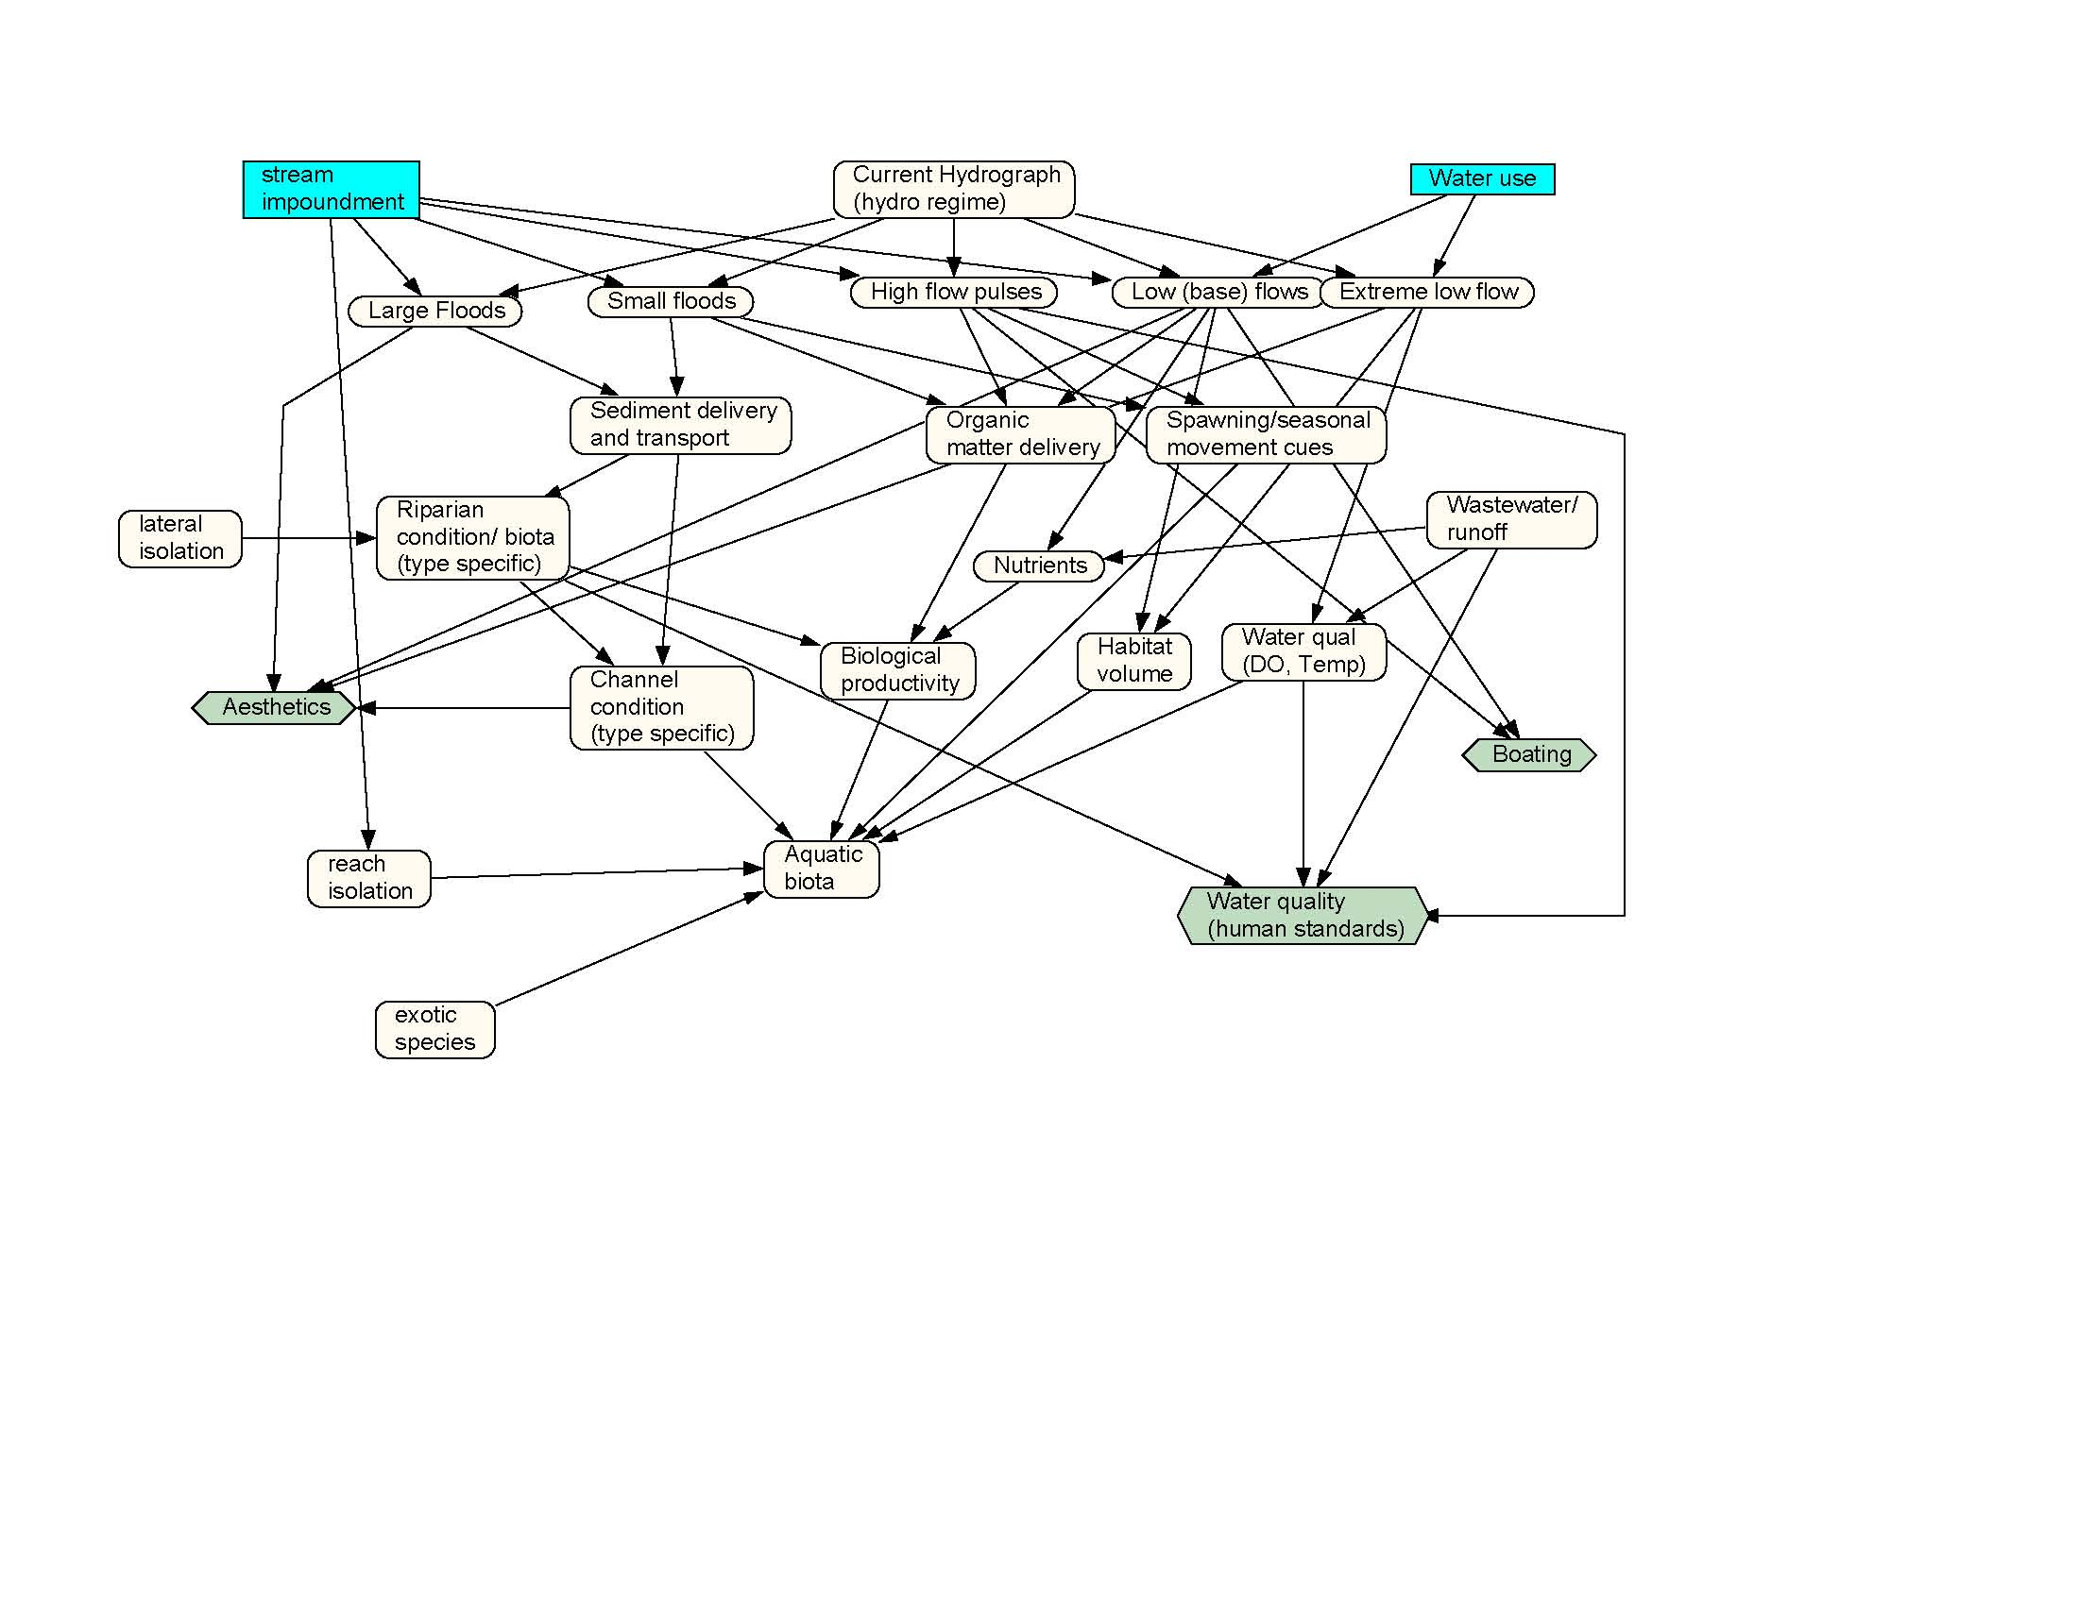
We need more data before deciding
Notes:
In addition to these baloney bullets, it’s key to understand some of the most effective claims. Asking for more data is almost always a winning strategy if instream flow opponents can get scientists to go along – because you can never have enough. Unfortunately, scientists being scientists like to fall for this suggestion in part because they like doing science and in part because they don’t have to decide anything. The unfortunate truth is that scientists will never be able to prove beyond a reasonable doubt that their recommendations are the best ones. Such standard is unrealistic with water management just like it’s unrealistic to expect meteorologists to prove that their forecasts are exactly right for the next month, week, or day. We can use existing knowledge and data to develop reasonably accurate assessments of the relative benefits of various flow regimes and that should be the goal of any flow regime assessment.

Slide 20
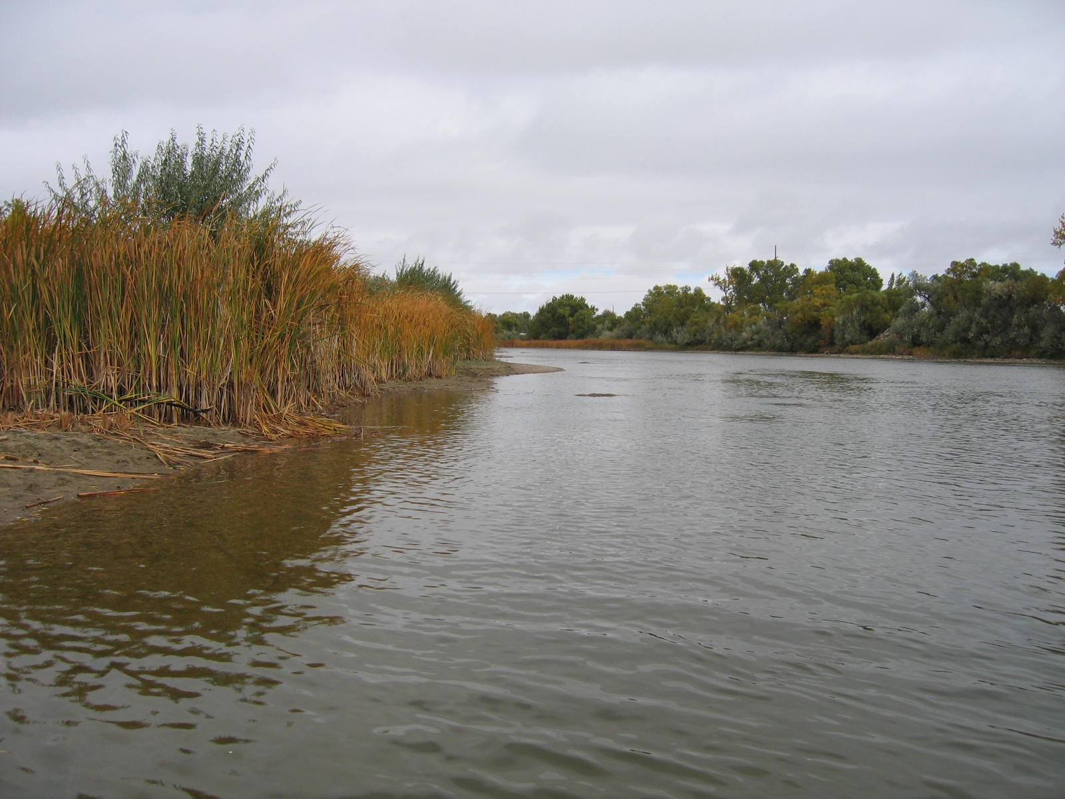
Saaay, you look different!
Notes:
Another way to minimize the value of water for environmental flow is to characterize this use as fundamentally different than “normal” (what we’re used to). When something can be shown to be radically different from the norm, it’s much easier to minimize it’s importance. Sometimes this characterization as “different” is simply a desperate last-ditch fabrication of the facts – just like the highly altered image here.
The fact is, water has been used for environmental purposes for much longer than we’ve used it for commercial purposes. We just didn’t need laws to protect those uses until now. Instream flow does address a fundamentally different value than consumptive users are accustomed to but it’s still an important use of water for public benefit.

Slide 21
Fear of the unknown (change)
As much as we value certainty and control, we really don’t like uncertainty about how things like flow management work.
Notes:
As much as we value certainty, we really don’t like uncertainty about how things (flow management) work. The fact is, we know very well how important water is to maintaining ecosystem services and playing the uncertainty card is simply a stalling tactic.

Slide 22
People are more important than fish?
Notes:
Another of the primary arguments against instream flow is the misrepresentation that such use is “only” for fish and people are much more important than fish. This argument is simply another twisted argument that sounds good but is way off the mark. Fish do not hold water rights or permits in any state . . . Only people hold such instruments. Instream flow is a use of water FOR PEOPLE and just happens to grow fish (and other aquatic resources) without diminishing the amount of water in a stream. It’s one of the very few uses of water where an important public benefit can be obtained without making the water go away – it’s still available for other uses after leaving the designated place/segment of use.

Slide 23
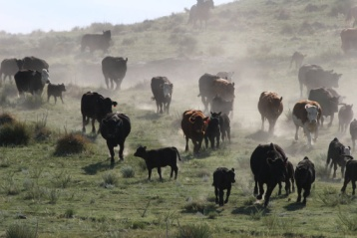
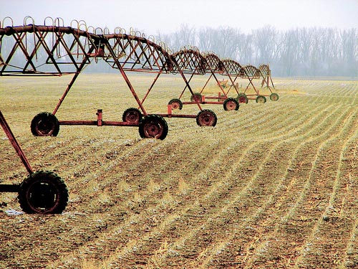
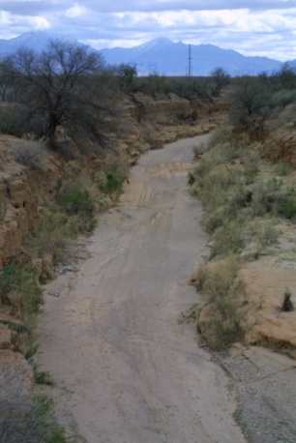
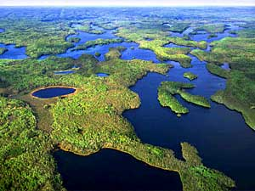
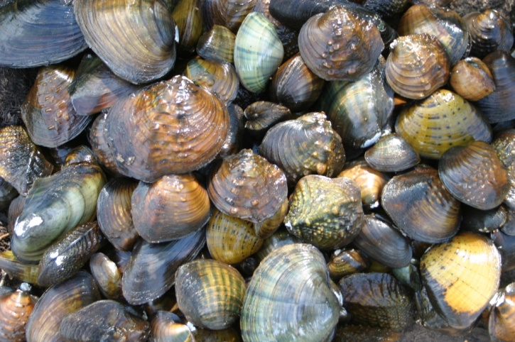
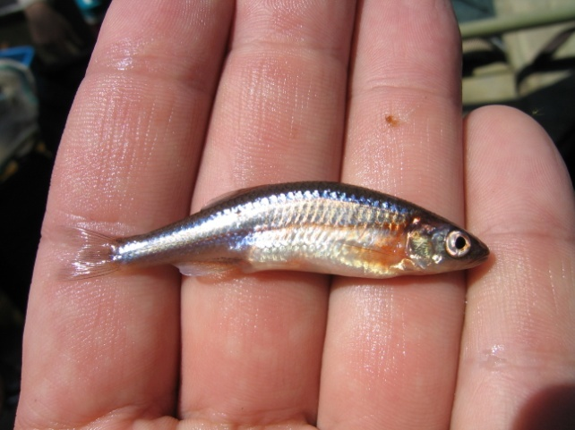
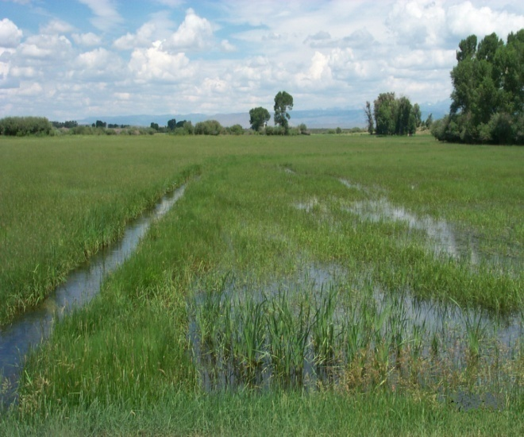
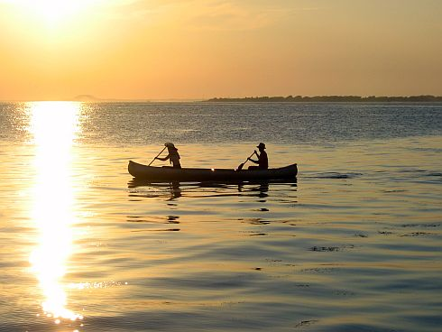
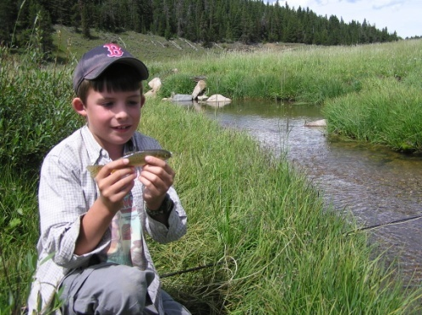
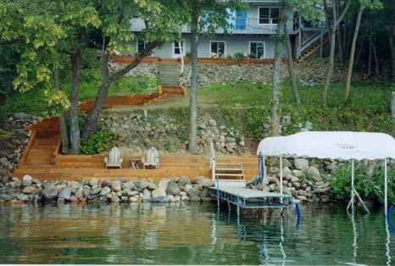
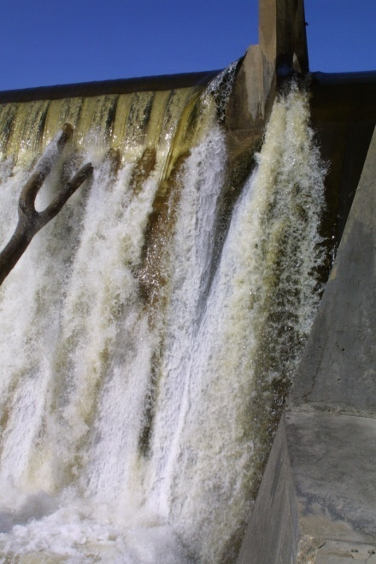
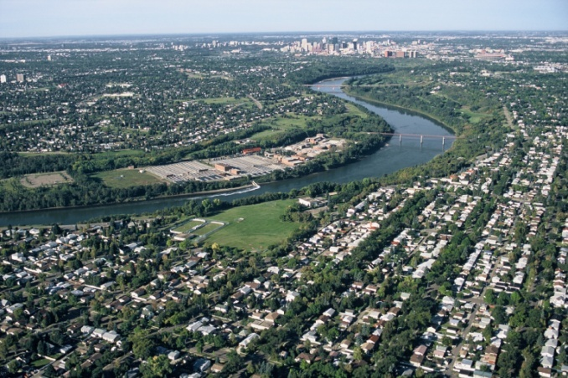
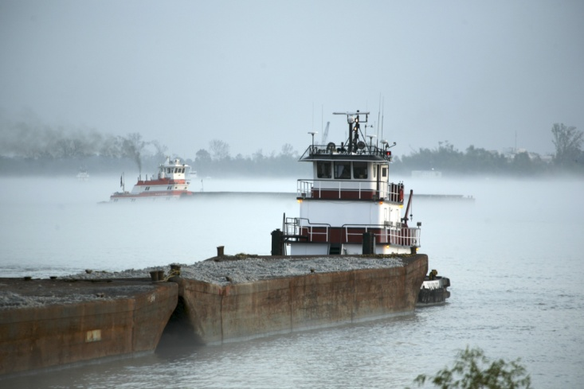
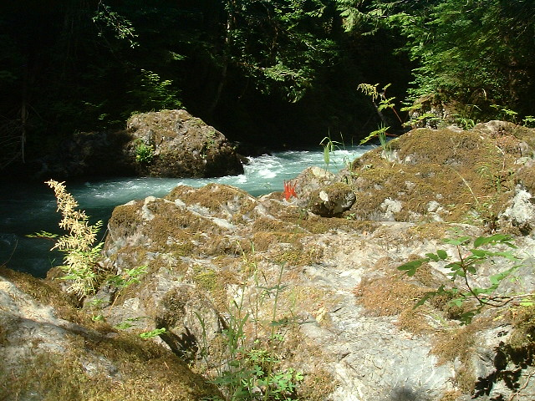
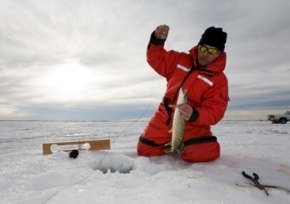
Instream flow is just one of many things people use water for
Notes:
In Wyoming, there are 54 legally recognized uses that benefit all sectors of society. Using water to protect fisheries in streams is just one of those that is now recognized by priority just like every other kind of water right.
In response to the argument that “instream flow is OK but we need to use our water,” it’s important to bear in mind that instream flow is a legal use of water. In fact, instream flow water gets used over and over as it passes through a segment and may be the most used water anywhere in the state. What’s more, after its use in the instream flow segment, the water is then available for even more uses. No other water right offers that kind of benefit.

Slide 24
Remain Vigilant
Wyoming
Alberta
Minnesota
California
Oregon
Alaska
Notes:
Each of these states and provinces has seemingly effective instream flow legislation and institutional capacity. However many of these have also seen their programs threatened or limited by pro-development interests within the past decade. So just because you achieve effective environmental flow legislation doesn’t mean the job is done. Each of the states listed on this image is a leader in terms of the effectiveness of their instream flow program, but each has borne the brunt of serious challenges in the past decade.

Slide 25
Basic Strategy
Identify outcomes – what do you want rivers to look like in the future?
Develop measurable outputs that lead to outcomes
Establish appropriate activities to achieve outputs
Strategic plans
Design and implement studies
Involve the public or at least key partners/sister agencies
Provide adequate resources (inputs)
Staff (should be full-time, dedicated to ISF)
Budgets
Training
Equipment
Notes:
To be truly effective when it comes to managing riverine resources, it’s important to decide what you want your streams to look like and how you want them to function.
Once you’ve got a vision of the outcomes you want to achieve, then you need to assess the resources, or inputs, at your disposal to achieve that goal. These can include things like recognizing water management needs in fishery management planning documents, developing staff, providing them a budget for training and performing their duties. This can also include lining up partners and securing public support.
You’ll also need to decide where you want to spend your time among the many possible activities that are worthy of attention.
Lastly, you’ll need to develop measurable outputs to gage your success and help determine when you’ve achieved the level of protection or restoration you’ve set out as a goal.
This is not an easy business but there’s a better chance of restoring or protecting environmental flow regimes if you have a plan and know what you’re up against than if you just charge off without a plan hoping to good things when opportunities present themselves.

Slide 26
Dealing with the public
Simplify problems and solutions.
Use concrete images (minimize words).
Identify real things, local needs and stories.
Use action words that stimulate senses, feelings.
A message for everyone is a message for no one.
There is no general public.
Who takes the lead on this?
Notes:
One of the most important and most overlooked strategies for securing instream flow regimes is dealing with the public. Having good laws, a good program, and good science are essential but leaving the public behind or not seeking their input and support is a formula for failure. So in addition to staff needing to know all about instream flow theory and methodologies, understand legal opportunities, and deal with institutional limitations, we also expect instream flow practitioners to be good sales people to work the public. There are many considerations for dealing with the public, some of which are shown on this image. But the most important consideration perhaps is for agencies to decide who will take the lead on this effort. It does not work to just assign messaging to existing I&E staff without providing them extensive training in the importance of using the right words and concepts in their messages.

Slide 27
The Power of One (Champions and Assassins)
Patience
Persistence
Professionalism
Notes:
As much as we try to engage the public the reality is that this group may not really exist – and if they do, they are bombarded by so many critically important issues that it’s nearly impossible to expect them to develop an articulate understanding of instream flows and turn out to support those efforts. For all its complexity, instream flow progress and failures typically comes down to the role of individuals or groups. One person or group can advance instream flow opportunities a long ways if done properly. Conversely, it only takes one person or group to bring down instream flow progress too. Patience can mean working for decades without positive feedback. Persistence means more than one letter or phone call. Professionalism means knowing your points, not backing down, and doing business with a smile.

Slide 28
Conclusions
Science is necessary and important but seldom compelling by itself
The law is important but can be limiting
Institutional processes are needed
Effective public involvement drives the system
Notes:
Strategies for securing instream flow regimes can seem daunting when you consider the range of things that interact with each other in fairly complex ways. But progress has been made in many states and is still being advanced today. Understanding the terms, concepts, and elements of instream flow is key as is the importance of understanding the values of those whose support you may seek and who may oppose advances in water management for riverine resource stewardship.

Slide 29
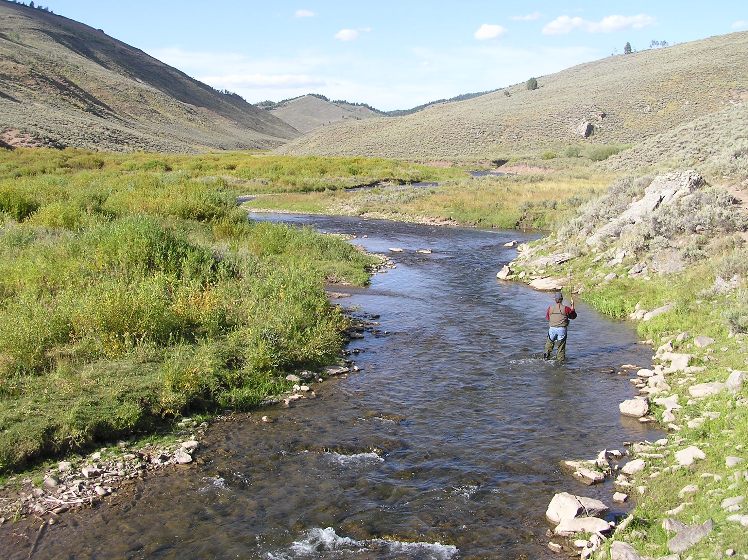
Notes:
Even the ugliest baby that you my not feel very close to now, can grow to be a responsible, contributing individual that you’re proud of if he’s provided effective rules and support. That’s the challenge with instream flow – to provide firm guidance and the opportunity to maximize the beneficial uses of water for the state’s citizens.

Slide 30
So What?
Were your expectations met?
Did your understanding or opinion(s) change?
What messages resonated?
What challenges seem bigger (or smaller)?
What are the most important things to work on?
What are you going to do tomorrow?
Notes:
What challenges seem bigger (or smaller) – Legal? Institutional? Science? Public?

