Slide 1
Developing Laws and Policies
If future generations are to remember us with gratitude rather than contempt, we must leave them more than the miracles of technology. We must leave them a glimpse of the world as it was in the beginning, not just after we got through with it.
President Lyndon B. Johnson upon signing the Wilderness Act in 1964.
Notes:
Writing laws is a considerable challenge. We must provide opportunity for societal benefit on several levels – both economic and environmental.

Slide 2
Outline
Status of legal opportunities in other states
Institutional capacity
Words and definitions matter
Characteristics and contents of good laws (ownership, level of protection, process,
Examples of legislation

Slide 3
Water laws are written to provide certainty and control
Weather variability patterns, water availability and changing human values and needs complicate things.
Notes:
Certainty and control are at the root of all disagreements – and settlements – over water.
Uncertainty is a huge driver in water negotiations and change is never a welcome player.

Slide 4
Good laws and protection?
 | Portion of miles of streams in unaltered condition | Portion of miles with no flow protection
Alberta | 26% - 75% | 26% - 75%
Minnesota | 6% - 25% | 76% - 100%
Wyoming | 6% - 25% | 76% - 100%
Washington | 6% - 25% | 76% - 100%
Notes:
Even in states with reasonably good laws, instream flow management has a tough time. Among the many reasons that good laws don’t always lead to good flow protection is that most of the flow in rivers (and volumes in lakes) has already been removed in many states like Wyoming and Washington and provinces like Alberta. In other situations, laws that appear to offer considerable potential are burdened by bureaucratic conditions and limitations that greatly impede the ability to fully implement basic provisions of flow laws. In the vast majority of states and most Canadian provinces, it is much easier for individuals to privatize public water resources for personal or commercial gain than it is to obtain adequate protection of public water resources for public benefit. Thus the challenge when crafting instream flow and water volume laws is to develop them in such a way that such rights, permits and authorities are on an equal (or better) par with the ability afforded for privatization of public water.

Slide 5
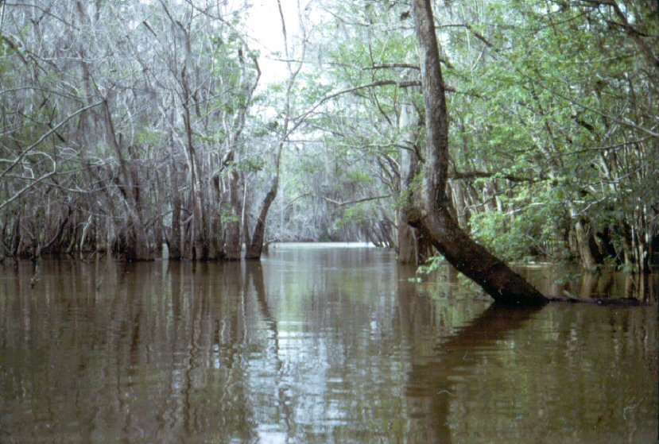
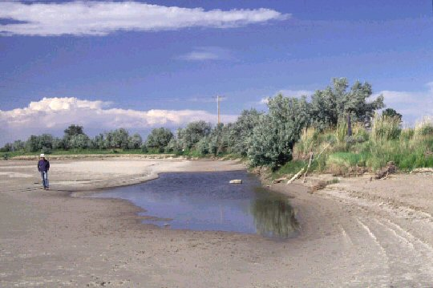
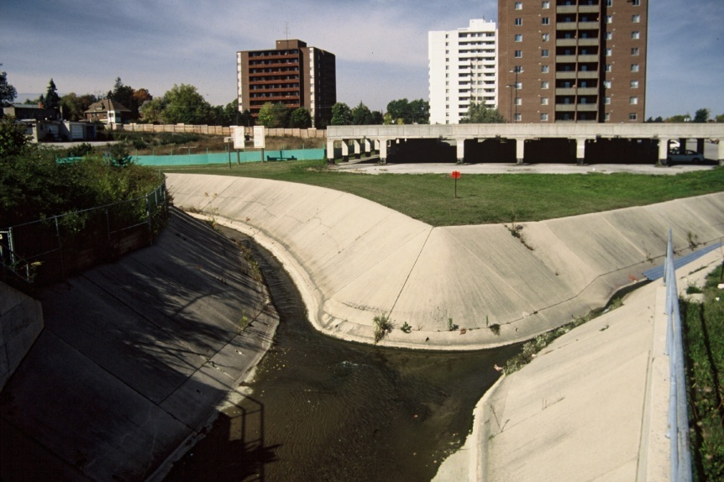
Goals: Protection vs. Restoration
Notes:
Bear in mind that laws need to address at least two aspects of instream flow management – protection and restoration. In too many situations states are getting a bit of a late start on protection and opportunities for restoration are limited. Managers need to craft laws that address each of these opportunities equally – in ways that afford the state needed certainty and control on in-channel water uses.

Slide 6
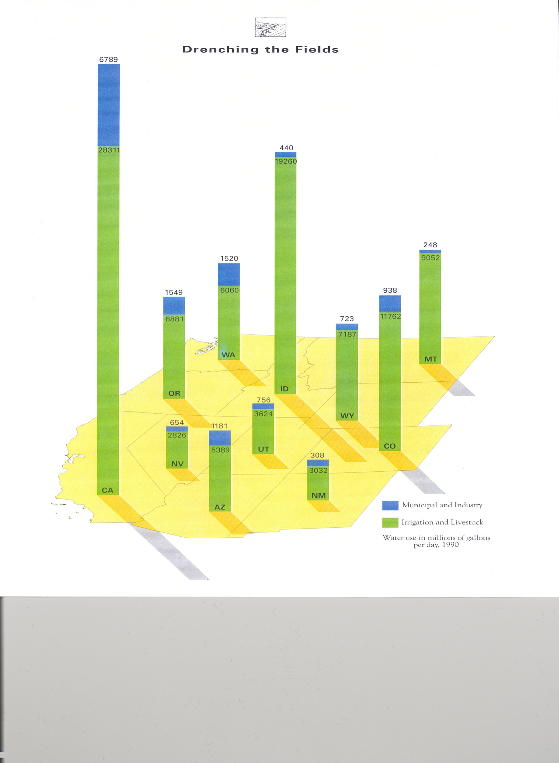
Notes:
The western U.S. provides an example of how far behind we are in terms of other uses already having full recognition and protection. Over 90% of all permitted uses of water are for out of channel uses such as irrigation and industrial. Riparian doctrine states don’t allocate water according to water rights but do permit many uses of water out of the natural channel.

Slide 7
Program inputs
Notes:
Make no mistake, though most fish and wildlife agencies devote much of their attention to science, the fact is that in virtually every state, the most needed tools to help manage environmental flow are more supportive regulations, laws and policies.
While many states think their staff is able to recognize water management needs, they typically don’t have the legal means to act on their knowledge.

Slide 8
Expectations for laws and public involvement
Notes:
According to the 2009 IFC survey of all state and provincial fish and wildlife agencies, almost 90 percent of respondents thought instream flow laws and policies would be about the same or better than they are today within the next ten years.

Slide 9
Expectations for flows and reservoir condition
Notes:
However when asked what ecological condition they expected rivers and lakes to be in over half of them thought conditions would be either somewhat less than today or much less.
These two graphs raise the possibility that survey participants were simply hopeful that laws and policies would be better but perhaps more realistic when it comes to projecting actual outcomes.

Slide 10
Water Right Doctrines
Notes:
There are 3 primary water allocation doctrines in the U.S. and Canada. Riparianism (sharing) and Allocation (first in time is first in right). Recently a new doctrine or basis for allocating water called Regulated Riparianism has begun to evolve (mostly in the eastern U.S.) that borrows features from both existing doctrines.

Slide 11
Regulated Riparianism
Combines elements of riparian doctrine with appropriation doctrine (e.g. priority dates)
Favors development interests who want to lock in guaranteed amounts of water (certainty and control).
Not much value to existing users.
Mechanism to take more water out of streams.
Uncertain how this doctrine could work for e-flows.
Notes:
Like the Appropriation and Riparian doctrines, Regulated Riparianism is actually just another way to administer the privatization (extraction) of water from rivers (and lakes). It’s primary purpose is to provide certainty and control to new water development projects (like subdivisions or industries that consume large amounts of water) to ensure that they will be able to promise water supplies to people who

Slide 12
Institutional Structure
Notes:
When crafting instream flow and water volume legislation, it’s necessary to either consider the existing institutional structure or devise a new/formal structure. This is important because the institutional structure will determine how laws are administered and how effective the laws are for their intended purpose. Good legislation without effective institutional capacity won’t really accomplish much in terms of managing instream flow and lake volumes. This is another time when it’s important to address the issues of certainty and control and build in features that maximize those abilities for the state (or province).

Slide 13
Key terms
Fish vs. fishery
Allow vs. require
Protect vs. restore
Feasible vs. available
Studies vs. assessments
Flow/volume vs. regime
Notes:
Terminology is of critical importance in all laws and that is absolutely the case when it comes to crafting laws for water management. Too often legislators and agency managers alike are either unaware of what words to include or assume everyone knows the meaning of key terms.
For example, there’s a huge difference between the words “fish” (which can mean one species or all species) and “fishery” (which technically embraces the community of all aquatic organisms in a stream, their habitat and habitat processes over time, and human users).
Each of the other terms shown here could innocently be used interchangeably by some but mean totally different things to different people (i.e. attorneys). Likewise, the failure to include a term such as “restore” (for example) may totally preclude opportunities for using water for anything other than protection (of a degraded condition).

Slide 14
Key components
Same status and process as all other water uses?
Who can hold or own the permit or water right?
What agencies are involved (does the same agency quantify flow needs that issues the permit)?
What resources exist or will be provided for staffing, funding, training, field studies?
Will flow quantification methods be limited or allow use of any methods?
What frequency of availability is needed, if any?
Notes:
This list of key components are other aspects of environmental flow legislation that are essential to address to secure or enhance the state’s certainty and control over waters used for environmental purposes. These bullets refer primarily to institutional capacity but there are also other components to address related to dealing with the public and conducting flow quantification studies. Omission of these kinds of elements means that sometimes water regulators will determine that no authority exists for holding a permit or water right (for example). In other situations, regulators may address these matters by rule making or in policy. Whenever possible, it is best to get these kinds of things recognized in statute . . . unless it appears the statute will be unnecessarily onerous and limiting. In those situations, proponents may argue for making these determinations by rule making and hope for a better outcome.

Slide 15
More key components
What about requirements for monitoring (and metering), enforcement, and penalties?
Allow flows for fish vs. all aquatic organisms vs. habitat vs. other values (wildlife, riparian vegetation, water quality, recreation, esthetics)?
Will protections have senior or junior priority status?
Permanent vs. temporary opportunities . . . or both?
What about conservation incentives?
What role / opportunity exists for public input?
Notes:
These are other components that are often important to address by statute. It should be noted that this is still just a partial list of considerations.

Slide 16
Level of Stream Flow Protection
Full flow protection
No allowances for additional withdrawals or manipulations. Hands-off strategy.
Comprehensive ecologically based
Protection based on all 5 riverine components, varies seasonally and between years.
Partial ecologically based
Protection based on one or more of 5 riverine components
Threshold protection
Baseline protection that is less than the average natural flow remaining in the channel
Notes:
Protection is not protection. You need to clearly specify the level of protection opportunities allowed under specific conditions.

Slide 17
Effort needed for protection
Notes:
It helps to see that the less protection provided, the more effort is needed to ensure protection. This perspective may help water managers to see where monitoring or gaging are likely to be important components of flow protection or restoration.

Slide 18
Water management options
Flow protection for a point vs. segment vs. system vs. regional vs. state-wide
Individual studies vs. regional or statewide thresholds
Water level / storage volume in standing waters
Notes:
When crafting laws to enable environmental uses of water, there are several aspects to consider that relate to both flowing and standing waters. Lately, some instream flow advocates have pressed for protection of regional standards of flow protection in all rivers. Though some research has been done in this area, most studies show that each stream has unique flow regime requirements that are not well served by protection of (relatively low) base flow amounts. Such standards may work if standards are set to protect much higher flow regimes on an instantaneous daily basis.

Slide 19
Lake and reservoir level protection
Distinguish between natural lakes and reservoirs?
Protect any amount of storage in reservoirs?
Protect only minimum pools in reservoirs?
Protect any amount of water up to full level in natural lakes?
Balance volumes in lakes with flows in streams?
Emulate natural fluctuations?
Notes:
Very few states or provinces have done much to protect or legally manage storage levels in natural lakes or man-made reservoirs. Several strategies exist for those who find opportunity to regulate or manage these water bodies.

Slide 20
Wyoming’s Instream Flow Law
Instream flow is a beneficial use of water
Instream flow rights are junior rights
Cannot obtain by filing abandonment
Can acquire existing rights & convert to instream flow
Available for other uses when water leaves a segment
No conservation incentive
Notes:
In spite of all the debate about what instream flows do or don’t do, the reality is that Wyoming’s law addresses a simple problem. The law, in its first few lines, establishes that water left in the stream channel for fisheries is a beneficial use of water. The bulk of the rest of the law deals almost entirely with matters of process – most of which are already addressed in other areas of state water law.
But most of all instream flow is just a water right – not another layer of government regulation.

Slide 21
Wyoming’s Instream Flow Law
Only the State can own an ISF right
Can come from direct flow or storage
Public hearing is required (paid by WGF)
Water is available after leaving ISF segment
Purpose = “minimum amount necessary to maintain or improve the existing fishery”
Notes:
In addition to address procedural issues, Wyoming’s law is also the victim of imprecise and undefined terminology.
The established purpose of allowing protection (not restoration) of the “minimum amount necessary to maintain or improve the existing fishery” creates great potential for uncertainty in spite of seemingly tight language. Just what do the terms “minimum, improve and fishery” mean?

Slide 22
Minimum flow
No more than models show is needed to provide the desired level of fishery management? Or
The least amount of water needed to keep fish alive?
Notes:
Minimum realistically could mean the same as it does for all other water uses – no more than can be beneficially used. But to some it could mean the least amount of water needed to keep fish alive. Initial determinations by sister water management agencies were that minimum was a very basic, low number. However over time, determinations have gradually moved toward the more enabling definition.

Slide 23
Maintain or Improve
No guidance on how much “improvement” is allowed. Seems very empowering and enabling. Or
Just a base level flow that doesn’t really offer more than the lowest levels of recorded flow.
Notes:
Allowing for protection of enough water to improve an existing fishery seems liberal and appropriate however no filing has yet been approved to improve a fishery anywhere in the state. The law has been interpreted to mean the state can maintain existing base flows for fisheries but cannot pursue improvements in flow.

Slide 24
Existing Fishery
An existing fishery is technically a dynamic metric. Fish populations are by their very nature in a kind of dynamic equilibrium over time – so the “existing” fishery relates to the dynamic maxima and minima in normal density levels. OR
The number of fish found in the stream right now, regardless of where the normal cycle is?
Notes:
Fish population dynamics are by definition dynamic. Thus the existing fishery is not a static number but variable over time. It’s ok to use the term “existing fishery” as long as a definition is included that says existing refers to the existing limits of population dynamics over time.

Slide 25
Existing Fishery
The accepted scientific definition of a fishery is the community of organisms, their habitat, and human users. Or
Does this relate to just persistence of fish?
Notes:
When our law was written, department participants successfully included the word “fishery” vs. fish thinking that it would afford greater opportunities for protection and restoring stream flows. However, state water managers thought, and continue to think, that the term “fishery” still just pertains narrowly to a static number of fish in a stream segment.

Slide 26
Implied Intent
Beware of the stuff that lies between the lines in printed statutes.
Notes:
The take home message with these interpretations is that regulators tend to fall back on implied intent (that not everyone else is aware of). This is why it’s so important to get as much clarification in print as possible.

Slide 27
The Process in Wyoming
WGF water plan guides stream selection
WGF conducts studies
WWDC files application
WWDC conducts feasibility study
SEO holds public hearing
SEO issues permit decision
Board of Control adjudicates water rights
Notes:
The process begins with a plan – WGF has had a guiding document since 1994 and posted them on our website so there’s no reason for anyone to say they don’t know what we’re up to.
The entire process can take anywhere from 5 to 27 years or more to complete all these steps and cost all agencies involved between $30,000 and $50,000 or more per stream segment.
WGF = Wyoming Game and Fish Commission
WWDC = Wyoming Water Development Commission
SEO = State Engineer’s Office
Board of Control (a branch of the Wyo SEO)

Slide 28
There are at least 49 other ways to develop an instream flow (and lake volume) program
Notes:
Wyoming’s approach is just one of 49 ways to address instream flow needs in the U.S. It’s not the best or worst template but offers insights to statutory features and considerations that may be included in the development of effective legislation in other parts of the country.

